Slide 1
Copyright & Cultural Appropriation: Then and Now
Trevor Reed | BCLJ-BCLT Race & Tech Symposium | September 19, 2024
Notes:
Thank: Niyati Narang, Justin Tri Do, and Mehtab Khan for their help organizing the panel, and also think my co panelists Angela Riley and Andrea Wallace.
You know, we’ve been talking about historical treatment of minority copyright owners, and I wanted to begin the discussion by highlighting early sound recording technology and how copyright law failed to protect Indigenous creators. The argument I want to advance here is that, in the age of AI, we need protections that are specifically tailord to Indigeous needs—and that can really only be done through federal enforcement of Tribal intellectual property law and policy.

Slide 2
Sample of Institutional Holdings of Indigenous Cultural Creativity
Music / Oral History
100,000 Indiana University Archives of Traditional Music
30,000 Columbia University
10,000 Library of Congress
10,000 Cleveland NHM
6,000 Dorris Duke OH Collection
Photographs
300,000 Smithsonian NMAI
534,000 Canada Reciprocal Research Network
40,000 Cleveland
18,000 Bureau of Indian Affairs
17,000 Library of Congress
PGS works & Cult. Obj.
8,000,000 Peabody Museum
825,000 National Museum of Am. Ind.
70,000 Chicago Field Museum
47,000 Am. Museum of Nat. Hist.
36,000 Heard Museum
10,000 Eiteljorg Museum

Slide 3
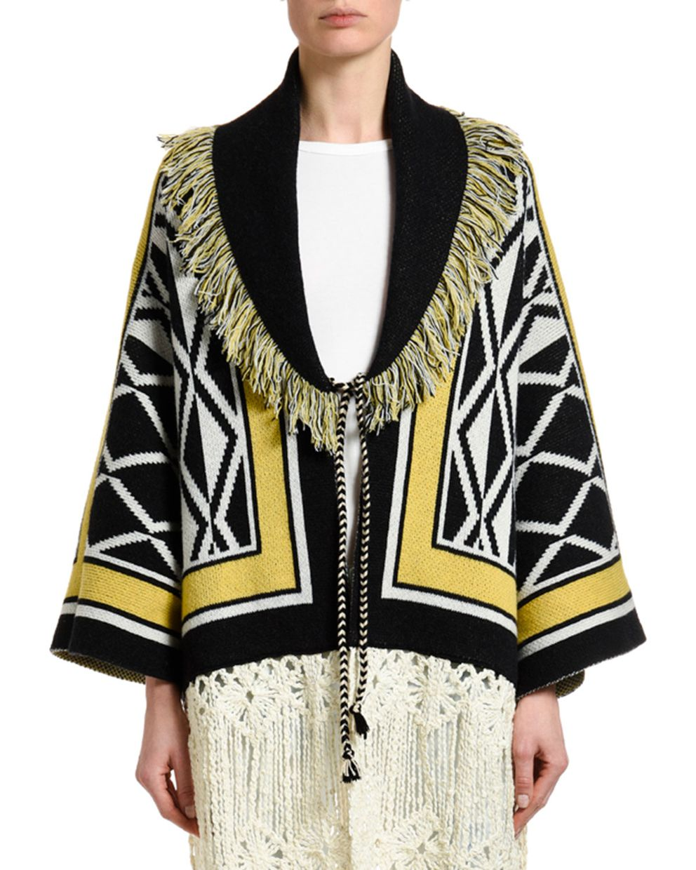
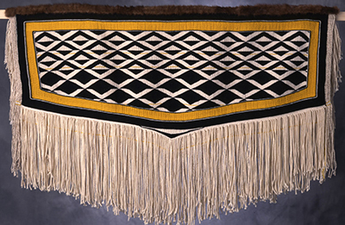
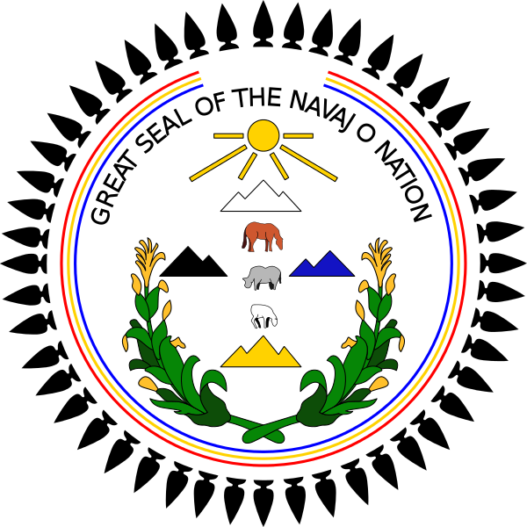
Left: Neiman Marcus Alanui Ravenstail Knitted Coat (2019)
Right: Clarisa Rizal Ravenstail Coat (1996)
Courtesy Sealaska Heritage Institute / KTOO.org
Bottom Right: Navajo Nation Seal (1953) Bottom Left: MadHappy Sweatshirt (2019)
Courtesy Donovan Quintero / Navajo Times
Notes:
Unfortunately, the problem of cultural appropriation has not let up in recent years. Fashion continues to be an area where significant exploitation of Indigenous creativity, culture, and expression takes place.
These are just two examples of instances of cultural appropriations of Indigenous copyrighted works in which Tribe’s have taken action:
The top one by neiman Marcus involved the alleged appropriation of this RavensTail Coat design, created by Alaska Native artist Clarissa Rizal. Sealaska Heritage Institute, who holds the rights to Rizal’s coat, sued Niman Marcus for copyright infringement. The case ultimately ended in a settlement, in which the offending articles were burned, according to Tlingit Law.
The botton one by MadHappy involved the use of what appears to be the Navajo Nation’s official seal. The Shirt uses the basic elements of the seal, adding in the names of Aspen Colorado ski resorts under what are clearly the Navajo Nation’s sacred mountains.
While both of these cases ultimately settled, it is clear that Indigenous peoples are willing to use copyright and other forms of intellectual property to defend their culture and creativity from misappropriation.

Slide 4
How Can Tribal Nations Protect Against Non-Member Appropriations?
(1) Tribal law protects the material, and non-Tribal-Member violates that law on a reservation (ex: Pascua Yaqui Tribal Code)
On Tribally owned lands: presumption of Tribal jurisdiction
On non-member-owned land:
Non-member has entered “consensual relationship” with tribe OR
Non-member conduct “threatens or has some direct effect” on economic security, political integrity, health & welfare of Tribe
(2) Tribal law protects the material and federal law provides a remedy (ex: NAGPRA, County of Oneida)
(3) Federal law or treaty provides right & remedy (ex: Copyright Act)
(4) Private agreement or institutional policy, if not contrary to public policy.

Slide 5
Tribal Law - Pascua Yaqui Tribal Code
The Pasqua Yaqui Tribal Code Title VII §§ 200-210 prohibits:
Disturbing, excavating, or desecrating traditional Indigenous IPs
Conducting unauthorized research, collecting, filming of traditional Indigenous IPs
Selling, purchasing, receiving Indigenous IPs illegally acquired.
The code authorizes civil damages awards for violations, including “cost of restoration and repair” and “costs associate with the culturally appropriate disposition of resources.”
Types of Cultural Expressions covered include:
knowledge of remembered histories
details of cultural sites and landscapes, sacred property like sounds, culture, images
knowledge of uses of plant and animal species, and
knowledge of their Indigenous language

Slide 6
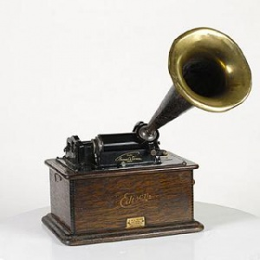
Copyright
A copyright is a TEMPORARY & LIMITED RIGHT to keep others from using a covered WORK by:
Copying
Creating Derivative Works
Distributing
Publicly Performing, Displaying, Streaming
Limited Scope (U.S.)
Limited Remedies (U.S.):
Damages
Actual
Statutory
Nonprofit institution exception.
Injunctions
Limited by 4-factor test
Other
Attorneys fees, impoundment, etc.
Expression
vs
ideas
Original to the Author
Fixed in a tangible medium
No facts, ideas, systems histories, etc.

Slide 7
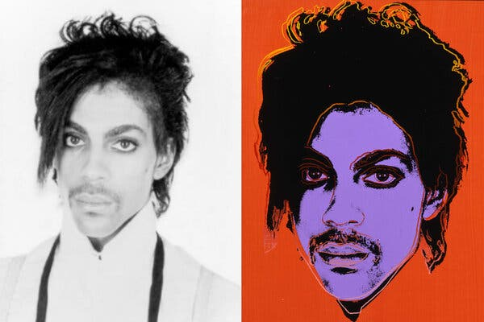
Infringement or Fair Use?
Purpose & Character
Nature of Work
Quantity & Quality
Market Effects
Left. Lynn Goldsmith photograph of Prince. Right. Andy Warhol, Orange Prince. See Brief of Lynn Goldsmith, Andy Warhol Foundation v. Goldsmith, No. 21-869 (Aug. 8, (2022)
Left: Navajo Nation Seal (1953) Right: MadHappy Sweatshirt (2019)
Courtesy Donovan Quintero / Navajo Times

Slide 8
Indigenizing AI
Lakota AI Code Camp
PolArctic LLC
https://www.youtube.com/watch?v=quwcGtupcBA
https://www.youtube.com/watch?v=F-b6cz78RW4

Slide 9
AI & Cultural Appropriation
https://www.youtube.com/watch?v=J1gkHHW9wFQ
Courtesy of Navajo-Hopi Oberver, https://www.nhonews.com/features/nizhoni-navajo-word-for-beautiful-at-center-of-ai-cultural-appropriation-controversy/article_1cc520c4-0197-11ef-8e42-af70b1b4f876.html

