Slide 1
Tax Workshop
Graduate Students
UCOP Tax Services
February 23, 2022

Slide 2
Scope
This presentation is intended for UC graduate students
This is not intended to provide tax advice; it is informational only and points to published resources such as the IRS and Franchise Tax Board. Please consult your personal tax advisor for more information

Slide 3
Tax Filing Due Date
April 18, 2023
Washington DC celebrates Emancipation Day
May 15, 2023
California Winter Storm Victims

Slide 4
IRS Tax Form
Form 1040, Individual Income Tax Return
US Citizens
Legal Permanent Resident Aliens (Green Card Holders)
Resident Alien for Tax Purposes
Form 1040-NR, US Nonresident Alien Income Tax Return
International students on F-1 visa
Professors on J-1 visa

Slide 5
California State Tax Form
Form 540NR, California Nonresident or Part-Year Resident Income Tax Return
Present in California for temporary or transitory purpose
Form 540, California Resident Income Tax Return
CA resident (9 months)

Slide 6
Scholarship vs Fellowship
Scholarships
Amount paid to assist students (undergraduate and graduate) with their studies at an educational institution
Fellowship Grants
Amount paid to assist individuals with their research

Slide 7
Tax-Free Scholarship
A scholarship is tax free only if you are:
Candidate for a degree
Eligible educational institution
Qualified scholarship
Qualified Tuition and Related Expenses
Tuition and Fees required
Course-related expenses such as books, supplies, and equipment required for the courses

Slide 8
Emergency Grant
Higher Education Emergency Relief Fund (HEERF)
American Rescue Plan (ARP)
Signed into law on March 11, 2021

Slide 9
Education Credits
IRS Form 8863
American Opportunity Credit
Lifetime Learning Credit

Slide 10
American Opportunity Credit
Available only 4 years of education after high school
Up to $2,500 per student
40% of credit refundable
Limit on modified adjusted gross income
$180,000 if married filing jointly
$90,000 if single, head of household

Slide 11
Lifetime Learning Credit
Available all years of education after high school
Up to $2,000 per return
Nonrefundable
Limit on modified adjusted gross income
$180,000 if married filing jointly
$90,000 if single, head of household

Slide 12
FORM 1098-T
The Form 1098-T reports qualified tuition and related expenses, scholarships, fellowships, and grants administered by the University without regard for its possible taxability
The Form 1098-T is generally only provided to U.S. citizens and resident immigrants

Slide 13
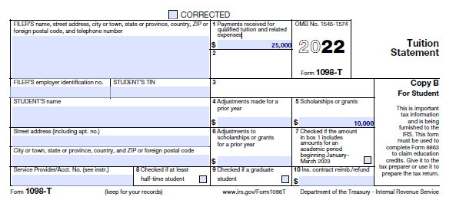
Example of Form 1098-T
Assume: Adjusted qualified education expenses =
(BOX 1) $25,000
(BOX 5) $10,000
Adjusted qualified education expenses = $15,000
Report the “Adjusted qualified education expenses” to potentially reduce your income taxes

Slide 14
Example: If a scholarship exceeds qualified education expenses
Assume the following:
Scholarship/Fellowship grants = $30,000
Qualified Tuition/Expenses = $26,000
$25,000 Tuition
$1,000 Nonacademic Enrollment Fees (Example: Student Health Insurance)
Books/Required Course Materials = $500
Question: How much is taxable nonqualified scholarship/fellowship?

Slide 15
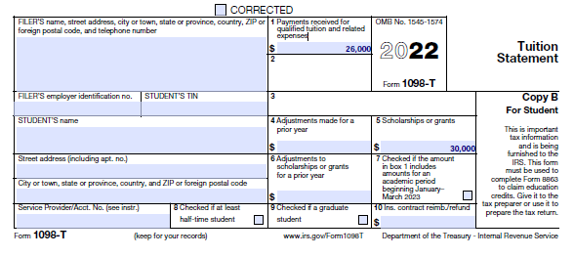
Additional Example: Nonqualified scholarship and fellowship payment amount
30,000 | Box 5 – Scholarships and Grants
30,000 | Box 5 – Scholarships
(1,000) (subtract nonacademic fees first as best tax strategy) | Box 1 – Nonacademic Fees (use this first to determine qualified scholarship)
(25,000) | Box 1 - Qualified tuition
(500) | Required Books
3,500 (taxable income because scholarships exceed expenses) | Nonqualified scholarship and fellowship payment amount

Slide 16
Example: If scholarship is less than qualified education expenses
Assume the following:
Scholarship/Fellowship grants = $20,000
Qualified Tuition/Expenses = $29,000
$28,000 Tuition
$1,000 Nonacademic Enrollment Fees (Example: Student Health Insurance)
Books/Required Course Materials = $500
Question: What is the potential available educational credit?

Slide 17
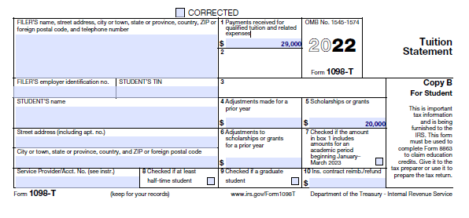
Additional Example: Qualified education expenses
20,000 | Box 5 – Scholarships and Grants
(1,000) (subtract nonacademic fees first as best tax strategy) | Box 1 – Nonacademic Fees (use this first to determine qualified scholarship)
(28,000) | Box 1 - Qualified tuition
(500) | Required Books
9,500* (expenses exceed scholarship) | Adjusted Qualified Education Expenses for taxpayer to take credit*
*Please remember the credit has a $2,000 limit, which can be further reduced depending on your income and qualified education expenses.

Slide 18
Resources
https://www.irs.gov/pub/irs-pdf/p970.pdf
Disclaimer
By sharing this publication [or a link to this publication], UC is providing this for educational and informational purposes only. UC does not intend to provide legal or tax advice, nor does the publication contain legal or tax advice. The information should in no way be taken as an indication of future legal or tax results. Accordingly, you should not act on any information provided without consulting competent legal and tax counsel.

