Slide 1
A Few Key Ongoing Issues in Chinese SEP Litigation
23rd Annual APLI, Stanford University
HAO Yuan, BCLT
Dec. 8, 2022
Notes:
Today I will introduce some of the ongoing issues that are important in Chinese SEP litigation. I understand some members of our audience may not be very familiar with Chinese law, so I try to give a more general introduction of these issues, rather than updates of the last year only. If you happen to know this area well, I appreciate it if you bear with me for a moment.

Slide 2
Roadmap
The Meaning of FRAND in China;
Granting Injunction in SEP infringement litigation;
Judicial Determination of FRAND Royalty: Legal Basis (?) and Methodologies
Takeaways
Notes:
I highlighted the meaning of FRAND, because this issue serves as part of the basis to almost all other ongoing issues in China, for instance, to decide whether an injunction should be granted in SEP infringement cases, a court needs to determine whether the SEP holder has breached its FRAND commitment, which naturally entails an interpretation of FRAND; and in FRAND royalty setting cases, the precise meaning of FRAND is closely relevant on a court’s legal basis to step in and deice on the price, as we will see in the Part III.

Slide 3

I. The Meaning of FRAND in China
Courts differed on the precise meaning of FRAND;
Consensus:
FRAND commitment $≠$ Licensing agreement
Discussions among legal practitioners and academics in reaching a commonly accepted interpretation
Notes:
At the outset, Chinese courts have not achieved the final consensus on the precise meaning of FRAND. Over the past decades, local courts in China have explored different interpretations, but one consensus is that FRAND commitment does not equal a license agreement. Most courts seem to consider FRAND as a form of pre-contractual obligation under contract law. As we will see very soon, this common understanding has rich implications in the injunction granting consideration and and royalty setting controversies in China today.

Slide 4
II. Granting Injunction in SEP Infringement Litigation
Background: general granting rate > 90%;
SEP Infringement Litigation:
- Injunction CAN be granted;
- “Fault assessment” approach based on Section 24, Supreme People’s Court (“SPC”) Judicial Interpretation on Patent Infringement Disputes II (2016)
- procedure and substantive assessment
- substantive: FRAND benchmark
Notes:
So generally speaking, injunction is a common remedy for patent infringement in China, and statistics said that the general granting rate is higher than 90%. This literal application has an exception in the SEP area however, because of the perceived public interest intensely involved with standards. On the other hand, injunction is not entirely impossible in SEP infringement. Based on a judicial interpretation issued by the SPC, injunction is only prohibited in circumstances where the SEP Holder has breached its FRAND commitment, and also the infringer /implementer has no apparent fault during the licensing negotiation process. The most recent case where an injunction was granted is Huawei v. Samsung, as some of you know. In that case, the SZ Intermediate Court assessed the parties’faults from both procedural and substantive perspective – not only discussed the details of both parties’behaviors in the negotiation process, but also compared both parties’ offers with FRAND benchmarks the Court calculated.

Slide 5
III. Judicial Determination of FRAND Royalty
1. Patent Infringement Claim – Injunction Consideration
2. Anti-monopoly Law Basis – Abuse of Market Dominance
3. “Free-Standing” FRAND Royalty Claim - No Statutory Basis
Section 3, Art. 24 of the Judicial Interpretation II (2016): Precondition for Judicial Determination - A mutually agreed royalty cannot be reached after adequate negotiations by both parties
Section 16, Art. 1 of the Judicial Interpretation I (2001)(revised in 2020): “Free-Standing” Claim on FRAND royalty dispute
Notes:
As we’ve seen on the last page, in granting injunction for PI claim a court might firstly determine a FRAND royalty benchmark. But this is not the only claim for judicial determination of FRAND royalty substantively. Overall, there are at least three types. In addition to P.I, in antimonopoly cases a court might also determine a FRAND benchmark, in assessing a so-called ‘unfairly high patent price”. Because the AML claim has not been very active in the past few years, I don’t want to discuss the details today within my limited time. I did post my paper on unfairly high patent price in China online, and you can take a look if interested. For now I’ll just focus on the third type: I call it the free-standing FRAND Royalty claim because unlike the first two, this claim has no explicit statutory basis. Instead, the legal basis exists in two JI.

Slide 6
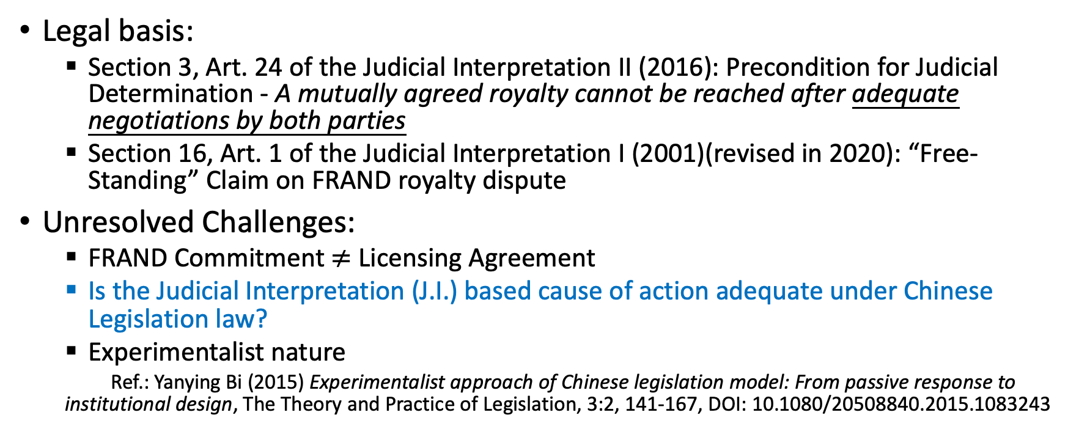
“Free-Standing” Claim: Judicial Determination of FRAND Royalty
Legal basis:
Section 3, Art. 24 of the Judicial Interpretation II (2016): Precondition for Judicial Determination - A mutually agreed royalty cannot be reached after adequate negotiations by both parties
Section 16, Art. 1 of the Judicial Interpretation I (2001)(revised in 2020): “Free-Standing” Claim on FRAND royalty dispute
Unresolved Challenges:
FRAND Commitment $≠$ Licensing Agreement
Is the Judicial Interpretation (J.I.) based cause of action adequate under Chinese Legislation law?
Experimentalist nature
Ref.: Yanying Bi (2015) Experimentalist approach of Chinese legislation model: From passive response to institutional design, The Theory and Practice of Legislation, 3:2, 141-167, DOI: 10.1080/20508840.2015.1083243
Notes:
Admittedly, the SPC seemed to have realized this weak basis when it emphasized that “if no agreement of royalty can be reached after adequate negotiations.” Seemingly the SPC was trying to invoke contract law for the proper statutory basis, because under Chinese contract law, if both parties consented to enter into a contract and only a few terms remain open, including the price, a court can step in now and decide the price based on the parties’ requests. However, if we follow this train of thought, how “adequate” the negotiation should have been for a court to conclude that both parties have formed assent to enter a contract, is subject to further clarification. But in any event, I want to note that this area of law has a highly experimentalist nature, as argued by some scholars. I hope in the next year or two the SPC will specify on more precise conditions for the contract law basis to apply.

Slide 7
FRAND Methodologies in Landmark Cases
Huawei v. Interdigital (Guangdong High People’s Court, 2013)
Comparable license approach
Huawei v. Samsung (Shenzhen Intermediate People’s Court, 2018)
Top-down approach
Huawei v. Conversant (Nanjing Intermediate People’s Court, 2019)
Top-down approach
Again, experimentalist nature – waiting for SPC to give guidance.
Notes:
Regarding the FRAND calculation methodologies, so far there are three landmark cases in China, and all of them have been decided by local courts. Both comparable license and the top-down approach have utilized in these cases. We are still waiting for the SPC to give guidance on the optimal FRAND approach – and until then, both approaches can be argued in a Chinese court.

Slide 8
Recent Judicial Willingness to Set “Global Royalty”
Sharp v. Oppo (Supreme People’s Court, IP Division)(2021) (2020 Zhi Ming Xia Zhong No. 517)
Parties’ willingness and previous negotiations to a global license;
Closer connection to China;
Proper jurisdiction
Notes:
One last point worthy of note is the Courts’ recent wiliness in setting global royalty. Previously Chinese courts were rather reluctant to set global royalty, yet this reluctance seems to change very recently due to various reasons. In the 2021 ruling of Sharp v. Oppo, the SPC stated that it is appropriate for a Chinese court to set global license terms, given the following three conditions are fulfilled together. One, both parties have willingness to seek a global license. Two, China has closer connection to the license dispute. Three, Chinese court has proper jurisdiction. Some argue that SPC’s decision has been partly triggered by the UK court’s willingness to decide global royalty in the first place.

Slide 9
Ongoing Litigation on FRAND Royalty Disputes (“Free-Standing Claim”)
Coolpad v. Pantech (Mar. 2022)(Shenzhen Int. Ct.）
Oppo v. IDC (Feb. 2022)(Guangzhou IP Ct.)
ZTE v. Tinno Mobile (Sep. 2021) (Shenzhen Int. Ct.)
Oppo v. Nokia (July 2021)(Chongqing No. 1 Int. Ct.)
……
In proceedings…
Notes:
In the past two years, a series of FRAND royalty disputes were filed in several courts. Some were combined with other causes of action, and others were free-standing claims. I list here a few cases where the plaintiff asked the court to set FRAND royalty for global SEP portfolio. Among them ZTE v. Tinno was an interesting one because this was the first global rate setting case between two domestic parties.

Slide 10
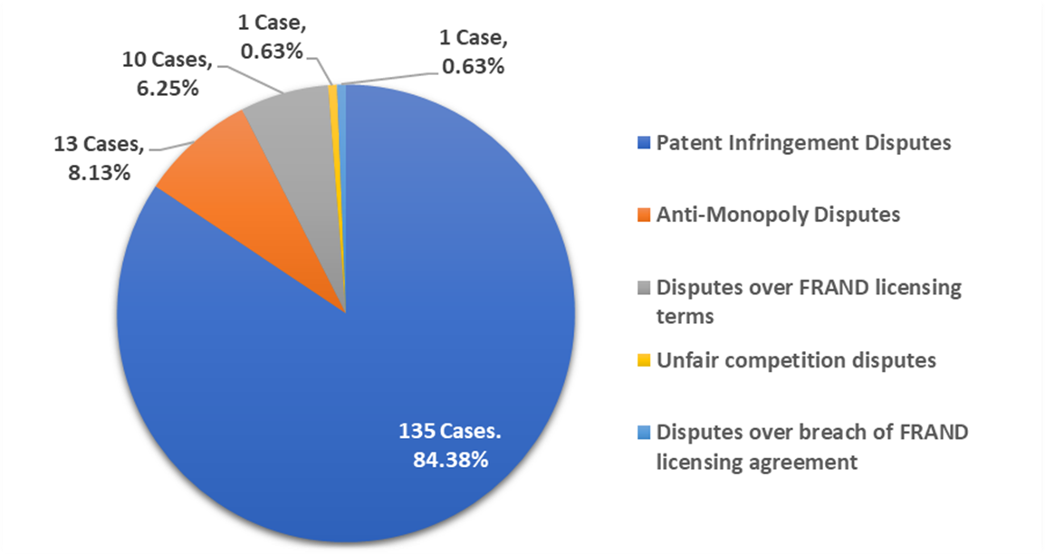
2011-2019 Chinese SEP Litigation Statistics (Lexfield, 2020)
My speculation for 2020 -2022: the rapidly rising number of “Free-Standing Claims” – likely to equal the sum of patent
infringement disputes and anti-monopoly disputes.
Notes:
With limited acceI also attached a figure from a statistics report conducted by Lexfield in 2019 – we can see that between 2011-2019 the vast majority of SEP litigation in China were patent infringement disputes, while only 6% were disputes over FRAND terms. My observation for 2020-2022 is that the no. of FRAND licensing dispute cases may have significantly increased, nearly amounting the sum of both PI cases and Aml cases. So again with the practical significance of this claim becomes higher, it seems imperative the SPC should clarify the legal nature of FRAND as well as the statutory basis of this FRAND royalty dispute.

Slide 11
Takeaways
The precise meaning of FRAND commitment still remains vague, yet consensus is that FRAND commitment ≠ License agreement or “3rd party beneficiary agreement” in China;
Fault assessment and balance in granting injunction for patent infringement;
Both top-down and comparative license methodologies have been used by local courts – awaits SPC guidance;
Existence of “free-standing” judicial determination of FRAND “global royalty”: despite its vague legal basis, the practical significance is increasing.

Slide 12
Thank you!
yih102@berkeley.edu

