Slide 1
Leadership at the USPTO
December 8, 2022
Terry Rea Joe Matal
The 23rd Annual
Berkeley-Stanford Advanced Patent Law Institute

Slide 2
Behind the scenes at the USPTO:
What the Director can and can’t do

Slide 3
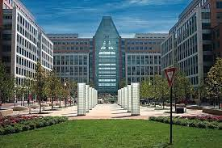
How did you become (Acting) Director?

Slide 4
“Functions” and “duties”
Maintaining relationships:
The Commerce Department
Congress
The Justice Department

Slide 5
What the Director can’t do
Chapters 10 and 11 of title 35 (101, 102, 103, 112)

Slide 6
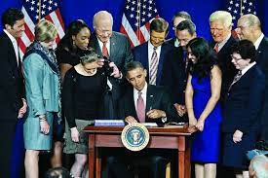
What the Director can do

Slide 8
The frontiers of the Director’s authority:
ODP
Implementing court decisions
“Discretionary” oversight (General Plastic)

Slide 9
Fintiv “discretionary denial” factors (Apple Inc. v. Fintiv, Inc., IPR 2020-00019, Mar. 20, 2020)
District court stay
District court trial date
“Investment” in district court proceeding
Overlap of issues
Same party
Merits
Notes:
Trial date, investment, and overlap in issues tend to be the most important issues.

Slide 10
The Noble and Most Ancient House of the US Justice Department

Slide 11
Prospects for § 101 legislation:

Slide 12
Thank you!
The 23rd Annual Berkeley-Stanford Advanced Patent Law Institute

