Slide 1
Jurisdiction and Venue — Latest Developments for Patent Cases
23rd Annual Berkeley-Stanford Advanced Patent Law Institute
December 8, 2022
          Sarah Guske, Baker Botts
          Aaron Nathan, Tensegrity
          Michael Smith, Scheef & Stone

Slide 2
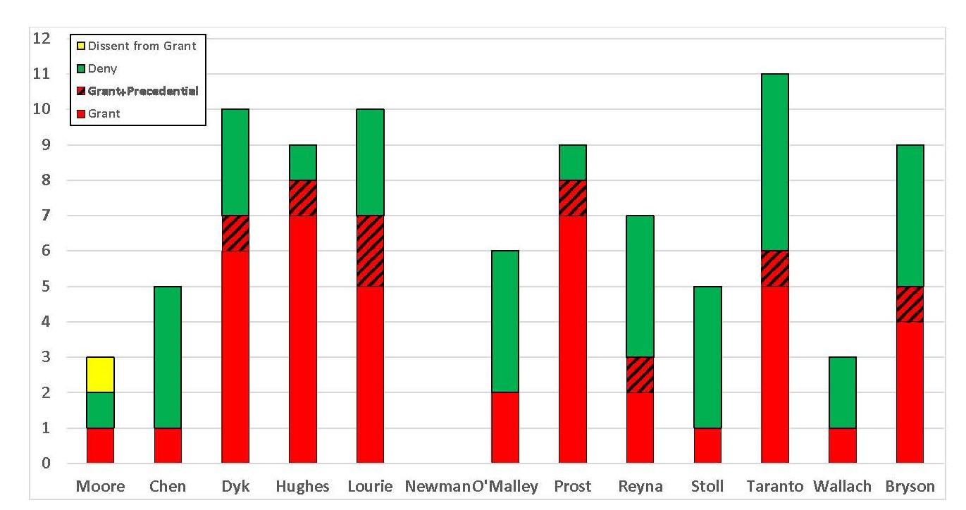
Distribution of Transfer-Related Mandamus Decisions Among CAFC Judges
Source: Smith, Rupp & Robinson, The Federal Circuit’s 2020-2021 Patent Venue Mandamus Cases – part 1

Slide 3
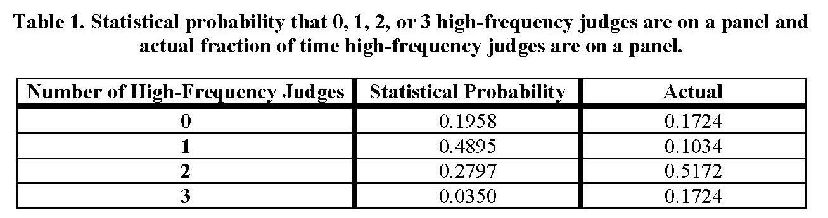
“High-Frequency” Judges Dominate Mandamus Panels
Source: Smith, Rupp & Robinson, The Federal Circuit’s 2020-2021 Patent Venue Mandamus Cases – part 2

Slide 4
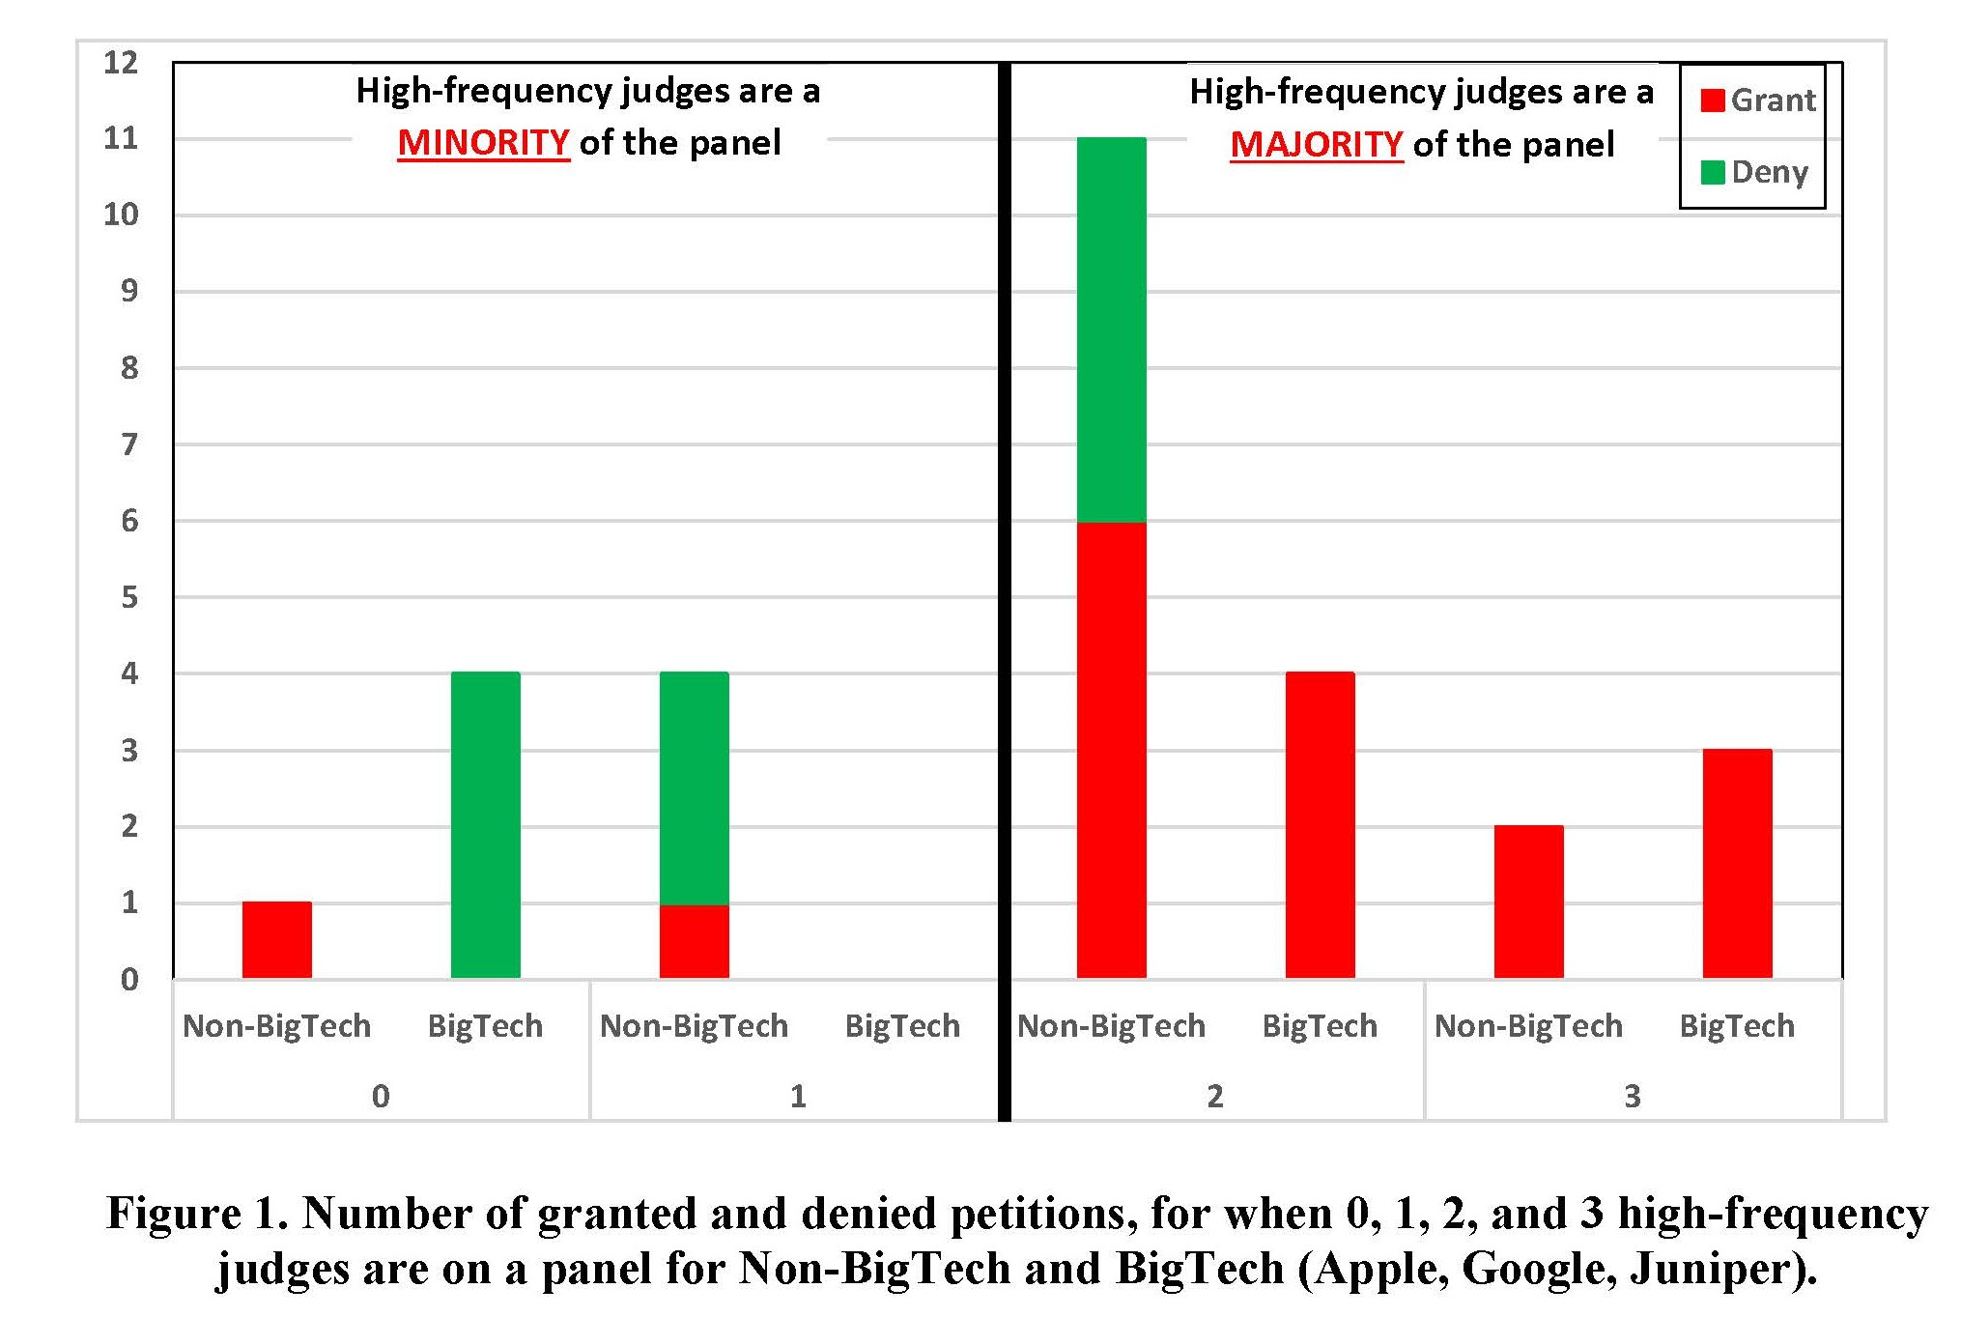
Mandamus Success Rates Compared to Panel Composition
Source: Smith, Rupp & Robinson, The Federal Circuit’s 2020-2021 Patent Venue Mandamus Cases – part 2

