Slide 1
Laboratories of Democracy: Careers in Municipal Law
Presented by
Jennifer Mizrahi & Deepa Sharma
League of California Cities Committee on Attorney Development and Succession

Slide 2
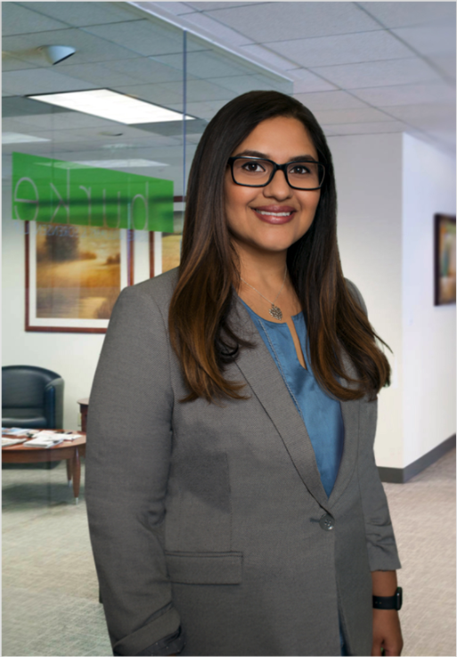
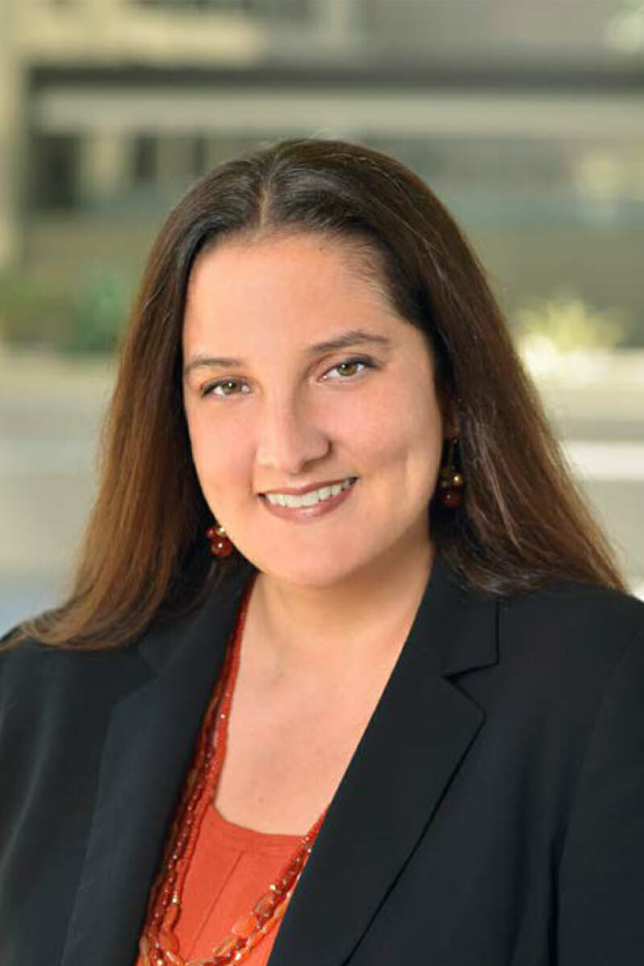
Deepa Sharma Burke, Williams & Sorensen, LLP
Jennifer Mizrahi Stream, Kim, Wrage, and Alfaro, P.C.
Specialties: housing, land use, and rent stabilization; litigation and municipal advice and counsel
Specialties: land use, cannabis, taxation; municipal advice and counsel

Slide 3
Municipal Law as a Career
What does a City Attorney do?
Advise on all legal issues that arise in a City
Staff City Council meetings
Work with City staff
Policy advisor
General practitioners
What does an Assistant/Deputy City Attorney do?
Assist City Attorney in rendering legal advice to the client
Staff public meetings
Work with City staff
Specialists

Slide 4
Career Pathways
In-house legal counsel
Examples: city attorney’s offices in Los Angeles, Glendale, Burbank, Santa Monica, San Francisco.
Things to consider: smaller cities generally look for more experience when hiring for City Attorney/Assistant roles, and these roles are typically filled by generalists
Larger cities like Los Angeles, San Francisco, or Oakland are organized by departments and generally look for issue expertise
Municipal Law Firms
Examples: Burke, Williams, & Sorenson; Stream Kim; Richards, Watson & Gershon; smaller law firms too, etc.
Provide contract city attorney services, usually to smaller cities, as well as specialty services depending on the law firm
Things to consider: private firm environment; small firm versus larger firm; traditional law firm experience while representing public clients

Slide 5
Career Pathways - continued
Issue specialization
Examples: Labor and employment; Telecommunications; code enforcement; personnel investigations; appellate law
Things to consider: developing expertise in a handful of laws could make you the “go-to” in the field; make sure you enjoy the issue area!

Slide 6
What issues do we “generally” deal with?
Land use/Planning
Constitutional law
Ethics
Solid waste/refuse
Marijuana law/regulatory compliance
Environmental (CEQA and regulatory compliance)
Labor
Employment
ADA
Hazardous waste
Eminent Domain
Real Estate Transactions

Slide 7
And . . .
Legislation (analysis and drafting)
Firefighter issues (FBOR)
Police (POBOR, use of force, etc)
Code enforcement (city prosecutor)
Civil Rights
Torts
Public works/bidding
Contracts
Insurance Coverage

Slide 8
And . . .
PUC issues
Mobile home parks
PERS
Bonds/public finance
Sales Tax
Property Tax issues
Special Taxes/Assessments
Election issues

Slide 9
And . . .
Brown Act (open meeting law)
Public Records Act
LAFCO (incorporations/annexations)
Joint Powers Authorities (JPA’s)
Conflicts of interest (financial and others)
Water, sewer, utility issues
Franchises
Telecommunications (cellular etc.)
Software and computer licensing

Slide 10
And . . .
Meetings
Meetings
Meetings
AND for those who want something different- LITIGATION
Police defense
Trip and Fall
Vehicular accidents
Harassment/discrimination
Writs
Limited only by imagination of Plaintiffs counsel

Slide 11
A LONG Day in the life of a City Attorney
8:00 am: Coffee, and then another cup
9:00 am: Go through emails, respond and delegate assignments
10:00 am- 12:00 pm: Zoom meetings with City Staff regarding everything from COVID issues, to street vendors, to taxes
1:00 pm-2:30 pm: Zoom continues – generally with City Manager on upcoming closed session litigation, and City Council meeting items; several calls with various attorneys in office to check on status of projects
2:30-3:00 pm: Fun Zoom with Cal Cities committee members (and more coffee)
3:00-5:00 pm: Respond to emails, again; review and revise memos from deputy city attorneys; provide feedback
5:00 pm- ???: Attend City Council meeting

Slide 12
Day in the life of a public law associate
8:30 am: Prepare for upcoming meeting with City staff
9:00 am: attend scheduled meetings with City staff
10:00am- 1pm: Draft an ordinance [e.g., moratorium on commercial evictions during COVID-19 emergency]
1:30 pm-3:30 pm: Draft staff report regarding ordinance
3:30 pm- 4 pm: Field spur of the moment call from City staff
4:00 pm- 4:30 pm: conduct follow up research stemming from spur of the moment staff question
4:30 pm- 5:00 pm: talk to the City Attorney regarding spur of the moment staff question
5:00 pm- ???: Research for brief

Slide 13
Unique Attributes of City Clients
Client is the governing board/City Council
Legal counsel must understand the political pressures decisionmakers face, and craft creative solutions to address those pressures
Comfort in “discomfort” by dealing with a plethora of topics.
City Attorneys “perform” our roles in the public eye
Must be careful what you say

Slide 14
Contact us
Jennifer Mizrahi: jennifer.mizrahi@streamkim.com
Deepa Sharma: dsharma@bwslaw.com

