Slide 1
Exam Workshop
Berkeley Law Academic Skills Program
October 7, 2020
October 28, 2020
November 18, 2020

Slide 2
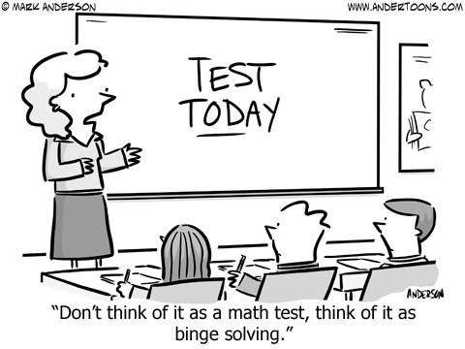
Stressed about exams?

Slide 3
Motivation/Focus in Difficult Times
Healthy and safety come first
Self-care comes first
Your loved ones come first
Feed your soul
Focus on long-term goals

Slide 4
Growth mindset; long-term goals
Focus on the things you can control (how much work you put into your classes), not the thing you cannot control (grades)
You came to law school to learn how to be a lawyer, not to get good grades
Focus on learning the skill of legal analysis
Practice is the best way to improve, and you get more out of it when you put more into it
Remind yourself why you are here -- what do you hope to do with your law degree?

Slide 5
Types of law school exam questions
Issue-spotter (“essay”) questions
Multiple-choice questions
Policy questions

Slide 6
Issue-spotter questions
What skills are tested?
Identify legal issues
Identify the rules relevant to resolving legal issues
Perform legal analysis – apply the law to the facts

Slide 7
1. Identify the legal issues
Identify all of the legal issues
But demonstrate an understanding of which legal issues (or sub-issues) are difficult and which are easy
Spend more time/space on the difficult issues (where the facts cut both ways) and far less time on the easy issues (where the conclusion is obvious)
Triage

Slide 8
2. Identify the relevant rules
State the rule(s) and sub-rules relevant to resolving the legal issues
Use IRAC structure with mini-IRACs for sub-rules
Use terms of art; avoid paraphrasing

Slide 9
3. Perform legal analysis
Apply
Apply the rule(s) to the facts
Identify
Identify the facts that are relevant to resolving the legal issue
Discuss
Discuss the relevant facts in detail
Explain
Explain why the facts matter and why they point to one conclusion or the other (“So what?”) Spend more time on difficult issues and less time on easy issues
Compare
Analogize to and distinguish relevant cases

Slide 10
Develop a process for issue-spotter questions
Read the question or prompt first
Read the fact pattern once all the way through without taking notes
Read the fact patter again and note the issues, underline key facts, etc.
Outline your answer with headings for each issue and sub-issue
Organize the issues chronologically
Use the IRAC structure to analyze each issue (use mini-IRACs for sub-issues)
Goal = clear and concise writing. Short paragraphs and short sentences.
Use policy considerations as a tie-breaker

Slide 11
IRAC vs. CREAC
IRAC (exams)
CREAC (memos or briefs)
Issue
Rule
Application
Conclusion
Conclusion
Rule
Explanation
Application
Conclusion

Slide 12
Structure: IRAC with mini-IRACs
Issue
Rule: If X and Y, then rule is met.
Sub-Issue X
Rule
Application
Conclusion
Sub-Issue Y
Rule
Application
Conclusion
Overall Conclusion

Slide 13
Caution: don’t just list the arguments
Plaintiff will argue X, Y, Z. Defendant will argue A, B, C.
What’s missing?
The analysis!
Take an objective perspective: consider all of the facts on both sides and then determine how a court would decide the issue. Use case comparisons to guide your thinking.

Slide 14
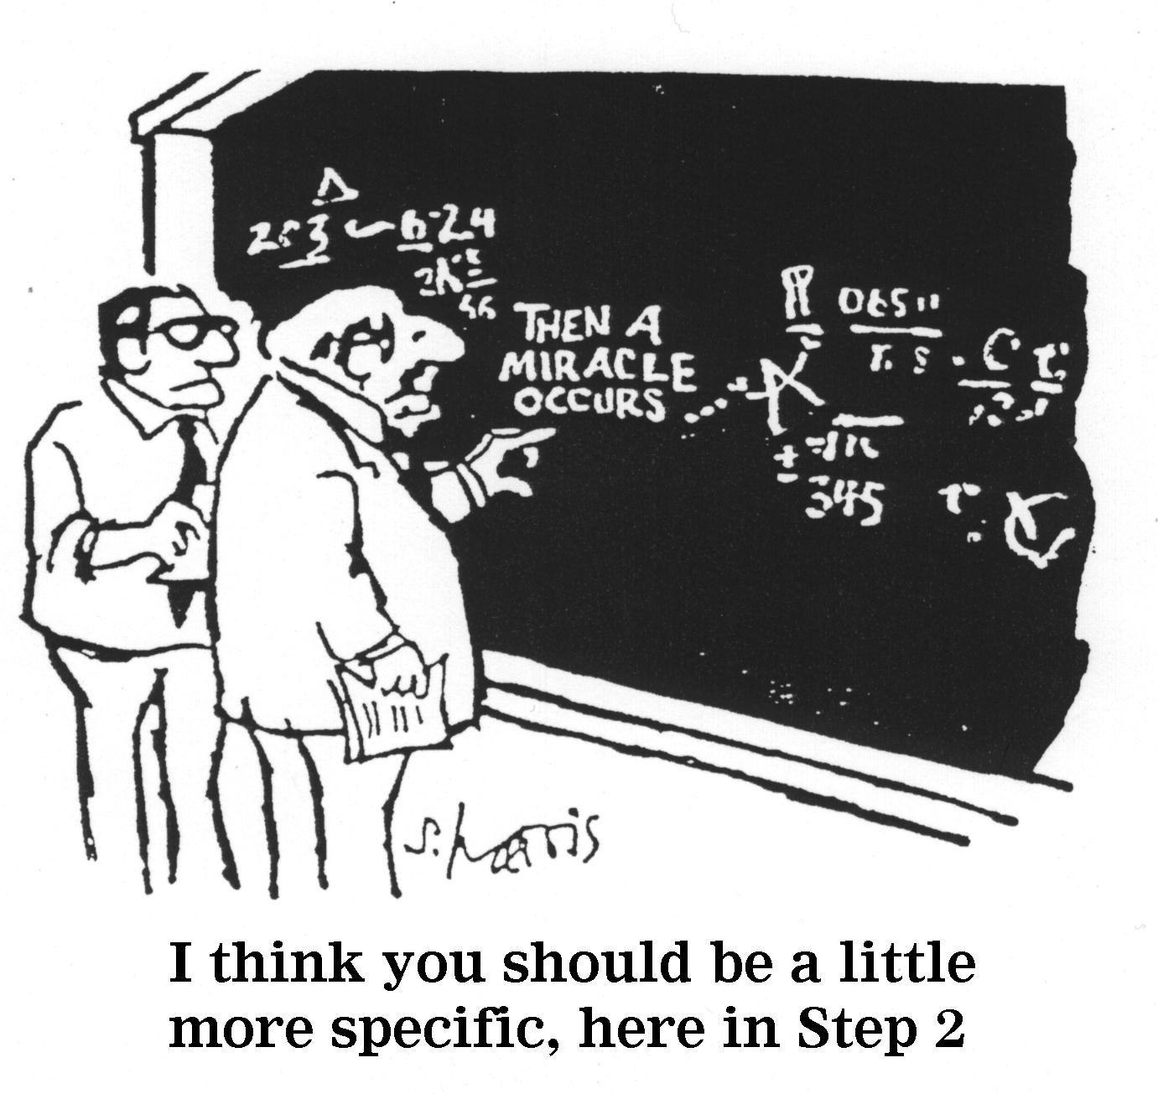
Show your work
Don’t skip any steps
Don’t jump to conclusions
Discuss all of the issues and sub-issues (e.g., elements), regardless of your conclusion on prior issues
Discuss relevant defenses even if you conclude the plaintiff’s claim likely fails

Slide 15
Multiple-Choice questions
Less common on take-home exams
Typically mini issue-spotter questions
For mini issue-spotter/fact application questions, do IRAC on scratch paper and then look for the conclusion in the answer
For other types of questions, read all of the answer choices, eliminate wrong answers, and then select the best remaining answer
Answer every question, even if you must guess (after eliminating wrong answers)
Read slowly and carefully

Slide 16
Policy questions
Short essay format
Asks you evaluate rules rather than apply them
Both descriptive and normative arguments
Typical questions:
A quote that takes a position – agree or disagree
“Discuss”
Proposed new rule
Implications of a doctrinal shift

Slide 17
How to prepare for policy questions
Pay close attention in class and take notes on policy discussions
In your outline, consider the policy considerations underlying every rule
What is the reason for or purpose of the rule?
Is the rule effective?
FIEP – Fairness, Incentives, Efficacy, Process
Focus on the policy considerations discussed in class

Slide 18
General Policy considerations: FIEP
Fairness
Incentives & EFFICACY
Process

Slide 19
Fairness, incentives, efficacy, Process
Fairness | Incentives & Efficacy | Process
Does this make the victim whole? Is there fair notice? Does this feel fair? Is this fair to the defendant? Is it proportional? Whom does this rule advantage/disadvantage and how? Disproportionate impact on a particular group? | Does the rule effectively carry out the intended purpose? What behavior would this rule deter? What behavior does this rule incentivize? Could this have perverse incentives? How would this impact insurance? | Is this judicially efficient? Is the jury equipped to resolve this issue? Would this dramatically increase the number of claims? What sorts of resources would need to be expended? Has the rule been fairly applied in practice?

Slide 20
Sample Answer structure
Discuss/evaluate the old/current rule or the author’s position (use FIEP)
1
Discuss/evalaute the new rule or a contrasting position (use FIEP)
2
Take a position and explain the reasons for your position (use FIEP)
3

Slide 21
Preparing for exams
Schedule time for reviewing and outlining
Schedule time to take practice exams and do hypos
Create a schedule for the exam period
Consider taking the exams that you are most worried about first
Consider taking the exam that you are least worried about last, when you are tired
Work backwards from your exam schedule to create a study schedule
Communicate with family members and housemates about your exam schedule

Slide 22
outlining
No magic, not Mt. Everest
Review your class notes and pull out the important stuff → what will help you on the exam?
Include policy considerations
Don’t get lost in too many resources
Use another student’s outline as a template to get you started, but ultimately create your own outline
An outline is a very personal tool; its value lies solely in how helpful and useful it is to you

Slide 23
When in doubt, practice!
Practice and testing are highly effective learning methods. Passively reviewing/reading information is not.
Practice way more than you think! If you are wondering whether you should review your notes or do a hypo, do the hypo.
First work through practice questions slowly to help you learn the material and develop a systematic approach.
Later do timed practices to simulate the pressure/adrenaline.
Compare your answer to a friend’s or a sample answer – look for IRAC structure and a detailed analysis of the facts. Or schedule a meeting with Senior ASP Fellow Haley Johnson.

Slide 24
Take care of yourself
Get lots of Sleep
Make time for movement
Connect and communicate with loved ones
Visit nature

Slide 25
Daily Mindfulness
Take a few deep breaths
Acknowledge how you are feeling
Connect with that emotion without judgment – name your feelings and welcome them
Extend compassion to yourself and others

Slide 26
Taking open-book exams
Prepare for open-book exams as if they were closed-book
Create a checklist of issues to make sure you don’t miss or forget anything
Stay within the time limits for each question. If time limits are not provided, allocate time for each question.
Develop a system for how to approach different types of exam questions and practice your system
Make sure you know your professor’s policy on cutting-and-pasting or retyping directly from an outline
Do not copy/paste or retype directly from any source other than materials you created yourself

Slide 27
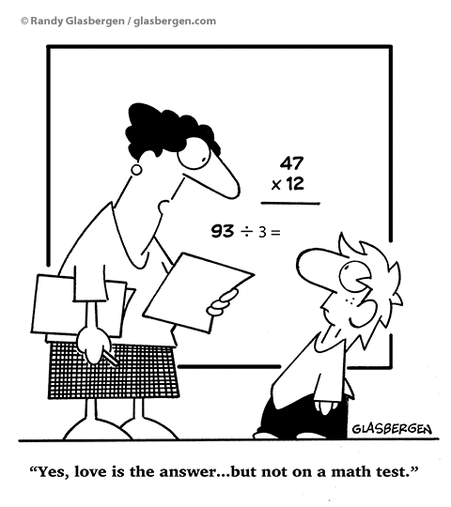
resources
Where can you find hypos and practice exam questions?
→ Academic Skills Program website
Where can you find more tips and advice?
→ Academic Skills Program website
Who can help?
→ Academic Skills Program, Student Services, Berkeley Law Staff Psychologists, Tang Center

