Slide 1
Municipal Redistricting in 2021: New Rules of the Road
A Presentation for the Municipal Law Institute
Chris Skinnell
Sean Welch
Douglas Johnson, Ph.D.
Nielsen Merksamer
Nielsen Merksamer
National Demographics Corp.
March 6, 2020

Slide 2
Redistricting in 2021 Under New California Rules and Federal Case Law
Redistricting will be different this time around.
An outline of what to expect:
Developments in federal case law
AB 849: new legislation that completely rewrites the state law rules governing the redistricting process, beginning in 2020
Practical considerations for city officials tasked with redrawing the lines

Slide 3
Federal Law Considerations
Population Equality
Voting Rights Act
Equal Protection/Restrictions on Racial Gerrymandering

Slide 4
Drawing the Lines—Legal Considerations: Population Equality
Overriding criterion is total population equality, see Reynolds v. Sims, 377 U.S. 533 (1964).
Unlike congressional districts, local electoral districts do not require perfect equality—some deviation acceptable to serve valid governmental interests.
Total deviation less than 10% presumptively constitutional. (Caution: the presumption can be overcome!)

Slide 5
Population Equality: What’s Changed?
As a matter of federal law, some clarification on population base, but questions remain.
Evenwel v. Abbott, 136 S. Ct. 1120 (2016)
Burns v. Richardson, 384 U.S. 73 (1966)
As a matter of state law, total population is mandatory, except that incarcerated persons only count in specified circumstances. See Elec. Code §§ 21500(a), 21601(a) & 21621(a)

Slide 6
Drawing the Lines—Legal Considerations: Federal VRA
Section 2 of the federal Voting Rights Act prohibits electoral systems (including district plans), which dilute racial and language minority voting rights by denying them an equal opportunity to nominate and elect candidates of their choice.
“Language minorities” are specifically defined in federal law: to mean persons of American Indian, Asian American, Alaskan Natives or Spanish heritage. CVRA expressly adopts the definition of “language minority.”
Creation of minority districts required only if the minority group can form the majority in a single member district that otherwise complies with the law. Bartlett v. Strickland, 556 U.S. 1 (2009).

Slide 7
Voting Rights Act “‘Packing’ refers to the practice of filling a district with a supermajority of a given group or party. ‘Cracking’ involves the splitting of a group or party among several districts to deny that group or party a majority in any of those districts.” -Vieth v. Jubelirer, 541 U.S. 267, 286 n.7 (2004)
Packing
District 4
District 1
Minority Voters
Minority Voters
District 2
District 3
Cracking
District 1
Minority Voters
Minority Voters
District 4
District 2
District 3

Slide 8
Voting Rights Act: What’s Changed?
Section 5 invalidated.
Shelby County v. Holder, 570 U.S. 529 (2013).
Move to reduce minority-majority percentages—increased focus on “packing” claims.
Relates to racial gerrymandering developments, discussed below

Slide 9
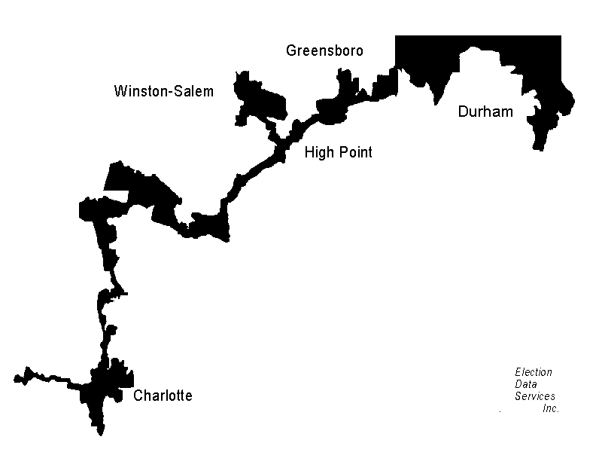
Drawing the Lines—Legal Considerations: No Gerrymandering
The Fourteenth Amendment restricts the use of race as the “predominant” criterion in drawing districts and the subordination of other considerations. Shaw v. Reno, 509 U.S. 630 (1993); Miller v. Johnson, 515 U.S. 900 (1995).
Such predominant use must be justified as narrowly tailored to fulfill a compelling state interest – i.e., strict scrutiny
Looks matter! Bizarrely shaped electoral districts can be evidence that racial considerations predominate. (See, e.g., North Carolina CD 12, which stretched 160 miles across the central part of the State, for part of its length no wider than the freeway right-of-way.)
But bizarre shape is not required for racial considerations to “predominate.”
Fourteenth Amendment does not, however, prohibit all consideration of race in redistricting. Easley v. Cromartie, 532 U.S. 234 (2001).
Focus on communities of interest.

Slide 10
No Gerrymandering: What’s Changed?
Lots
Ala. Legis. Black Caucus v. Alabama, 135 S. Ct. 1257 (2015)
Harris v. Ariz. Indep. Redistricting Comm’n, 136 S. Ct. 1301 (2016)
Bethune-Hill v. Va. State Bd. of Elections, 137 S. Ct. 788 (2017)
Cooper v. Harris, 137 S. Ct. 1455 (2017)
Abbott v. Perez, 138 S. Ct. 2305 (2018)
North Carolina v. Covington, 138 S. Ct. 2548 (2018)

Slide 11
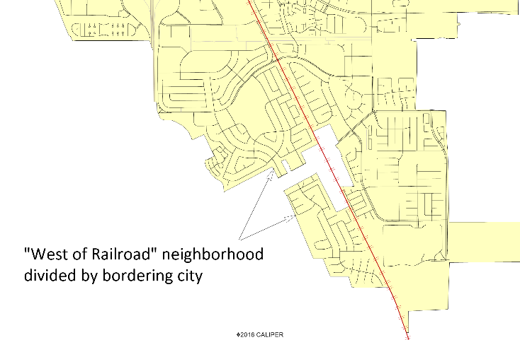
Drawing the Lines—Legal Considerations: State Law Criteria
In the following order of priority:
(1) To the extent practicable, council districts shall be geographically contiguous. Areas that meet only at the points of adjoining corners are not contiguous. Areas that are separated by water and not connected by a bridge, tunnel, or regular ferry service are not contiguous.
(2) To the extent practicable, the geographic integrity of any local neighborhood or local community of interest shall be respected in a manner that minimizes its division. A “community of interest” is a population that shares common social or economic interests that should be included within a single district for purposes of its effective and fair representation. Communities of interest do not include relationships with political parties, incumbents, or political candidates.

Slide 12
Drawing the Lines—Legal Considerations: State Law Criteria
In the following order of priority (continued):
(3) Council district boundaries should be easily identifiable and understandable by residents. To the extent practicable, council districts shall be bounded by natural and artificial barriers, by streets, or by the boundaries of the city.
(4) To the extent practicable, and where it does not conflict with the preceding criteria in this subdivision, council districts shall be drawn to encourage geographical compactness in a manner that nearby areas of population are not bypassed in favor of more distant populations.
Districts “shall not adopt boundaries for the purpose of favoring or discriminating against a political party.”

Slide 13
State Law Criteria: What’s Changed?
Lots
Other than equal population, Voting Rights Act, and equal protection, criteria were formerly discretionary and permissive (the board or council “may” consider the others). Now appear mandatory.
Criteria now ranked in order of priority.
No longer clear the extent to which non-statutory criteria can be considered.
Consideration of incumbency and political parties now restricted.
Explicitly made applicable to charter cities. Constitutional issues? (Pending AB1276 change)
Exclusion of prisoners previously a policy choice; not now.
Note: school districts and special districts remain under old rules.
Mid-decade redistricting previously allowed; now only under specific circumstances.

Slide 14
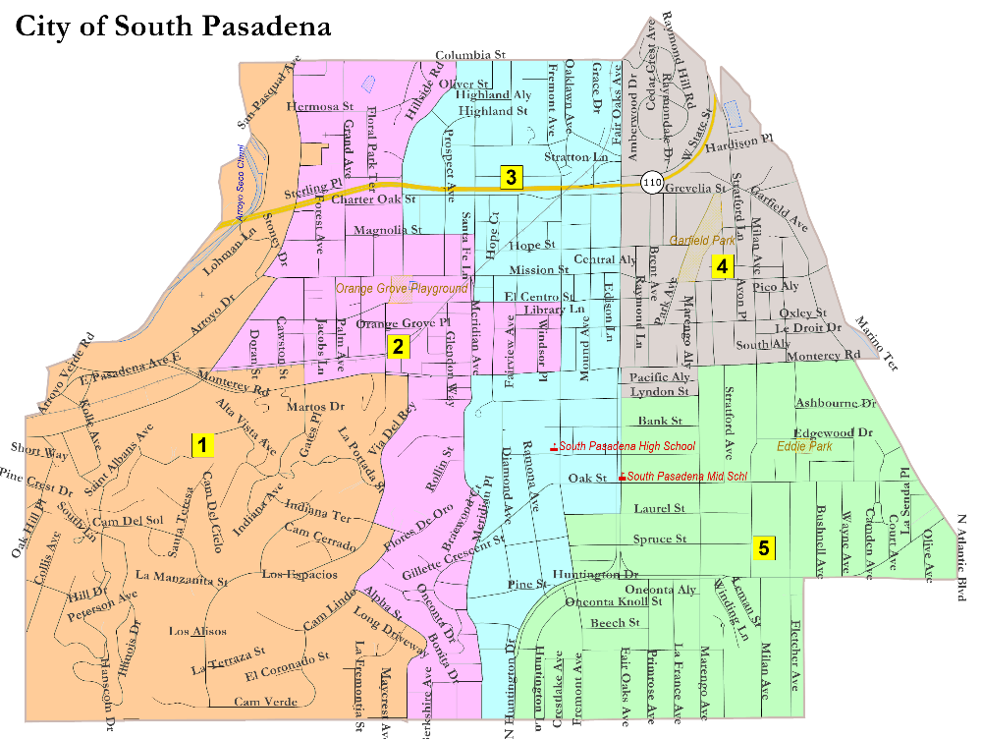
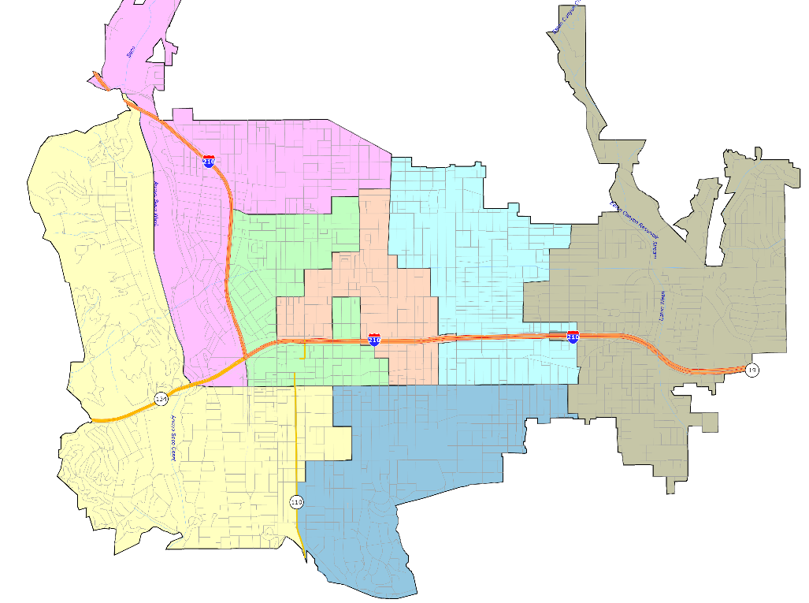
Traditional Policy Decisions Now in Doubt

Slide 15
Non-Statutory Criteria
Ability to consider is unclear:
Respect will of the voters / avoid head-to-head contests
NDC estimates 20 to 50 Councilmembers are going to be forced into head-to-head contests, or unable to run for re-election at all, due to the new criteria (including many of our post-CVRA newly elected Asian-American and Latino Councilmembers)
Minimize shifting voters from one election year to another
Voters currently in districts scheduled to vote in 2022 could be redistricted into a 2024 district, meaning there would be a six year gap between their voting in Council elections

Slide 16
Drawing the Lines—Legal Considerations: State Law Process
Timing:
THEN: before the first day of November of the year following the year in which each decennial federal census is taken
NOW: no earlier than August 1, 2021, and August 1 in each year ending in the number one thereafter, but no later than 151 days before the jurisdiction’s next regular election occurring after March 1, 2022, and after March 1 in each year ending in the number two thereafter.
Charter cities can set their own timing
Timing for cities with March elections compressed

Slide 17
Schedule Congestion
2011: 150 to 200 jurisdictions had to redistrict
Many had off-year (2011/2013) elections, and redistricted in 2012
2021: about 500!
Almost all off-year elections have been eliminated, so virtually everyone will redistrict in 2021
This will be a massive workload increase for the County Registrars who receive and implement all the redistricting maps, and for the attorneys and demographers who assist jurisdictions with this process

Slide 18
Drawing the Lines—Legal Considerations: State Law Process
Backup Procedure if Deadline Missed:
THEN: default to at-large elections for general law cities
NOW: petition to the superior court, which may use special masters and experts at the expense of the jurisdiction, and local facilities, computers and personnel
Charter cities are permitted to have their own default procedures

Slide 19
Drawing the Lines—Legal Considerations: State Law Process
Hearings:
THEN: one public hearing on the proposal prior to the public hearing at which the city council votes to approve or defeat the proposal.
NOW: at least four public hearings: at least one before draft maps are drawn (and can be conducted by staff or consultant); at least two after draft maps are drawn; at least one on a Saturday, Sunday or after 6:00 P.M. Monday through Friday

Slide 20
Drawing the Lines—Legal Considerations: State Law Process
Public Outreach
THEN: None in particular required, except compliance with Brown Act
NOW: jurisdiction must encourage public participation through
Media outreach
Good government, civil rights, civic engagement & community groups
Live translation, if requested 72 hours in advance of meeting
Publication of notices on the internet
Publication of a draft map at least seven days before adoption
Publication of relevant demographic data
Receipt of maps or testimony from the public in writing or electronically

Slide 21
Drawing the Lines—Legal Considerations: State Law Process
Recordkeeping
THEN: None in particular required, except compliance with Public Records Act
NOW: record of each public comment and governing body deliberations at every public hearing or workshop – made available to the public within two weeks
Internet webpage maintained for 10 years in multiple languages that includes:
An explanation of the redistricting process
Procedures for testifying or submitting written testimony
Calendar of all hearings and workshops
Notice and agenda for each hearing and workshop
Recording or written summary of each hearing and workshop
All draft maps & adopted map
Secretary of State to provide template

Slide 22
Drawing the Lines—Legal Considerations: State Law Process
Mid-Decade Redistricting
THEN: At any time, based on a mid-decade Census or population estimates prepared by the State Department of Finance
NOW: Never, unless in conjunction with judicial proceedings, or jurisdictional boundary changes, and then with qualifications
Charter cities can have different rules pertaining to mid-decade redistricting

Slide 23
Drawing the Lines—Legal Considerations: State Law Process
There are other options for cities and counties –
A variety of redistricting commissions, including an advisory commission (specifically referenced in AB 849), a hybrid commission, or an independent commission
Commissions mandatory for Los Angeles and San Diego County Boards of Supervisors
Note: numerous restrictive qualifications for appointment as commissioner
Note: specific limitations on subsequently political activities of commissioners

Slide 24
Commission Pressure & Risks
Commissions More Popular in 2021
Advisory or Independent Commissions may limit the negative impact on Council dynamics if the new state criteria force Councilmembers together
We anticipate considerable public pressure for “independent commissions,” especially in the Bay Area
Independent Commissions have an added requirement: “The commission shall not draw districts for the purpose of favoring or discriminating against an incumbent or political candidate.” [Elections Code Section 23003(g)]

Slide 25
Question Time

Slide 26
Municipal Redistricting in 2021: New Rules of the Road
A Presentation for the Municipal Law Institute
Chris Skinnell
Sean Welch
Douglas Johnson, Ph.D.
Nielsen Merksamer
Nielsen Merksamer
National Demographics Corp.
March 6, 2020

