Slide 1
IPRs: Coordination & Estoppel
Making sure the PTAB or the District Court doesn’t steal your Christmas
Heidi Keefe, Cooley
Jared Bobrow, Orrick

Slide 2
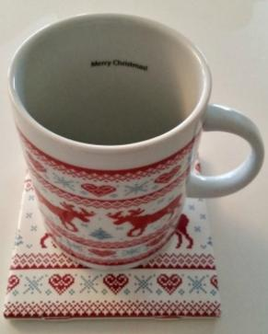
The Claim
1. A beverage holder comprising:
a base;
a large vessel for holding liquid;
happy holiday decorations;
a handle; and
a warming mechanism that warms said liquid in said large vessel.

Slide 3
The Infringer
1. A beverage holder comprising:
a base;
a large vessel for holding liquid;
happy holiday decorations;
a handle; and
a warming mechanism (microwave not shown)

Slide 4
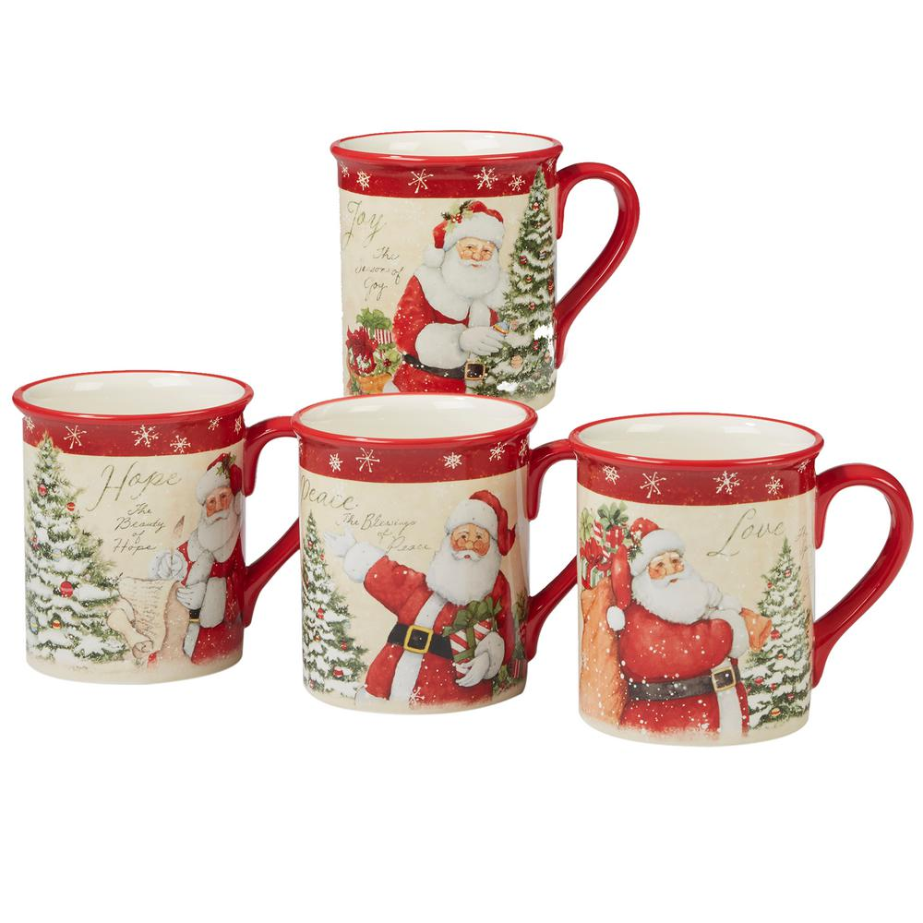
The Prior Art
1. A beverage holder comprising:
a base;
a large vessel for holding liquid;
happy holiday decorations;
a handle; and
a warming mechanism (kettle not shown)

Slide 5
What would you do?
1. A beverage holder comprising:
a base;
a large vessel for holding liquid;
happy holiday decorations;
a handle; and
a warming mechanism

Slide 6
N.D. Cal. Co-pending Litigation Timeline (Early IPR Filing)
3-1 Infringement Contentions
Claim Construction Hearing
Complaint Filed
Trial
~ 5 months
~ 5 to 7 months
~ 30 to 36 months from filing
Request for Stay?
PTAB
3 months
3 months
No more than 12 months
Petition Filed
PO Prelim Response
Institution Decision
Final Written Decision

Slide 7
N.D. Cal. Co-pending Litigation Timeline (Late IPR Filing)
3-1 Infringement Contentions
Claim Construction Hearing
Complaint Filed
Trial
~ 5 months
~ 5 to 7 months
~ 30 to 36 months from filing
Request for Stay?
PTAB
3 months
3 months
No more than 12 months
Petition Filed
PO Prelim Response
Institution Decision
Final Written Decision

