Slide 1
Is Design Patent Examination Too Lax?
Sarah Burstein
The University of Oklahoma College of Law
@design_law

Slide 2
Design Patent Basics
A quick overview before we dive in…

Slide 3
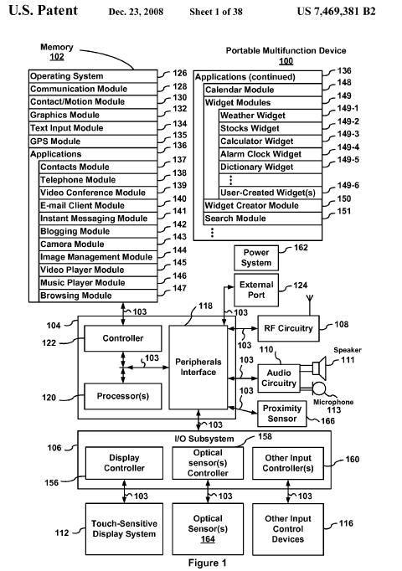
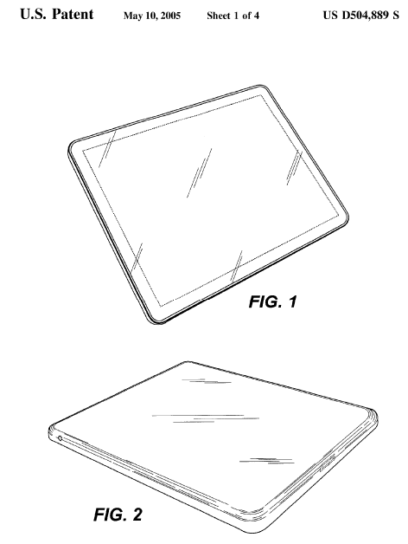
Patents
Utility Patents
Plant Patents
Design Patents
Notes:
Utility: U.S. Patent No. 7,469,381 (“the ’381 patent”), which claims the iPad and iPhone “bounce” feature
Plant: U.S. Plant Pat. 550 (1942), “Rose Plant”
Design: U.S. Des. Patent No. 504,889 (“the D’889 patent”)

Slide 4
35 U.S.C. § 171(a)
Whoever invents any new, original, and ornamental design for an article of manufacture may obtain a patent therefor, subject to the conditions and requirements of this title.
Notes:
Note – this statute has been amended since your book came out!

Slide 5
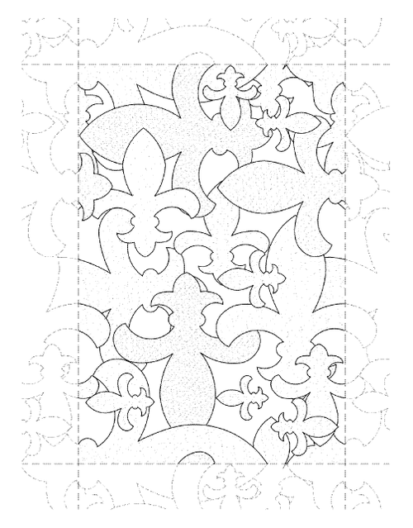
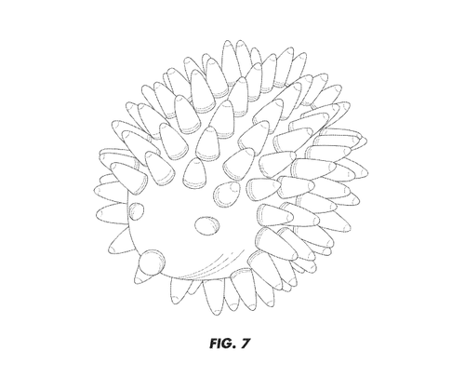
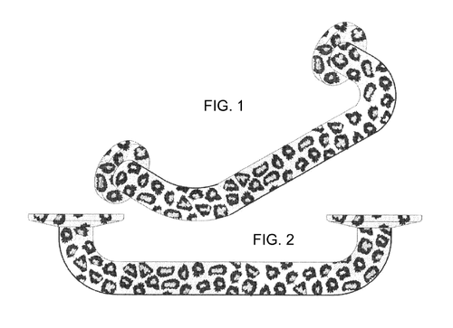
What types of designs can be patented?
Notes:
http://design-law.tumblr.com/post/78134213008/issued-this-week-to-kikkerland-design
http://design-law.tumblr.com/post/72084718418/issued-this-week-d696-521-for-this-fleur-de-lis
http://design-law.tumblr.com/post/78838961205/issued-this-week-d700-687-for-a-grab-bar-having

Slide 6
Claiming Designs
A quick overview.

Slide 7
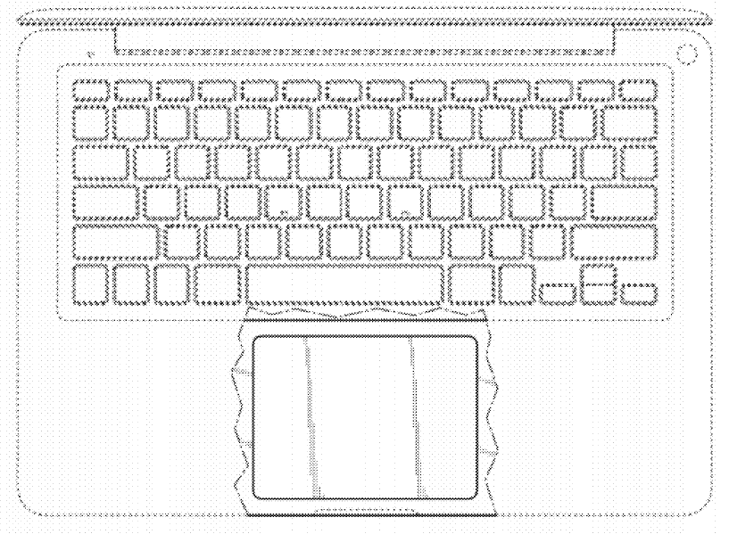
D674,382 – “Portable Computer”
(filed Mar. 8, 2012)

Slide 8
D702,150 – “Ornament”
(filed Mar. 9, 2012)

Slide 9
D711,198 – “Fruit Cutter”
(filed June 27, 2012)
Notes:
Drawing convention showing an article of indeterminate length.

Slide 10
D604,305 – “Graphical User Interface for a Display Screen or Portion Thereof”
(filed June 23, 2007)

Slide 11
Some examples
Of recently-issued design patents

Slide 12
D814,216 – Display Case
(issued April 3, 2018)

Slide 13
D814,616 – Commercial Toilet Seat
(issued April 3, 2018)

Slide 14
D814,112 – Hair Clip
(issued Mar. 27, 2018)

Slide 15
D813,944 – Label Sheet Assemby
(issued Mar. 27, 2018)

Slide 16
What’s going on?
Crouch, 2010:
Data shows ≈ 90% grant rate
This reflects “the USPTO’s sub silento abdication of its gatekeeper function in the realm of design patents.”
Risch, 2013:
“[Ex]xaminers’ hands are tied to some extent” by “the obviousness rules for design patents.”

Slide 17
Questions?
Sarah Burstein
Associate Professor of Law
The University of Oklahoma College of Law
300 Timberdell Road w Norman, OK 73019 405-325-0537 w sarah.burstein@ou.edu
@design_law

