Slide 1
Global Data Privacy Law and the Diffusion (or not) of EU Data Protection BCLT Privacy Forum Palo Alto, CA March 23, 2018
Moderated by:
Paul M. Schwartz
Berkeley Law School
Presentation: Annual BCLT Privacy Forum
March 23, 2018
Twitter: @paulmschwartz

Slide 2
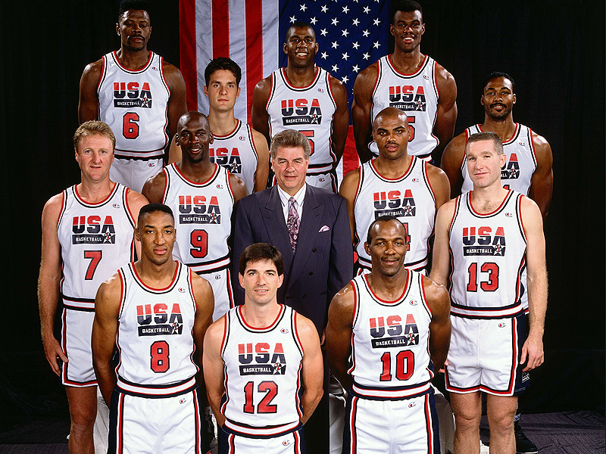
Introducing the Dream Team
Charles Barkley, Larry Bird, Clyde Drexler, Patrick Ewing, Magic Johnson, Michael Jordan, Christian Laettner, Karl Malone, Chris Mullin, Scottie Pippen, David Robinson and John Stockton.

Slide 3
Introducing the Dream Team
Lothar Determann, Baker McKenzie
Alison Howard, Microsoft
Michael Rubin, Latham & Watkins LLP
Lindsey Tonsager, Covington

Slide 4
Lothar Determann
Baker McKenzie, Partner
Data Privacy, Information Technology, Copyright, Product Regulations, and International Commercial Law

Slide 5
Alison Howard, Microsoft
Assistant General Counsel

Slide 6
Michael Rubin, Latham & Watkins, Partner
Information Law, Data Privacy & Cybersecurity Practice

Slide 7
Lindsey L. Tonsager, Covington & Burling,
Partner, Data Privacy & Cybersecurity, Communications & Media, Advertising & Consumer Law

Slide 8
GDPR: The New Privacy Benchmark
Notes:
http://deloitte.wsj.com/cio/2018/02/21/6-ways-to-prepare-for-gdpr/
https://www.nytimes.com/2018/01/28/technology/europe-data-privacy-rules.html
(same link for Brill quote)
Alternative quote from the same NYT article (above): Angelo Spenillo, general counsel for Siteimprove, which helps companies manage their presence online, said many little tech companies have been looking toward Google and Facebook for how user privacy and data will be managed online. “Where the bigger companies go, the smaller companies will follow suit.”

Slide 9
GDPR: The New Privacy Benchmark

Slide 10
GDPR: The New Privacy Benchmark
“Europe has set the regulatory standard in reining in the immense power of tech giants” NY Times (Jan. 28, 2018)
“The rules are significant because they are some of the most robust since the dawn of the Internet exceeding consumer protection in the United States.” Washington Post (Jan. 29, 2018)
“Avoidance isn’t an option.” Wired (March 19, 2018)
Notes:
http://deloitte.wsj.com/cio/2018/02/21/6-ways-to-prepare-for-gdpr/
https://www.nytimes.com/2018/01/28/technology/europe-data-privacy-rules.html
(same link for Brill quote)
Alternative quote from the same NYT article (above): Angelo Spenillo, general counsel for Siteimprove, which helps companies manage their presence online, said many little tech companies have been looking toward Google and Facebook for how user privacy and data will be managed online. “Where the bigger companies go, the smaller companies will follow suit.”

Slide 11
How did EU privacy law become the global benchmark?
What does that mean for U.S. companies?

Slide 13
Jack Goldsmith & Tim Wu, Who Controls the Internet? (2006)
“For many purposes, the EU is today the effective sovereign of global privacy law.”
“Unilateral global law of the sort doled out by the EU in the privacy context depends on significant market power

Slide 14
Jack Goldsmith & Tim Wu, Who Controls the Internet? (2006)
“[A] global law that results from the unusual combination of Europe’s market power and its unusual concern for its citizen’s privacy.”
Notes:
EU privacy laws are not a treaty, not a WTO-trade dispute, and not a result of the Internet’s architecture like ICANN

Slide 15
Schwartz & Peifer, Transatlantic Data Privacy Law, 106 Geo L.J. 115 (2017)
Goodman-Jinks Model: states seek to influence other states and institutions in three ways:
Coercion;
Persuasion;
Acculturation
Notes:
Coercion – ability to restrict data transfers to US. Coercion escalates the “benefits of conformity or costs of nonconformity through material rewards and punishments.”
Persuasion – lots of formal and informal institutional environments, such as Privacy Shield, for consultations and discussions. Int’l dialogue.
Acculturation– creation of new privacy norms among global community of privacy professionals

Slide 16
Coercion, Persuasion, and Acculturation

Slide 17
Schwartz & Peifer, Transatlantic Data Privacy Law, 106 Geo L.J. 115 (2017)
“[L]ike the Safe Habor before it, the Privacy Shield creates a normative infrastructure for bringing EU-style privacy practices into the United States.”
BCR and other mechanisms
“These processes create a force for acculturation and conformity within a global community of privacy professionals.”

Slide 18
What about the rest of the world?
Notes:
What about the world outside the EU-US?

Slide 19
What about the rest of the world?
Notes:
What about the world outside the EU-US?

Slide 20
APEC Privacy Regulations: The Basics
Asia-Pacific Economic Cooperation (APEC) is a cooperative of economies located along the Pacific Ocean
Includes: U.S., China, Japan, Russia, New Zealand, Peru, Indonesia, Mexico, Singapore, Thailand, and Vietnam
APEC Privacy framework, based on OECD Privacy Guidelines, adopted 11/24/2004

Slide 21
APEC Privacy Principles
Preventing harm
Notice
Collection limitation
Use of Personal Information
Choice
Integrity
Security safeguards
Access and correction
Accountability
The APEC Framework is not binding upon APEC nations, and does not prohibit data transfers to countries that do not comply with it.

Slide 22
APEC Cross Border Privacy Rules (CBPR)
System of voluntary cross-border privacy rules (adopted in 2011).
Four Elements
Self-assessment
Compliance review
Recognition/acceptance
Dispute resolution and enforcement
Five countries currently participating: Canada, Japan, Republic of Korea, Mexico, and the U.S.

Slide 26
EU officials: How GDPR is good for digital businesses
“GDPR will help businesses fully benefit from the digital economy throughout the EU’s Digital Single Market (DSM)”
GDPR implementation in all member countries lays foundation for DSM project
DSM is an initiative to boost the digital economy by enabling European citizens and businesses to fully exploit the benefits of globalization and e-commerce
Notes:
https://ec.europa.eu/commission/sites/beta-political/files/data-protection-factsheet-business_en.pdf
https://ec.europa.eu/commission/commissioners/2014-2019/ansip/blog/online-privacy-building-trust-digital-age_en
https://www.isaca.org/Journal/archives/2016/volume-6/Pages/the-new-eu-general-data-protection-regulation.aspx#4

Slide 27
EU officials: How GDPR is good for digital businesses
“One set of rules, one interlocutor and one interpretation across the EU”
“ … businesses in the EU had to deal with 28 different data protection laws. For many companies looking to access new markets, this fragmentation created costly administrative burdens. The new regulation will cut red tape. It will do away with, for example, the obligation for businesses to notify different national data protection authorities about the personal data they are processing. …”
Notes:
https://ec.europa.eu/commission/sites/beta-political/files/data-protection-factsheet-business_en.pdf

Slide 28
Discussion with the Dream Team

Slide 29
Question and Answer Period

Slide 30
EU officials: How GDPR is good for digital businesses
The benefits for smaller companies
“The GDPR aims to remove any undue administrative requirements that could be too burdensome for smaller companies. …
companies with fewer than 250 employees don’t need to keep records of their processing activities unless processing of personal data is a regular activity, poses a threat to individuals’ rights and freedoms, or concerns sensitive data or criminal records.
… many SMEs will benefit from the fact that companies are not required to appoint a Data Protection Officer, unless their business are activities that present specific data protection risks … But even those who are required to do so don’t have to hire a full-time employee…”
Notes:
https://ec.europa.eu/commission/sites/beta-political/files/data-protection-factsheet-business_en.pdf

Slide 31
EU officials: How GDPR is good for digital businesses
Encouraging innovation
“The GDPR gives businesses the flexibility they need to make innovative use of big data while protecting individuals’ fundamental rights. Building data protection safeguards into products and services from the earliest stages of development – data protection by design – is now an essential principle of doing business. It incentivises businesses to innovate and develop new ideas, methods and technologies for securing and protecting personal data.”
Notes:
https://ec.europa.eu/commission/sites/beta-political/files/data-protection-factsheet-business_en.pdf

Slide 32
EU officials: How GDPR is good for digital businesses
Facilitating international data flows
“The General Data Protection Regulation clarifies the conditions under which a company can transfer Europeans’ personal data to countries outside the EU, while guaranteeing a high level of protection for the data travelling abroad. The new rules expand the possibilities for companies to use existing instruments like standard contractual clauses and binding corporate rules, and reduce red tape by abolishing the requirement of prior notification to Data Protection Authorities. They also introduce new instruments for international transfers, such as approved codes of conduct or certification mechanisms (privacy seals or marks).”
Notes:
https://ec.europa.eu/commission/sites/beta-political/files/data-protection-factsheet-business_en.pdf

Slide 33
EU officials: How GDPR is good for digital businesses
“It’s all about consumer trust, also online”
“Consumers highly value their privacy online. Businesses who fail to adequately protect an individual’s personal data risk losing their trust.”
“The GDPR addresses citizens’ concerns and helps businesses regain consumer trust. Under the GDPR, citizens have a number of rights that give them more control over their personal data. These include . . . the right to move their personal data from one service provider to another.
The ability to move personal data from one provider to another means start-ups and smaller companies can now access data markets once dominated by digital giants. “
Notes:
https://ec.europa.eu/commission/sites/beta-political/files/data-protection-factsheet-business_en.pdf

