Slide 1


The Initial Distribution of Asset Value Created through Carbon Pricing
Dallas Burtraw
Resources for the Future
California-Germany Climate Policy Workshop
Boalt Hall
Berkeley, 2 October 2017

Slide 2
Public Perception of Trading
Media reactions to first SO₂ allowance trades in 1992:
  “What’s next, the L.A. Police Department trying to buy civil rights credits in Wisconsin?” (quote from A.P. wire story)
  “Why applaud a deal that lets companies buy pollution rights? People will die.” (op. ed. in USA Today)

Slide 3
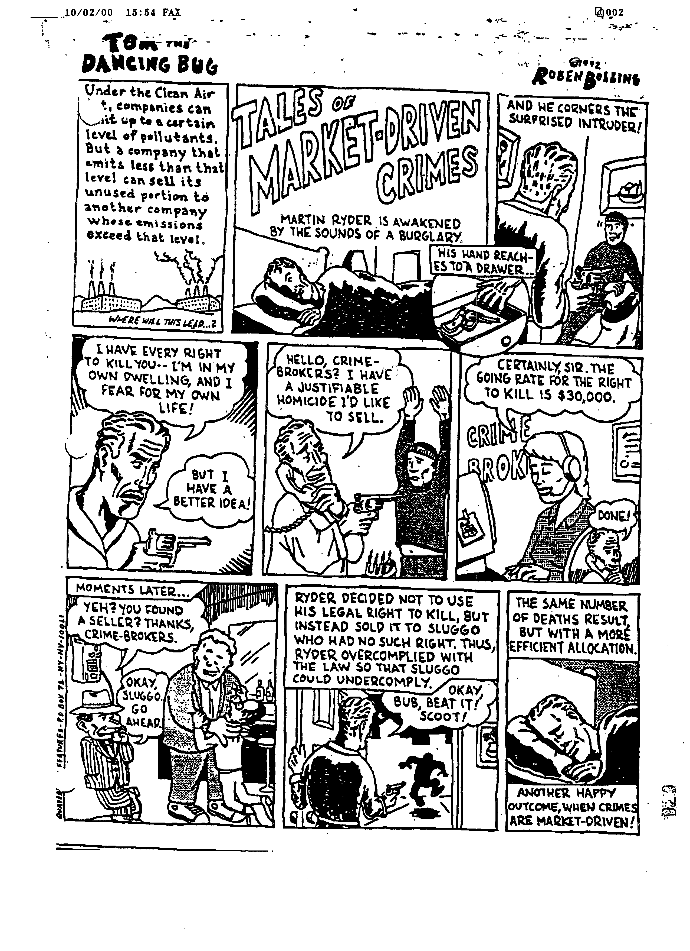
Reactions to Early Trades

Slide 4
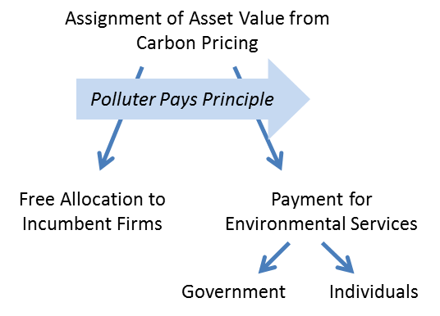
Evolution in atmosphere resource markets

Slide 5
Roadmap for presentation
Three standards (and tradeoffs) to keep in mind for evaluation.
Efficiency. Equity. Efficacy.
Outline
History of allowance prices in atmosphere resource markets.
How the allowance asset value is initially distributed and used.
I aim to show how these outcomes are related.

Slide 6
History of allowance prices….
Recognizing gravity as the strong force in atmosphere emissions markets….

Slide 7

Illinois Emissions Reduction Market System VOC Allowance Prices
Note: Auction prices are used as market prices are not available.
Source: Illinois EPA.

Slide 8
US SO₂ Allowance Prices
Sources: Cantor Fitzgerald; T. Huetteman.

Slide 9
US NOx Allowance Prices
Source: G. Hart.

Slide 10
EU Emissions Trading System Carbon Allowance Prices
Source: Thomson Reuters.

Slide 11
RGGI Carbon Allowance Prices
Note: Auction prices are used where market prices are not available.
Sources: Thomson Reuters; RGGI.

Slide 12
California and Quebec Carbon Allowance Prices
Note: Auction prices are used where market prices are not available.
Sources: Thomson Reuters; California ARB; Quebec MDDELCC.

Slide 13

History of allowance prices….
Recognizing gravity as the strong force in atmosphere emissions markets. Why?
Over-allocation – political economy, who is in the room?
Incentives work to find ways to lower costs
Companion policies, serving additional concerns:
  air quality, job creation, economic development strategy, and good old fashioned fighting for rents.
Sub-jurisdictional efforts, and the powerful force of federalism
Program related spending
But, a fixed supply of allowances
may create a waterbed effect

Slide 14
RGGI’s price floor innovation. Now an “adaptive cap.”
Intended Cap
CCR
Savings are “shared” with the environmental goal.
ECR
D^{Expected}
P_{min}
D^{Low}
This quantity is not sold.

Slide 15
RGGI’s new design is a big deal
It further infuses economic ideas into environmental policy
  Relevance to the discussion of price supports in the EU setting?
As RGGI is effectively a program that “links” nine there is implied transfer to the two states that will not implement the price step
  Further relevance for implied transfers in the EU?

Slide 16
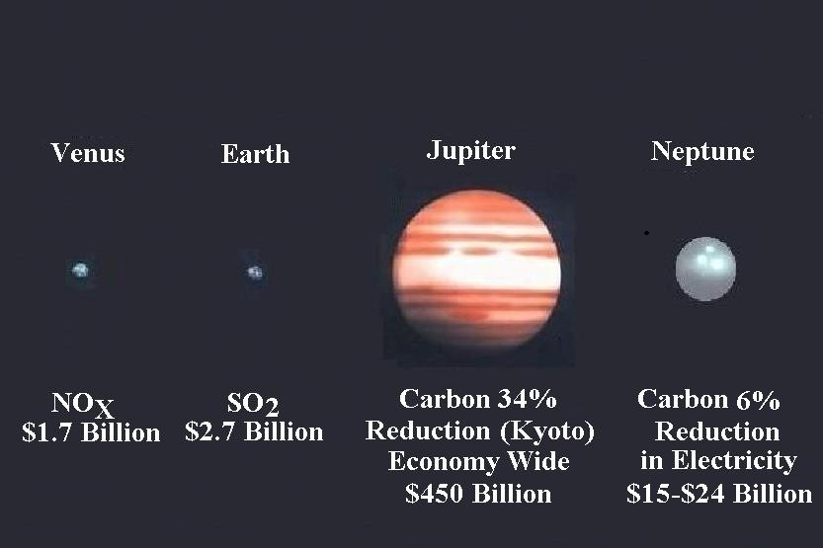
Economy-wide CO₂ pricing would constitute the largest distribution of a federally-enforced property right since the 19th century American west.

Slide 17
Efficiency. Equity. Efficacy.
What we do with the allowance asset value trades off among these standards.
Note importantly, the outcome is not static.
What enables the next step?
Is there a policy sequence?

Slide 18
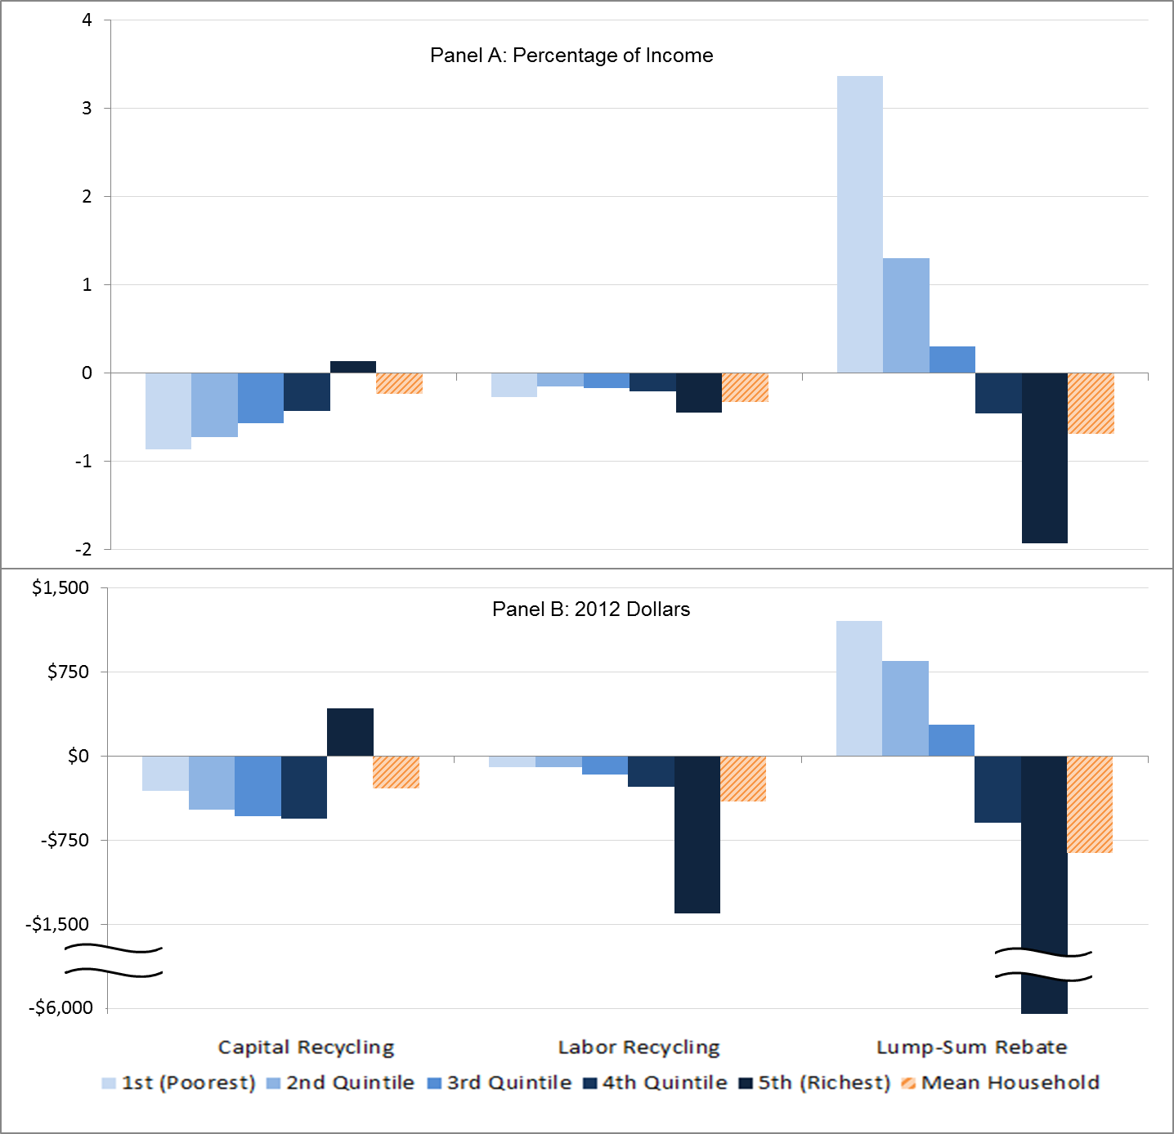
Distributional effects – by income
The result is accentuated by geography
Lump sum rebate is more than twice as expensive but about two-thirds of households are net winners. NatTaxJ 2015

Slide 19
Evolution in atmosphere resource markets
  Public finance goals – tax swaps (not observed)
  Compensation & Environmental Justice
  Combating leakage
  Program related spending
  Efficiency
  Equity
  Efficacy

Slide 20
EU ETS Distribution of Asset Value
Source: Thomson Reuters.

Slide 21
RGGI Distribution of Asset Value
Note: Auction prices are used where market prices are not available.
Sources: Thomson Reuters; RGGI.

Slide 22
California Distribution of Asset Value
Note: Auction prices are used where market prices are not available.
Sources: Thomson Reuters; California ARB.

Slide 23
Quebec Distribution of Asset Value
Note: Auction prices are used where market prices are not available.
Sources: Quebec MDDELCC.

Slide 24
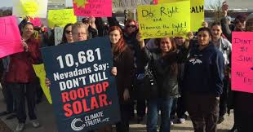
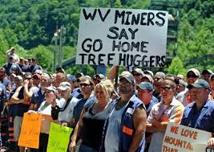
Efficiency. Equity. Efficacy.
Designed policy approaches have not been realized. We do not observe a tax swap in carbon markets, and we observe dividends only rarely. In practice…
Equity and efficacy perspective are prominent:
Compensation to consumers and program related spending has yielded incremental progress. Why?
  Reinforces downward pressure on allowance prices
  Protects against competitive threats
  Minimizes tax interaction effects
  Addresses environmental justice issues
  Creates new constituencies that balance incumbent interests
  A challenge for economics is to infuse greater efficiency over time

