Slide 1
Platforms, Entitlement & the Twilight of Consumer Protection Law
University of California Berkeley School of Law
21st Annual BCLT/BTLJ Symposium
Platform Law: Public and Private Regulation of Online Platforms
Consumer Protection
April 20, 2017
Jane K. Winn
Charles I. Stone Professor
University of Washington School of Law
Fulbright Research Scholar, Guanghua Law School, Zhejiang University, Hangzhou, China Spring 2017

Slide 2
Platforms, Empowerment & Twilight of Consumer Protection Law
Consumer Protection Law as Protective Legislation
From Industrial Pipelines and Information Hierarchies to Knowledge Platforms
Knowledge Intermediary Principal-Agent Conflicts
Transforming the Political Economy of Knowledge

Slide 3
Consumer Protection Law as Protective Legislation

Slide 4
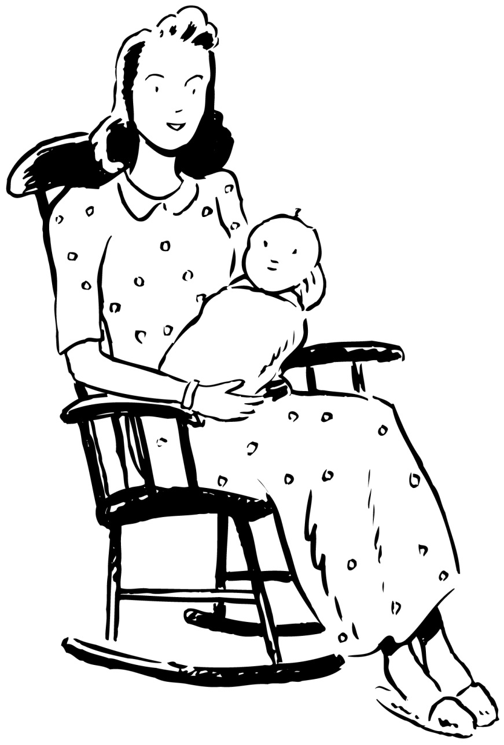
Brandeis Brief for Protective Legislation for Women: Muller v. Oregon, 208 U.S. 412 (1908)

Slide 5
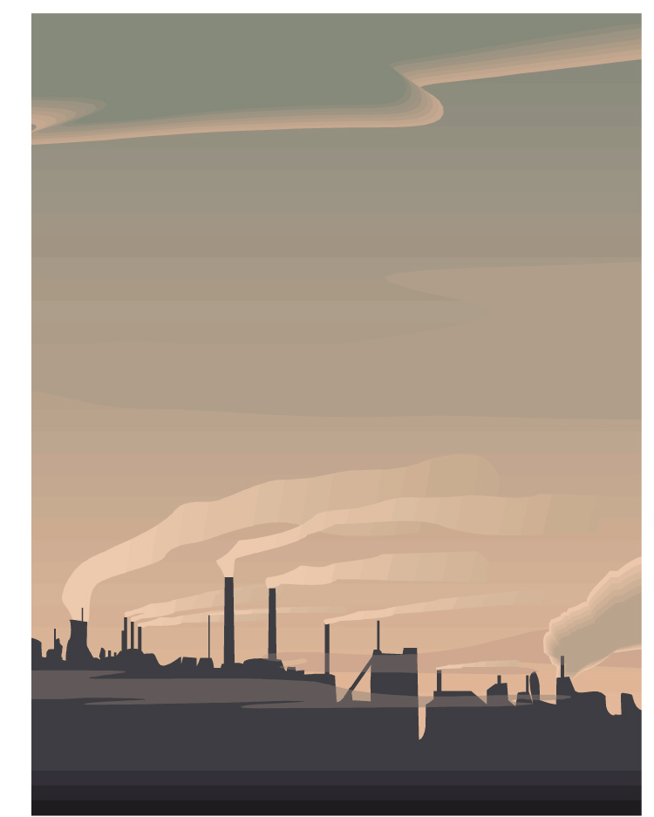
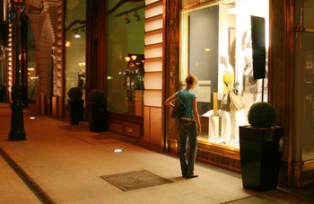
Consumerism as a Faustian Bargain

Slide 7
From Industrial Pipelines and Information Hierarchies to Knowledge Platforms

Slide 8
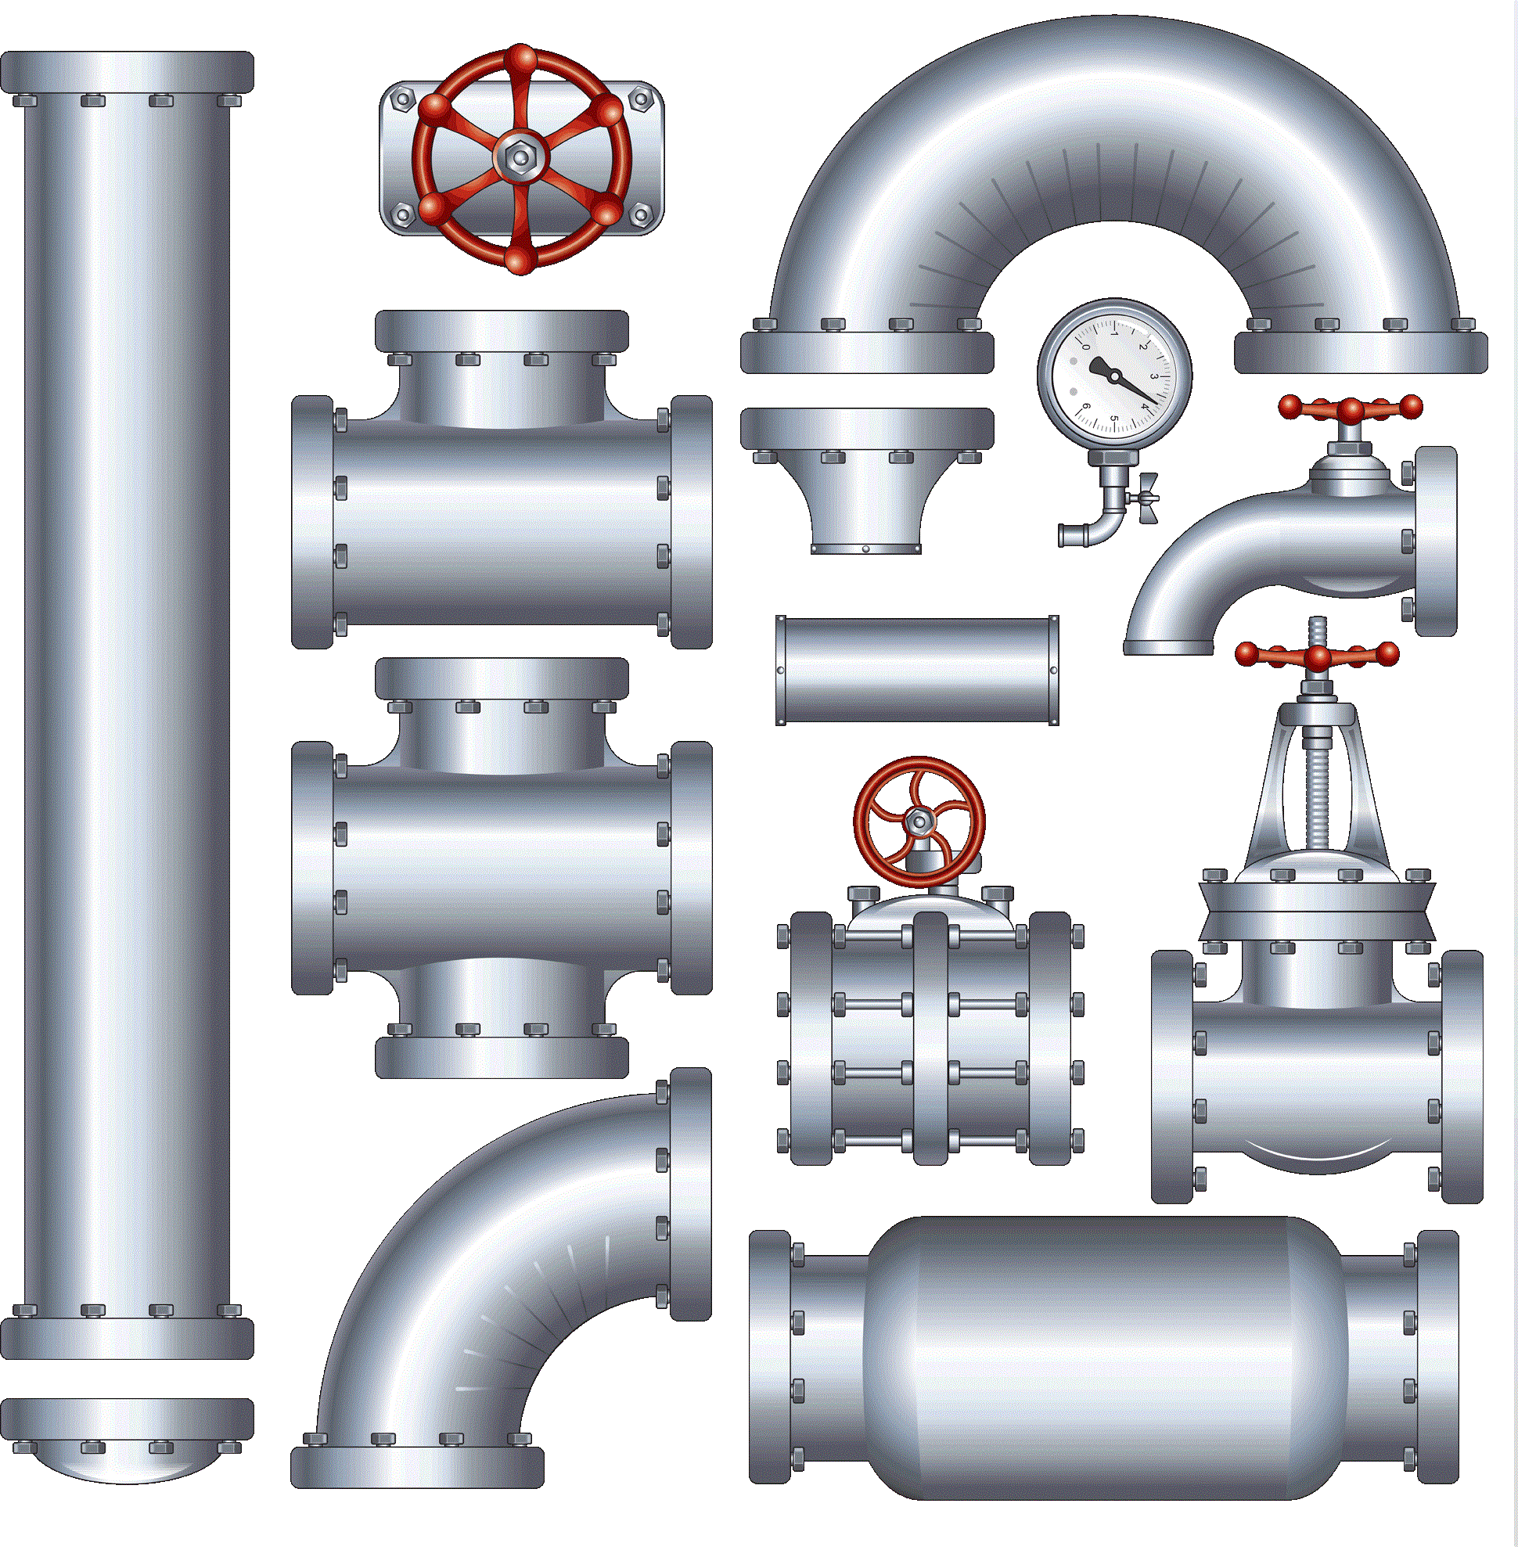
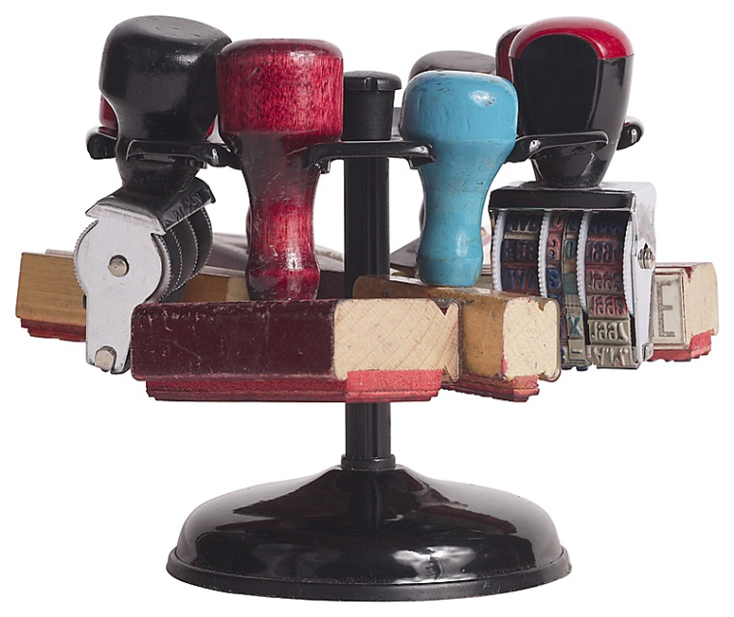
From Industrial, Information Revolutions to a Knowledge Revolution

Slide 9
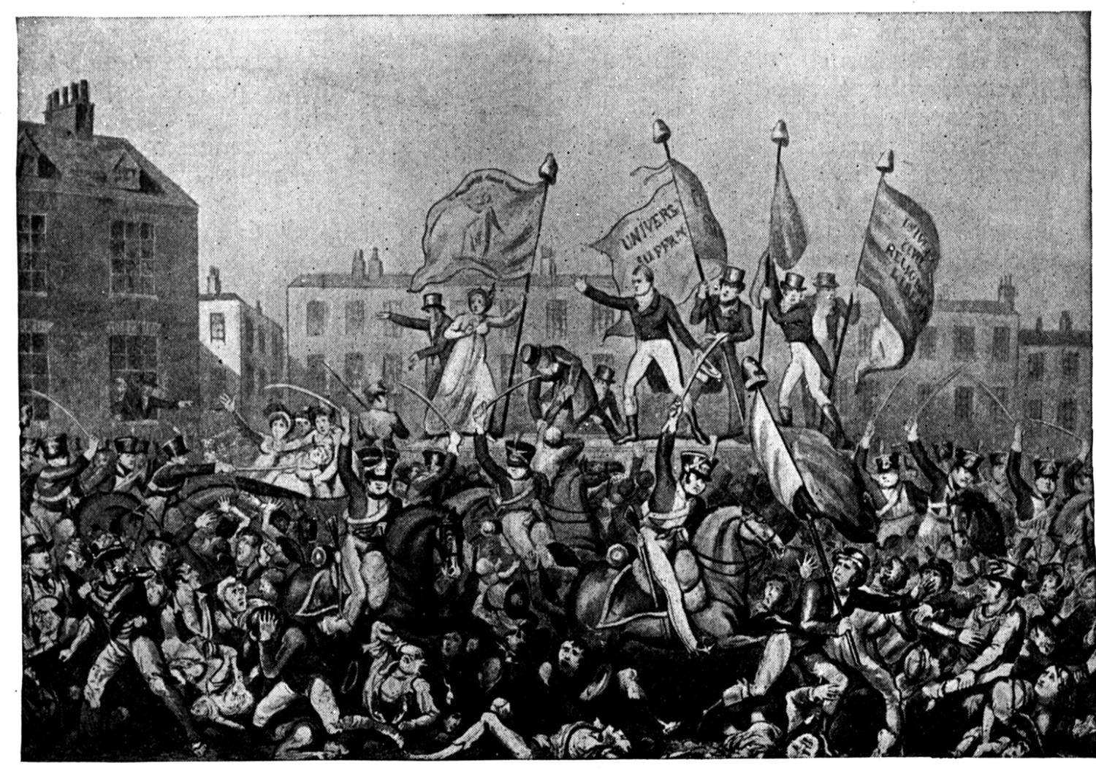
A revolution is not a dinner party, or writing an essay, or painting a picture, or doing embroidery; it cannot be so refined, so leisurely and gentle, so temperate, kind, courteous, restrained and magnanimous. A revolution is an insurrection, an act of violence by which one class overthrows another.
Mao Zedong, Report on an Investigation of the Peasant Movement in Hunan, Mao Zedong (1927)

Slide 10
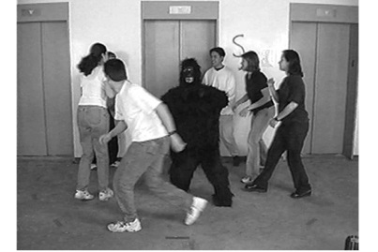
Selective Perception?

Slide 11
Knowledge Intermediary Principal-Agent Conflicts

Slide 12
Terence J. Johnson, Professions & Power (1972)
“The increase in the number of professionals and the growth of professionalism has generally been accepted by social scientists as a major if not defining characteristic of industrial societies.
So much so that a recent president of the American Sociological Association felt able to assert as his first official utterance that, “An industrializing society is a professionalizing society.”
…the professional [associations] are far from anti-bureaucratic; they themselves are bureaucratic mechanisms with the function of enforcing monopolistic practices.”

Slide 13
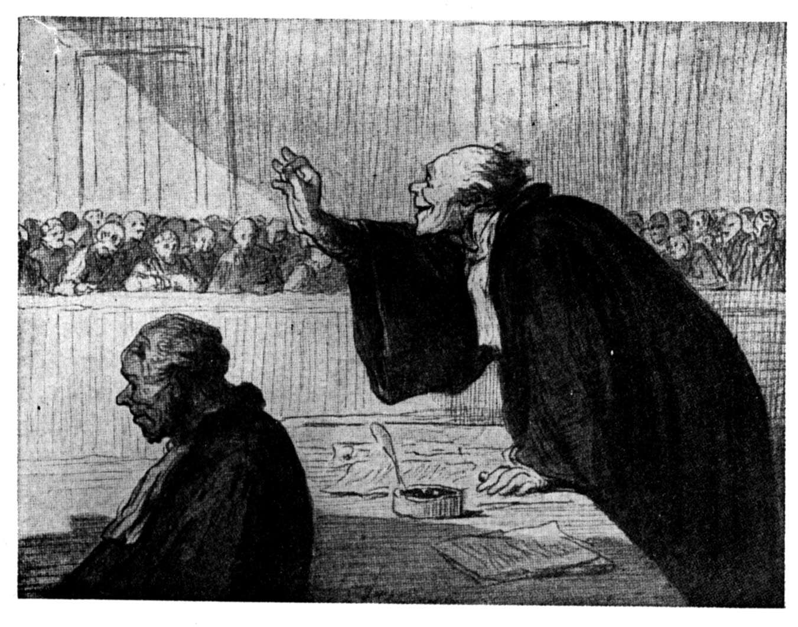
Market-Creating Innovation: If only the skilled and the rich have access to a product or a service today…

Slide 14
The Value Proposition for the Underserved 70% is Not Access

Slide 15
Transforming the Political Economy of Knowledge

Slide 16
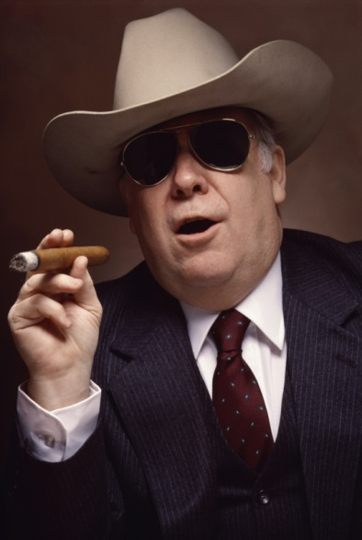
Meet the New Boss, Same as the Old Boss?

Slide 17
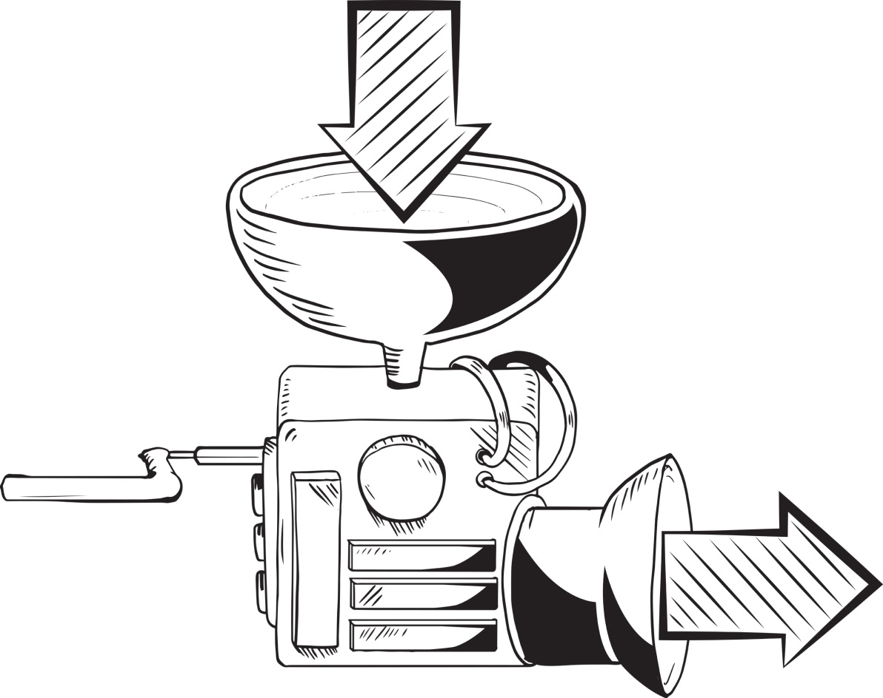
Governance Design Not for Consumption, but Self-Determination

Slide 18
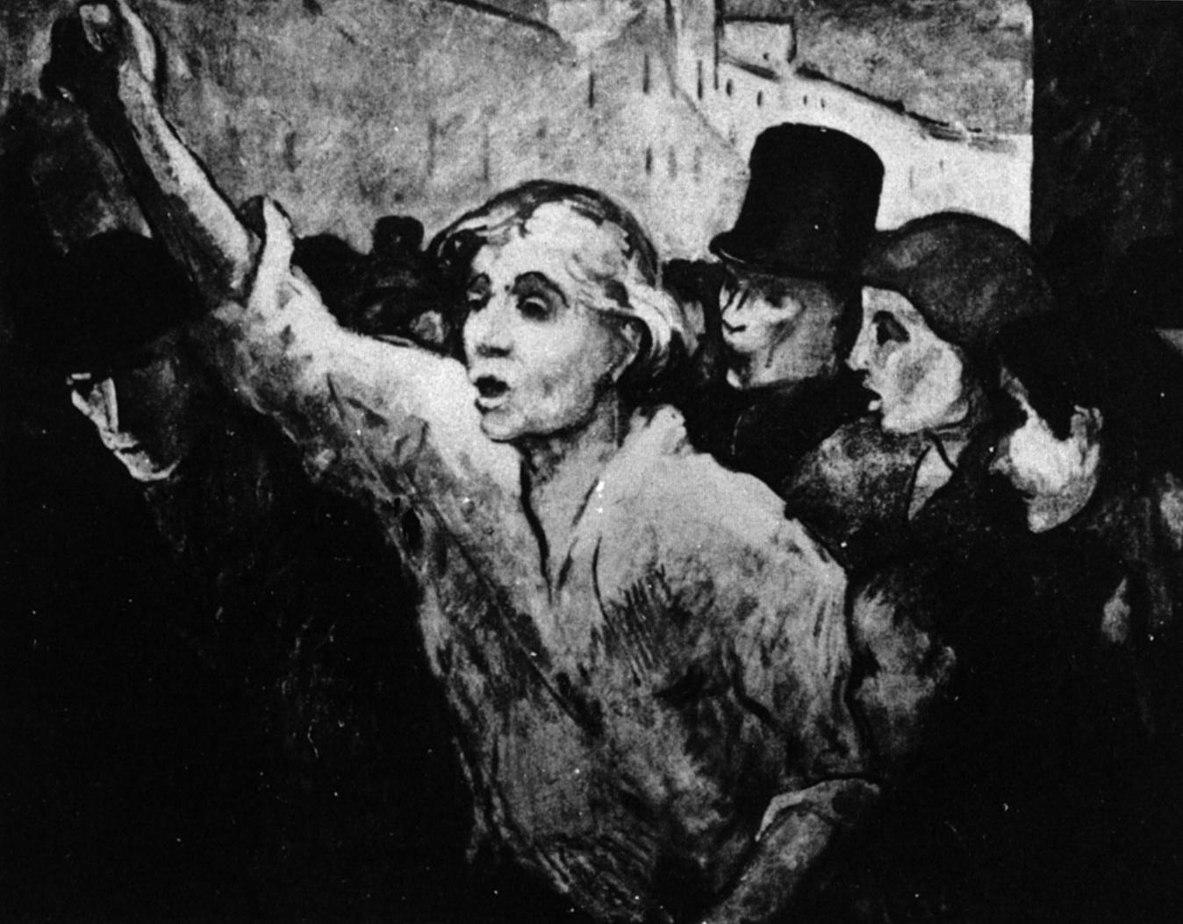
The question is, said Humpty Dumpty, which is to be master -- that’s all.

