Slide 1
DATA VIOLENCE
Dignity, Discrimination, and Algorithmic Identity
Anna Lauren Hoffmann | UC Berkeley | @annaeveryday

Slide 2
“
She died…because of his butchery. She wept and repeated over and over again, ‘It is not me, it is not me he is writing about. It’s a distortion.
He says I live in delusions, but it is he, he who does not see me, or anyone, as I am, as they are.
He makes everything ugly.’
-Anaïs Nin recounting June Miller’s reaction to her husband’s book, Tropic of Cancer

Slide 3
ALGORITHMS = CHOICES
▽
MORAL
▽
▽
TECHNICAL
PRACTICAL

Slide 4
ALGORITHMS = CHOICES
▽
MORAL
▾
SOCIAL JUSTICE

Slide 5
ALGORITHMS & SOCIAL JUSTICE
Algorithmic and automated processes increasingly shape the distribution of security and vulnerability
▾
▾
▾
RIGHTS &
LIBERTIES
WEALTH &
RESOURCES
DIGNITY &
SELF-RESPECT

Slide 7
“
Our self-respect...depends in part upon the respect shown to us by others; no one can long possess an assurance of his own value in the face of enduring contempt or even the indifference of others.
- John Rawls

Slide 8
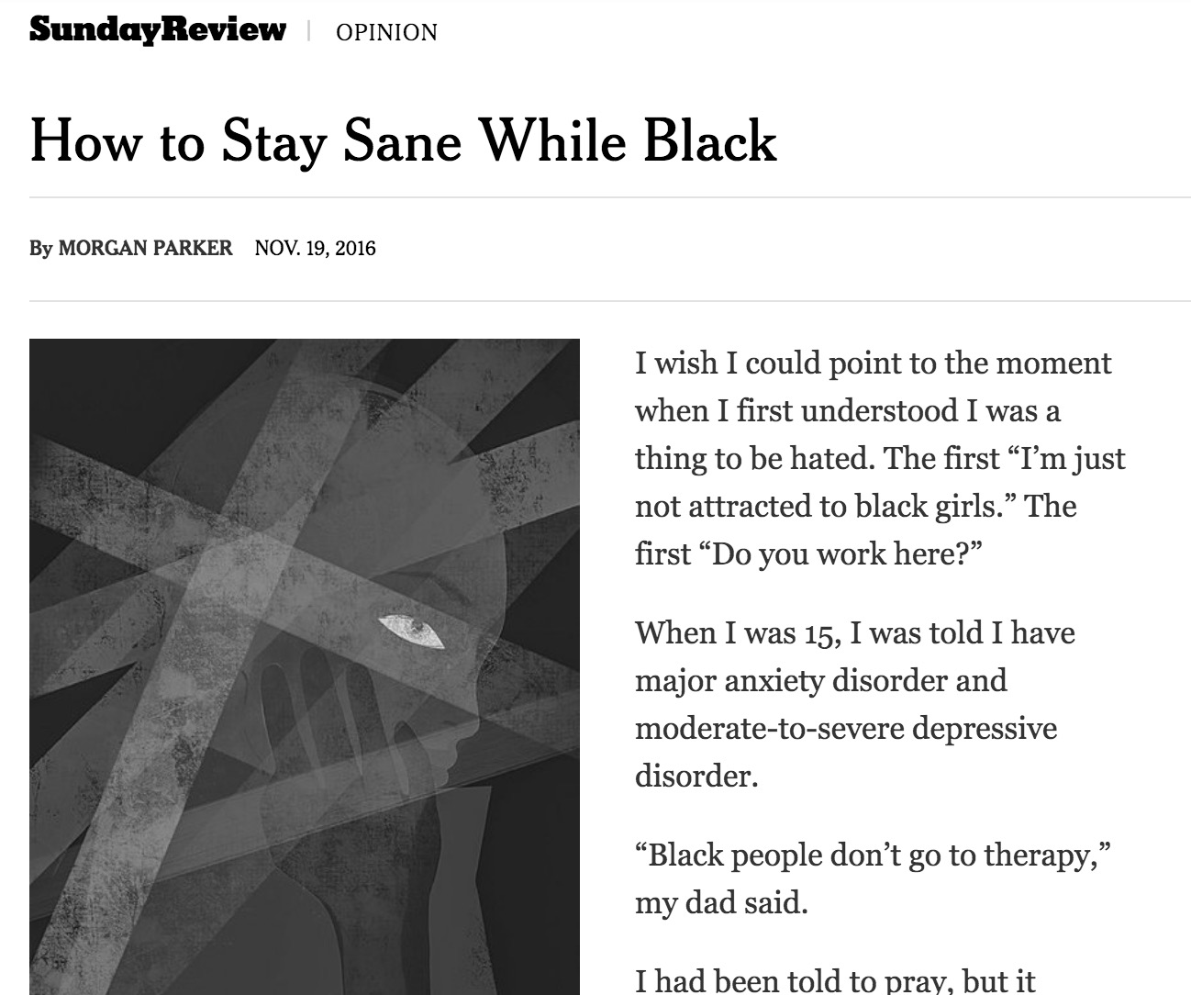

Slide 9
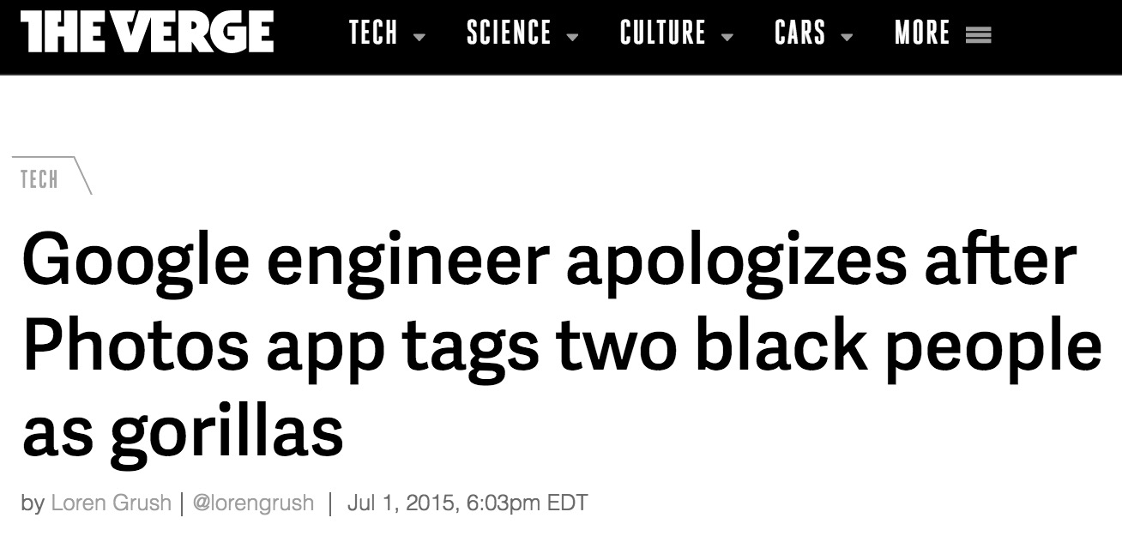

Slide 10
“
Where subordination and devaluation of a category of persons pervades social, cultural, and political reality, we should expect…the respect such persons can have for themselves to be shaped in particular ways.
- Robin Dillon

Slide 11
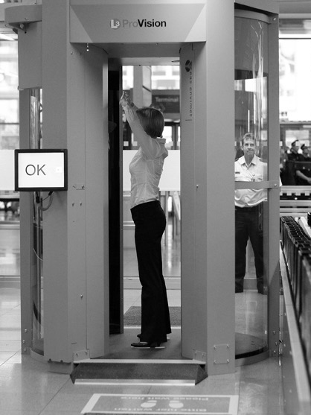
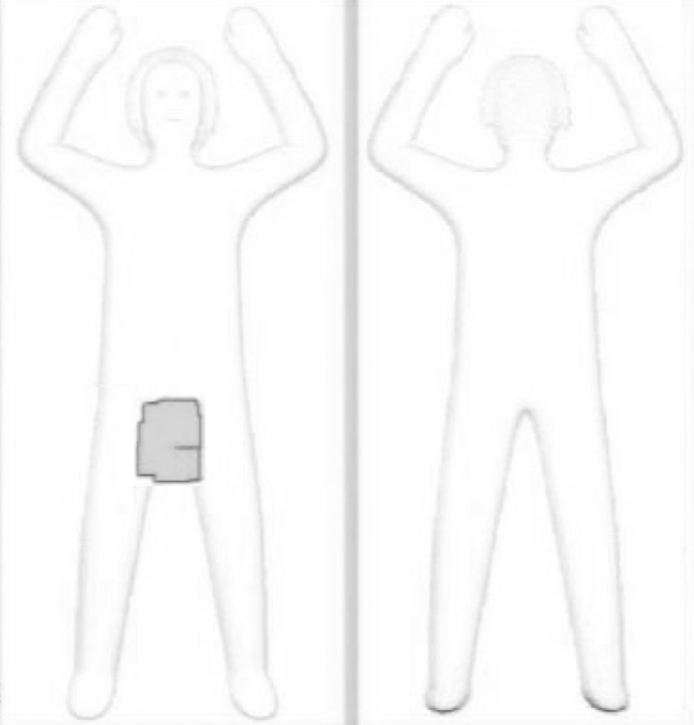

Slide 13
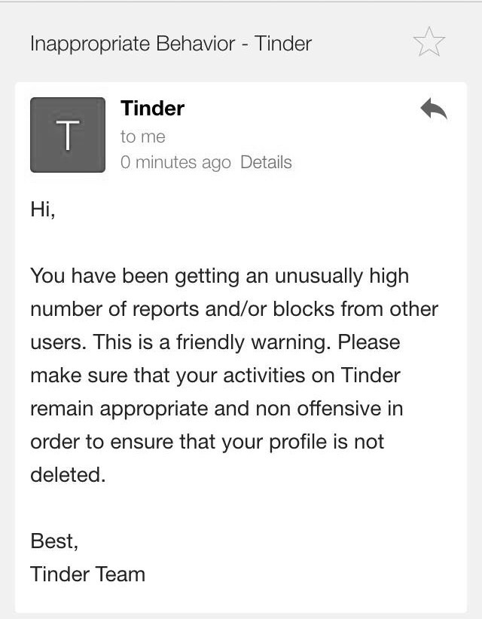
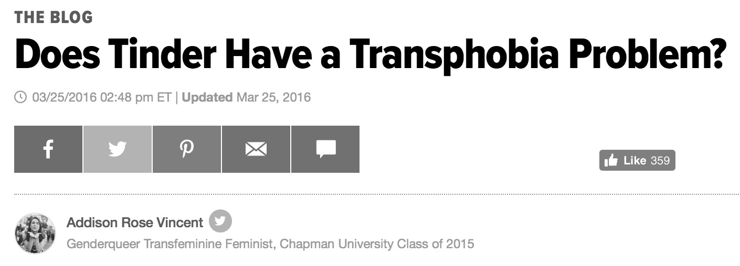

Slide 14
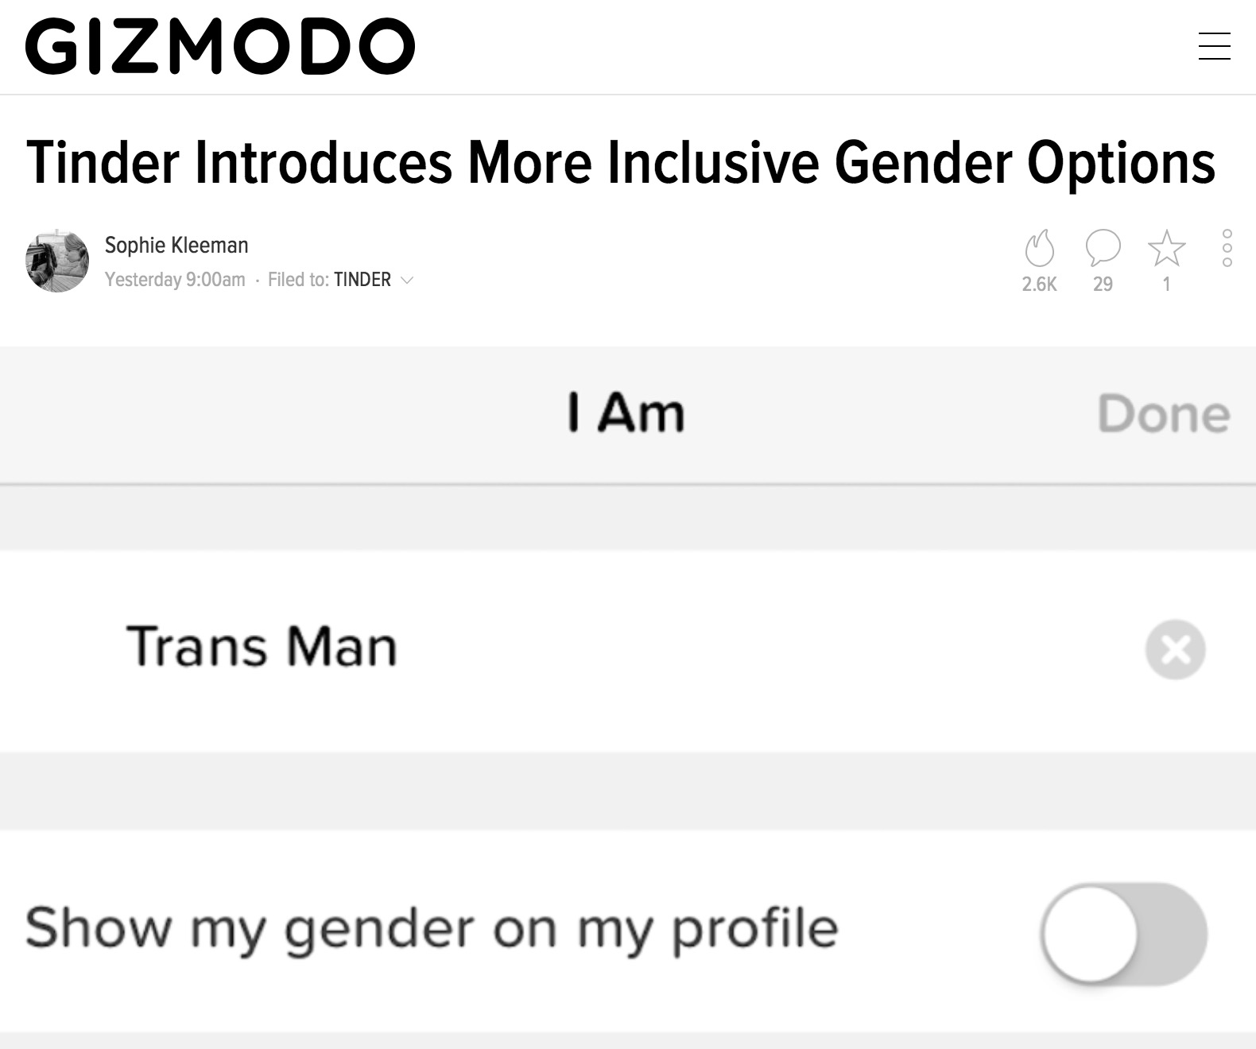

Slide 15
Data violence as a form of discursive violence
1) produced by and through data-intensive, algorithmically-mediated systems 2) that targets one’s dignity and self-respect

