Slide 1
Open algorithmic systems: lessons on opening the black box from Wikipedia
Stuart Geiger
@staeiou | stuart@stuartgeiger.com
Ethnographer/Postdoc
UC-Berkeley Institute for Data Science
21st Annual BCLT/BTLJ Symposium | Berkeley, CA | 20 April 2017

Slide 2
Itinerary
Wikipedia is heavily regulated by algorithms*
Wikipedians have been regulating participation in Wikipedia with algorithms for a long time
Many ideals of openness and transparency we are wanting from tech & govt are already part of Wikipedian principles and practices
But it isn’t a rosy utopian future, openness can paradoxically lead to inequality, as there are still many barriers to participation

Slide 3
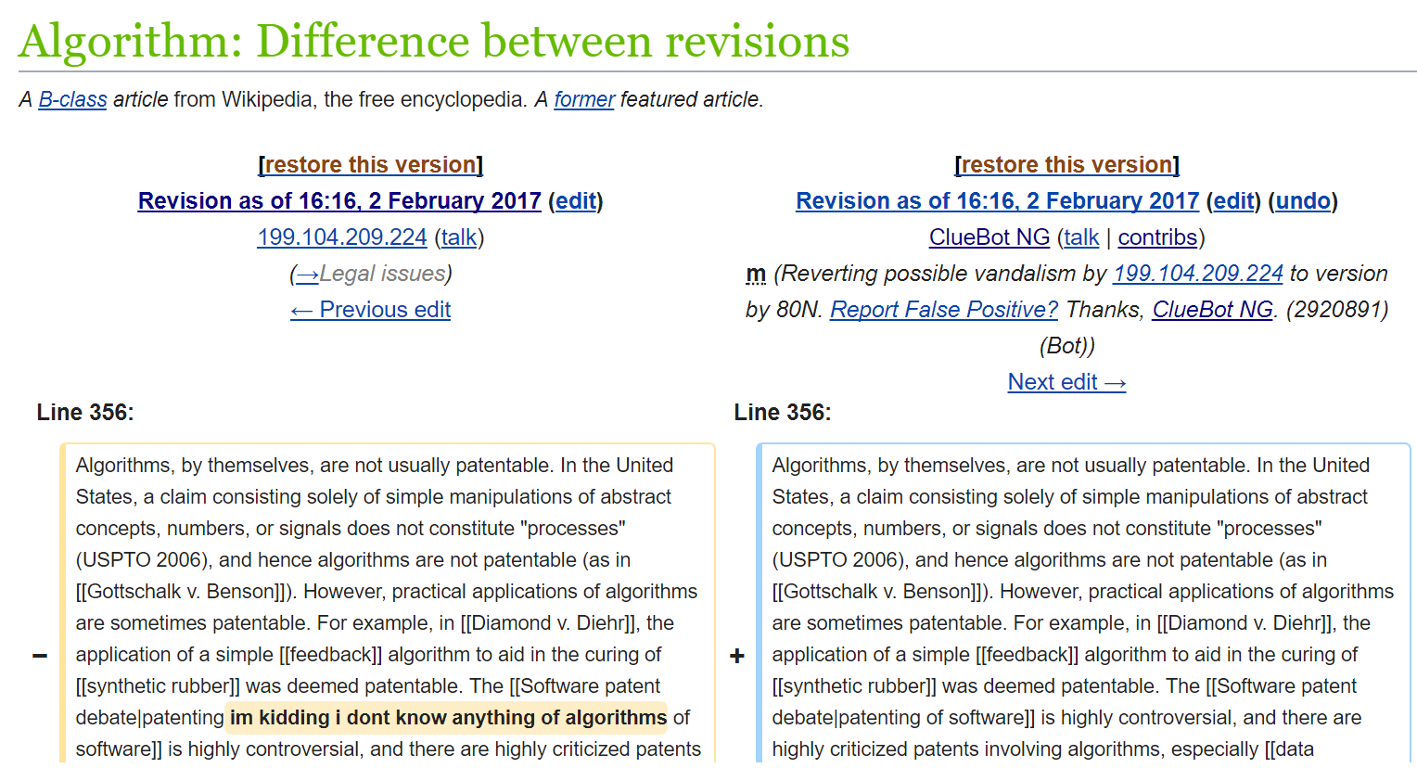
Wikipedia is heavily regulated by algorithmic systems
Notes:
1 min: this is a diff of an edit that was added to Wikipedia and then reverted less than a minute later by a fully-automated bot, using a machine learning classifier trained to detect ‘vandalism’
[read edit summary]

Slide 4
Wikipedia is heavily regulated by algorithmic systems
Bots make ~25-30% of all edits on English Wikipedia
Notes:
2 mins

Slide 5
Wikipedia is heavily regulated by algorithmic systems
Bots make ~25-30% of all edits on English Wikipedia
The most active quality control bot, ClueBot NG, has reverted 4.5 million edits, ~2,500-3,000 edits per day
Notes:
2 mins

Slide 6
Wikipedia is heavily regulated by algorithmic systems
Bots make ~25-30% of all edits on English Wikipedia
The most active quality control bot, ClueBot NG, has reverted 4.5 million edits, ~2,500-3,000 edits per day
About 75% of newcomers have their first interaction with either a fully-automated quality control bot or a human using a semi-automated tool to remove their edits
Notes:
2 mins

Slide 7
Wikipedia is heavily regulated by algorithmic systems
Bots make ~25-30% of all edits on English Wikipedia
The most active quality control bot, ClueBot NG, has reverted 4.5 million edits, ~2,500-3,000 edits per day
About 75% of newcomers have their first interaction with either a fully-automated quality control bot or a human using a semi-automated tool to remove their edits
Bots structure administrative processes & workflows
e.g. identifying conflicts, task assignment, ticketing queues
Notes:
2 mins

Slide 8
Wikipedia is heavily regulated by algorithmic systems
Bots make ~25-30% of all edits on English Wikipedia
The most active quality control bot, ClueBot NG, has reverted 4.5 million edits, ~2,500-3,000 edits per day
About 75% of newcomers have their first interaction with either a fully-automated quality control bot or a human using a semi-automated tool to remove their edits
Bots structure administrative processes & workflows
e.g. identifying conflicts, task assignment, ticketing queues
Bots standardize style/content based on wiki-wide policies
e.g. date formatting, word usage, article categorization
Notes:
2 mins

Slide 9
Wikipedia is heavily regulated by algorithmic systems
Bots make ~25-30% of all edits on English Wikipedia
The most active quality control bot, ClueBot NG, has reverted 4.5 million edits, ~2,500-3,000 edits per day
About 75% of newcomers have their first interaction with either a fully-automated quality control bot or a human using a semi-automated tool to remove their edits
Bots structure administrative processes & workflows
e.g. identifying conflicts, task assignment, ticketing queues
Bots standardize style/content based on wiki-wide policies
e.g. date formatting, word usage, article categorization
Bots & tools are volunteer-developed, regulated, and run
Notes:
2 mins

Slide 10
from:
Wikipedia is heavily regulated by algorithms
to:
Wikipedia is heavily regulated by people who design, build, use, discuss, and debate many different overlapping algorithmic systems
Notes:
I want to move us from the first to the second. Many of the major platforms make it very difficult to see the messiness of how the sausage is made. But this is all done in the open in Wikipedia. It also means that the discourses of algorithmic objectivity are far less prevalent in Wikipedia, because every veteran Wikipedian can recite multiple cases where the bots have gone horribly wrong, or ruthlessly implemented a task that they personally disagreed with. The best way to do this is history.
(10 mins left at this slide)

Slide 11
A brief history of algorithmic regulation in Wikipedia
January 2001: Wikipedia is founded
Notes:
3 mins for this slide

Slide 12
A brief history of algorithmic regulation in Wikipedia
January 2001: Wikipedia is founded
August 2001: An editor writes a bot to import Easton's Bible Dictionary, a public domain work written in 1897. A debate ensues on the mailing list.
Notes:
3 mins for this slide

Slide 13
A brief history of algorithmic regulation in Wikipedia
January 2001: Wikipedia is founded
August 2001: An editor writes a bot to import Easton's Bible Dictionary, a public domain work written in 1897. A debate ensues on the mailing list.
October 2002: RamMan deploys RamBot, which doubles the size of Wikipedia by creating articles for every U.S. city and town based on census data.
Notes:
3 mins for this slide

Slide 14
A brief history of algorithmic regulation in Wikipedia
January 2001: Wikipedia is founded
August 2001: An editor writes a bot to import Easton's Bible Dictionary, a public domain work written in 1897. A debate ensues on the mailing list.
October 2002: RamMan deploys RamBot, which doubles the size of Wikipedia by creating articles for every U.S. city and town based on census data.
October 2002: Wikipedians debate the impact of RamBot and begin working on a Wikipedia-wide bot policy (“Avoid using bots”) and a consensus-based bot approval process.
Notes:
3 mins for this slide

Slide 15
A brief history of algorithmic regulation in Wikipedia
January 2001: Wikipedia is founded
August 2001: An editor writes a bot to import Easton's Bible Dictionary, a public domain work written in 1897. A debate ensues on the mailing list.
October 2002: RamMan deploys RamBot, which doubles the size of Wikipedia by creating articles for every U.S. city and town based on census data.
October 2002: Wikipedians debate the impact of RamBot and begin working on a Wikipedia-wide bot policy (“Avoid using bots”) and a consensus-based bot approval process.
April 2004: The bot policy and approval process stabilizes, with 6 active approved bots that do minor cleanup tasks
Notes:
3 mins for this slide
Any fans of the federal register 1037C glossary of telecommunications terms

Slide 16
A brief history of algorithmic regulation in Wikipedia
2005-2006: Wikipedia becomes popular, starts exponential growth phase (in terms of readers, edits, and editors)
Notes:
3 mins for this slide

Slide 17
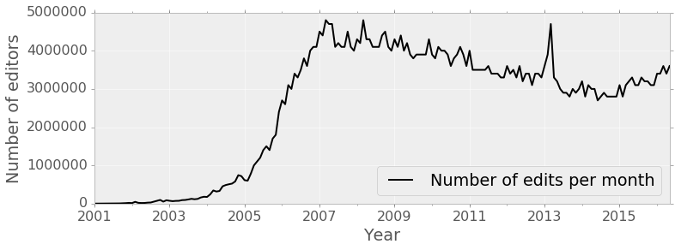
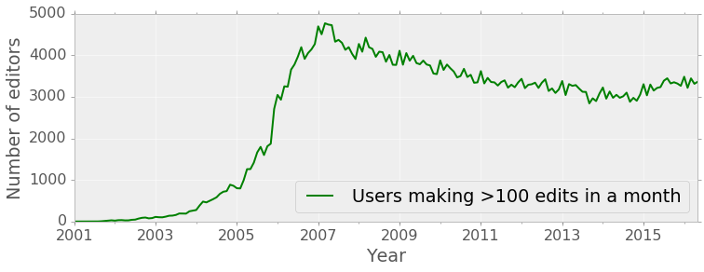
A brief history of algorithmic regulation in Wikipedia
2005-2006: Wikipedia becomes popular, starts exponential growth phase (in terms of readers, edits, and editors)
Notes:
3 mins for this slide

Slide 18
A brief history of algorithmic regulation in Wikipedia
2005-2006: Wikipedia becomes popular, starts exponential growth phase (in terms of readers, edits, and editors)
February 2006: An administrator creates the first auto-reverting anti-vandalism bot based on bad word lists, designed to combat a wave of vandalism across the site
Notes:
3 mins for this slide

Slide 19
A brief history of algorithmic regulation in Wikipedia
2005-2006: Wikipedia becomes popular, starts exponential growth phase (in terms of readers, edits, and editors)
February 2006: An administrator creates the first auto-reverting anti-vandalism bot based on bad word lists, designed to combat a wave of vandalism across the site
January 2008: Semi-automated vandal fighting tools are created to send ‘suspicious’ edits to on-call Wikipedians for instant review (a Mechanical Turk-style process)
Notes:
3 mins for this slide

Slide 20
Semi-automated moderation support tools
Notes:
3 mins for this slide

Slide 21
A brief history of algorithmic regulation in Wikipedia
2005-2006: Wikipedia becomes popular, starts exponential growth phase (in terms of readers, edits, and editors)
February 2006: An administrator creates the first auto-reverting anti-vandalism bot based on bad word lists, designed to combat a wave of vandalism across the site
January 2008: Semi-automated vandal fighting tools are created to send ‘suspicious’ edits to on-call Wikipedians for instant review (a Mechanical Turk-style process)
October 2010: ClueBot NG, the first counter-vandalism bot using a machine learning classifier, is approved
Notes:
3 mins for this slide

Slide 22
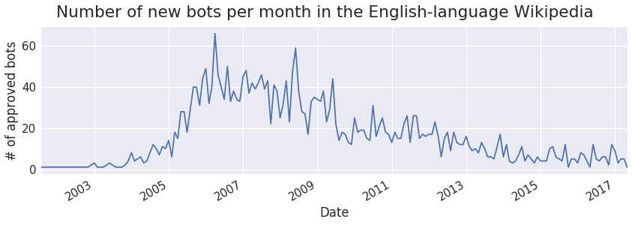
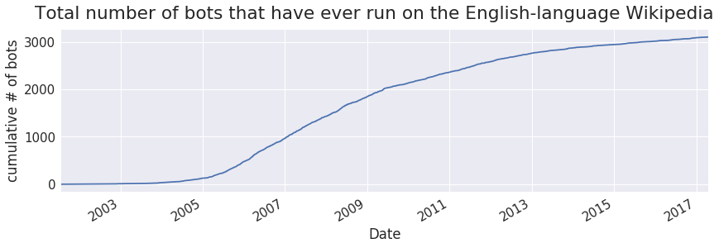
Source: https://github.com/staeiou/wiki-stat-notebooks/bot-history

Slide 23
Wikipedia’s bot approval process
today

Slide 24
Imagine an algorithmic utopia, where people have strong ideals of openness:
People write proposals about new or existing algorithmic systems in the platform, which anyone can read & comment on
Notes:
So imagine, if you will, a utopia where people have strong ideals of openness

Slide 25
Imagine an algorithmic utopia, where people have strong ideals of openness:
People write proposals about new or existing algorithmic systems in the platform, which anyone can read & comment on
Proposals have a ‘plain language’ description of what it will do, how it will make decisions, and who is responsible for it
Notes:
So imagine, if you will, a utopia where people have strong ideals of openness

Slide 26
Imagine an algorithmic utopia, where people have strong ideals of openness:
People write proposals about new or existing algorithmic systems in the platform, which anyone can read & comment on
Proposals have a ‘plain language’ description of what it will do, how it will make decisions, and who is responsible for it
There is a committee (of programmers and non-programmers) who review and discuss these proposals
Notes:
So imagine, if you will, a utopia where people have strong ideals of openness

Slide 27
Imagine an algorithmic utopia, where people have strong ideals of openness:
People write proposals about new or existing algorithmic systems in the platform, which anyone can read & comment on
Proposals have a ‘plain language’ description of what it will do, how it will make decisions, and who is responsible for it
There is a committee (of programmers and non-programmers) who review and discuss these proposals
There is an open infrastructure provided to run & audit algorithmic systems (at no cost to the developer), but code must be open source
Notes:
So imagine, if you will, a utopia where people have strong ideals of openness

Slide 28
Imagine an algorithmic utopia, where people have strong ideals of openness:
People write proposals about new or existing algorithmic systems in the platform, which anyone can read & comment on
Proposals have a ‘plain language’ description of what it will do, how it will make decisions, and who is responsible for it
There is a committee (of programmers and non-programmers) who review and discuss these proposals
There is an open infrastructure provided to run & audit algorithmic systems (at no cost to the developer), but code must be open source
There are public, meta-level discussions about the standards and enforcement used at various levels in this process
Notes:
So imagine, if you will, a utopia where people have strong ideals of openness

Slide 29
Imagine an algorithmic utopia, where people have strong ideals of openness:
People write proposals about new or existing algorithmic systems in the platform, which anyone can read & comment on
Proposals have a ‘plain language’ description of what it will do, how it will make decisions, and who is responsible for it
There is a committee (of programmers and non-programmers) who review and discuss these proposals
There is an open infrastructure provided to run & audit algorithmic systems (at no cost to the developer), but code must be open source
There are public, meta-level discussions about the standards and enforcement used at various levels in this process
Academics are invited to participate in this process, evaluating, co-designing, and ‘thinking with’ people who design & build it
Notes:
So imagine, if you will, a utopia where people have strong ideals of openness

Slide 30
Notes:
Yay, Wikipedia did it. The end.

Slide 31
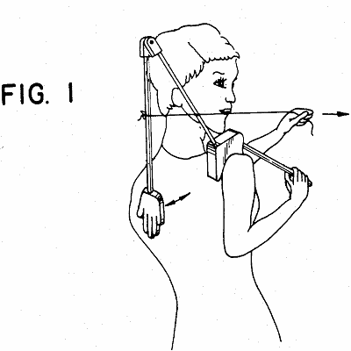
Notes:
But before we pat ourselves on the back, we should look at how openness takes place.
Because we know that openness != access != participation != representation != community (see a long line of people including Freeman 1970, Ostrom 1990, Frasier 1990, to Wikipedia specific work like Ford and Geiger 2012, Reagle 2012, Morgan et al 2013, Sen et al 2015, Osman 2015, Tkacz 2015 and many more)

Slide 32
The paradox of openness
Openness does not necessarily lead to universal access, participation, representation, inclusion, or community -- it can actually exacerbate inequality
(see a long line of people including Freeman 1970, Ostrom 1990, Frasier 1990, to Wikipedia specific work like Ford and Geiger 2012, Reagle 2012, Morgan et al 2013, Osman 2015, Tkacz 2015 and many more)
Notes:
1 min

Slide 33
Barriers to participation
Some technical literacy and opacities inherent in machine learning, but that is not the major area of concern
Organizational opacity/literacy
Communications platforms used
Organizational norms and processes
Jargon and terms of art
Like many OSS communities, Wikipedia is conflict-driven and antagonistic, which impacts who participates
Selection bias, people must:
learn that the process exists from somewhere
volunteer their valuable time to participate
believe they will have agency & be heard
Notes:
2 minutes
So those are cases where Wikipedian volunteers were able to successfully “look into the black box” and make valuable feedback that changed how these algorithmic systems were built. But just because you make something open doesn’t mean that everyone is going to participate. Decades of experience in open source and Wikipedia shows us that there are many barriers to participation, even in systems that are officially open to public participation.
There is still the technical literacy and opacities inherent in machine learning that Burrell talks about, although I want to add some additional kinds of opacities. And these are the organizational opacities that come with participating in a system like Wikipedia. First there are the communications platforms used. Some people use wikis, IRC, ticketing systems, and code repositories every day and know them very well, while other people have never used them before and find them weird and confusing.
Second, there are the organizational norms and processes that are specific to a given project or platform. How to participate in a wiki talk page (particularly when things get heated) isn’t just an issue of knowing how to use MediaWiki, as Heather Ford and I have argued. It is also about norms, policies, and expectations that get debated and formalized in pages like WP:Consensus, the Bots policy and Bot Approvals Group, or “Bold, Revert, Discuss.”
And finally, there is a lot of jargon and terms of art. A “revert” has a specific definition and meaning to Wikipedians. It is something one does in the software, but it also implies something socially specific in the community. Same with “good faith.” Wikipedians talk about namespaces or “Meta” in ways that are really productive shorthands for those in the know, but can be difficult for newcomers to understand.

Slide 34
Notes:
As lessig argues, code is law b/c it has the force of law

Slide 35
A more public policy approach to ‘code is law’
In practice, code is law in Wikipedia in that it is a complex text that people read, summarize, discuss, negotiate, contest, and appeal. Code does not just have political implications -- it is also a site in which politics takes place.

