Slide 1
An Über-Ambivalence: The Role of employment Status in Worker collectivities
Professor V.B. Dubal
University of California, Hastings College of the Law

Slide 2
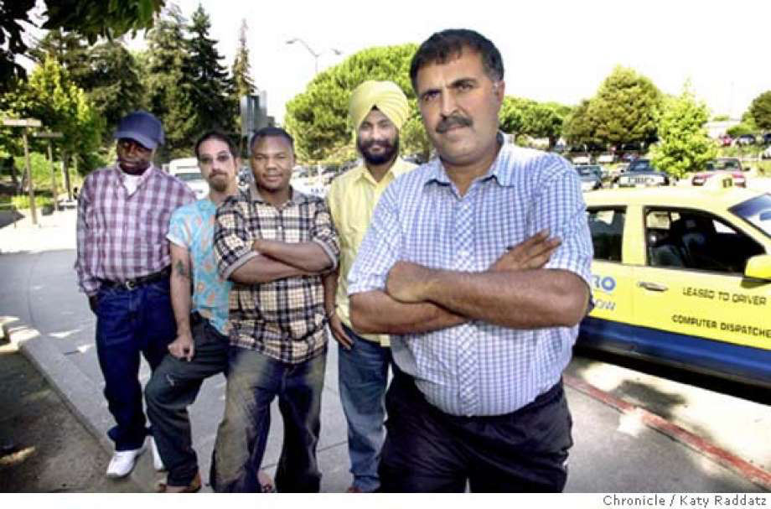
Sources: http://www.sfgate.com/bayarea/article/EAST-BAY-Cabbies-join-union-after-labor-board-2738125.php and http://www.dailymail.co.uk/tvshowbiz/article-2600530/Shahs-Sunsets-Lilly-Ghalichi-makes-sure-people-notice-1-2-million-engagement-ring-dinner-date-fiance-Dhar-Mann.html

Slide 3
PUZZLES.
How do atomized and rights-strips workers organize, and how and why do state and non-state actors aid or abet them in their fights?
How do workers and their supporters make sense of and deal with the burden of the law: the fact that independent contractors are carved out of employment laws?

Slide 4
EMPLOYEES ONLY: REGIME OF RIGHTS UNAVAILABLE TO INDEPENDENT CONTRACTORS
RIGHT | LAW
Minimum Wage | FLSA
Workers’ Compensation | State Laws
Unemployment Insurance | State Laws
Collective Bargaining | NLRA
Job Protection & Unpaid Leave | FMLA
Safety and Health Protections | OSHA
Medicare | SSA
Pension | ERISA
Prohibition Against Discrimination | Title VII, ADA, ADEA
Retirement & Disability | SSA

Slide 5
RESEARCH METHODOLOGIES.
Surveys (co-investigator Professor Ruth Collier, Chris Carter, UC Berkeley)
administered during UberX rides in San Francisco
~200 surveys completed
Ethnography:
Qualitative Interviews
Participant Observation
“Hanging Out”

Slide 6
SF UBERX DRIVERS: “Would you prefer to be an employee or an independent contractor, and why?”

Slide 7
Ethnography: Ambivalent Worker Perspective on Employment Identities.
“Well, maybe not me personally because eventually I would like to move on to another job. But it would be nice to be able to have like paid time off though. But at the same rate, Uber’s a horrible company. If they did have us as employees, they may be a lot more strict in terms of the customer feedback. Maybe if a customer gave really bad feedback, they may fire us. …” –Paul, 35 year old white man

Slide 8
Ethnography: Ambivalent Worker Perspective on Employment Identities.
“When they [Uber and Lyft] started dropping the prices in this price war and I just kept working more and more and more to where I’m going I’m working 60, 70 hours a week. You know, over Christmas, I worked what, 60 hours every week but the last week of December and by the time all my expenses were done, I had $200 leftover. So my family for Christmas presents got to go to Star Wars, that’s it. No popcorn, you know, because it’s $30 to get into the movies. “
-Kelsey Tilander, white man in his mid-50s, involved father of 9 year old girl, helping to organize workers to join Teamsters

Slide 9
Labor’s Schism over Uber Organizing.
Fight for Employee Status | Relinquish Employee Status
National AFL-CIO | Teamsters Local 117 (Seattle)
National Taxi Workers Alliance (alt labor, AFL-CIO) | Teamsters Joint Council 7 (Northern California, Central California, Northern Nevada)
 | Silicon Valley Rising (alt labor)
 | Machinists District 15 (Independent Drivers’ Guild – New York City)
 | Free Lancers’ Union (alt labor)

Slide 10
Ethnography: Ambivalent Worker Perspective on Employment Identities.
“I don’t care. These companies – taxis, Uber, Lyft, they are the same. They control us. We work hard; we make little money. They do what they want. We can’t. That’s the point, Miss Veena.” (emphasis added)
--Anwar Zadran, 55-year-old Uber/Lyft driver, former taxi driver

