Slide 1
Consent and Contract under EU Data Protection Law
Paul M. Schwartz
BCLT Privacy Law Forum: Silicon Valley
March 24, 2017
Twitter: @paulmschwartz

Slide 2
My Co-Author Professor Peifer
Prof. Dr. Karl-Nikolaus Peifer
Director,
Institute for Media Law
And Communications Law
And Director,
Institute for Broadcasting Law
University of Cologne

Slide 3
Katherine Tassi, Snap

Slide 4
Lindsey L. Tonsager, Covington & Burling

Slide 5
Dr. Kai Westerwelle, Taylor Wessing

Slide 6
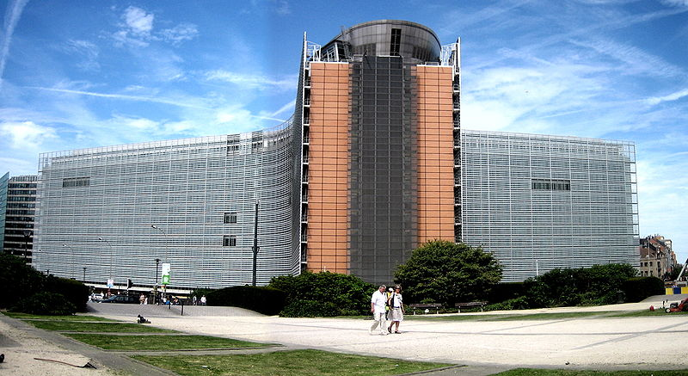
Overview
Different visions of Data Privacy
Shared Doctrine: Contract and Consent
EU: Rights Talk in Action
US: Protecting the Privacy Consumer
Data Privacy’s International Future

Slide 7
Different Visions of Data Privacy: the EU
“Rights talk”: strong constitutionalization of privacy and data protection
Statutory laws anchored in constitution rights
Proportionality test to protect privacy
European Court of Justice, Luxembourg

Slide 8
Different Visions of Data Privacy: the US
Weak constitutional protections for information privacy
Strong constitutional protections for free flow of information
“Marketplace discourse”: protection of privacy consumer in marketplace

Slide 9
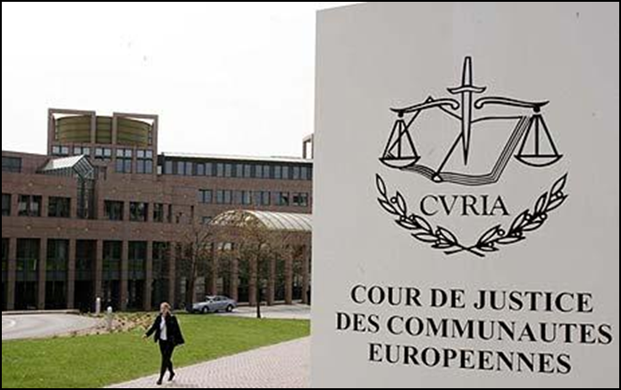
EU: Rights Talk in Action
Strong limits on contract and consent in EU
“EU data protection puts a core of important data privacy rights beyond the ability of a person to trade because such individual behavior would both erode a capacity of self-determination and have a negative collective impact.”
Contract and consent cannot trump the GDPR’s fundamental rules, including legal basis for processing, data minimization, and purpose specification.

Slide 10
GDPR on Consent, Article 7
If consent presented as part of written declaration concerning other matters, “the request for consent must be presented in a manner which is clearly distinguishable from the other matters, in an intelligible and easily accessible form, using clear and plain language”
Right to withdraw consent at any time.
Notes:
“It shall be as easy to withdraw consent as to give it”

Slide 11
GDPR on Consent, Article 7
“When assessing whether consent is freely given, utmost account shall be taken of the fact whether, among others, the performance of a contract, including the provision of a service, is made conditional on the consent to the processing of data that is not necessary for the performance of this contract.”

Slide 12
US: Protecting the Privacy Consumer
Main privacy inalienability is that of mandated disclosure requirements
Contract largely irrelevant– for data processors, a realm of “heads, I win; tails, you lose.”
Consent plays a limited role in U.S. law. Minor role for “warning function” -- opt-in.

Slide 13
Data Privacy’s International Future (1)
“Rights talk” is a key part of the EU project
“Privacy consumers” ties into deep-rooted US concepts
A shift to institutions: e.g., Privacy Shield: Data Integrity, Choice, Enforcement and Oversight

Slide 14
Privacy Shield (2016)

Slide 15
Privacy Shield (2016)

Slide 16
A Way Forward?
Law is “agreement about the things that are fundamental.” Cardozo, 1924

Slide 17
Data Privacy’s International Future (2)
New Institutions and New Structures
New understandings of data privacy to be created in international institutions and new processes
European Data Protection Board
Privacy Shield – deputizes U.S. institutions, officials and private parties to enforce the interests of EU citizens

Slide 18
Katherine Tassi, Snap

Slide 19
GDPR, Article 6, “legitimate interests”
Article 6: Processing is lawful when it “is necessary for the purposes of the legitimate interests pursued by the controller or by a third party except where such interests are overridden by the interests or fundamental rights and freedoms of the data subject which require protection of personal data…”

Slide 20
GDPR, Article 47, “legitimate interests
Recital 47: “The legitimate interests of a controller … or of a third party, may provide a legal basis for processing, provided that the interests or the fundamental rights and freedoms of the data subject are not overriding, taking into consideration the reasonable expectations of the data subjects based on their relationship with the controller.”

Slide 21
Katherine Tassi, Snap
Will the “legitimacy” basis in GDPR turn into important grounds for processing for US companies?
Is the future one of segregation of EU personal data from the rest of the world’s?

Slide 22
Lindsey L. Tonsager, Covington & Burling

Slide 23
Lindsey L. Tonsager, Covington & Burling
Are US and EU privacy laws really different?
Can the GDPR actually be value-added for your business?

Slide 24
Dr. Kai Westerwelle, Taylor Wessing

Slide 25
Dr. Kai Westerwelle, Taylor Wessing
Threats to the Privacy Shield and Model Clauses: the State of Play
Privacy Shield under scrutiny
Schrems II: Model Contractual Clauses
Opinions of EU Regulators

Slide 26
Question and Answer Period

