Slide 1
ELQ Blurb Writing
Research Guide
Prepared by Leah Granger, 2012.
Revised by I-Wei Wang, 2013.
Revised by Dean C. Rowan, 2014.

Slide 2
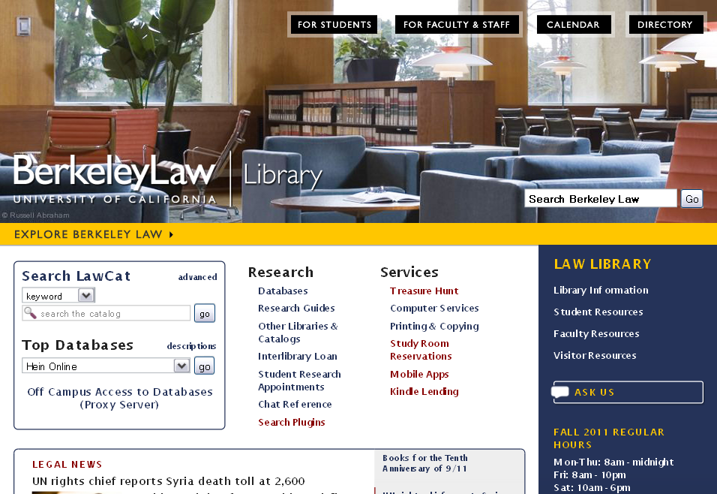
Writing Process Aids
J.D. Writing Requirement
Choosing a topic
Research
Organizing your work
Getting published
Environmental Law Research Guides
Georgetown
Vermont
Lewis & Clark
Berkeley Law
Student Research Appointments

Slide 3
Academic Scholarship
Research Tools for the Writing Process
Secondary Analysis, Current Awareness, Cases, Statutes, Regulations, & Staying Organized
Additional Resources
Eugene Volokh, Academic Legal Writing: Law Review Articles, Student Notes, Seminar Papers, and Getting on Law Review (4th ed. 2010) (Reserve Collection KF250 .V65 2010).
Elizabeth Fajans & Mary R. Falk, Scholarly Writing For Law Students: Seminar Papers, Law Review Notes, and Law Review Competition Papers (4th ed. 2011) (Reserve Collection KF250 .F35 2011).
Wendy Laura Belcher, Writing Your Article in 12 Weeks: A Guide to Academic Publishing Success (Reserve Collection KF250.B45 2009).
Jessica L. Clark, Scholarly Writing: Ideas, Examples, and Execution (Stacks KF250.C528 2010).
Francis A. Gabor, Guide to Legal Research and Writing from the Transnational Perspective (2008) (Stacks K85 .G33 2008).
Eugene Volokh, Writing a Student Article, 48 J. Legal Educ. 247 (1998).

Slide 4
General Guidelines
Write about something interesting!
Say something original.
Be
Comprehensive
Correct
Logical
Clear
Readable

Slide 5
The Process of Scholarly Writing
The Process of Scholarly Writing Writer-Centered → Reader-Centered
STAGE | Prewriting: Reading, Notetaking, Thinking |  |  | Writing as Learning |  | Writing as Communication
PURPOSE | 1. Finding a Topic | 2. Narrowing the Topic | 3. Creating a Thesis | 4. Getting Started | 5. Writing Drafts |  | 6. Revising and Polishing

Slide 6
Types of Critical Scholarship
Comparative
analysis of development or controversy in the law (comment)
law across jurisdictions
Summative
analysis of a single judicial opinion (case note)
analysis of legislation
Historical/Theoretical
needed reform / re-envisioning of an issue
origins and development of a rule
discussions of the legal profession (ethics, practice, education, language)
Interdisciplinary/ Empirical
insights from another field (psychology, economics, sociology)
analysis of trends & hard data

Slide 7
Book reviews
Not a book report!
Describe, identify > compare, contextualize
Critique > suggest
Evaluate > enable informed decision
Humility … and a grain of salt

Slide 8
Case notes – structure
Background/history
Short and sweet
Discussion/analysis
Prove your claim – doctrinal, policy levels
Your arguments – turn problems to your advantage
Interesting implications and twists?
Connect to broader context
Iterative process

Slide 9
Case notes – structure
Introduction (last)
Show a problem, concretely
Your claim: novelty, non-obviousness, and utility
Frame the issue: roadmap
Restate claim
Briefly summarize proof
Remind us …
Conclusion (last)
utility

Slide 10
Case Notes . . . So, what now?
Read, read again. . .
Discuss/brainstorm/list
Context: books & treatises, articles, news
Background: briefs, decisions below
“Deep” background
Regulations
Central statute, its history

Slide 11
Context – subject area
Books – LawCat (law library), OskiCat (other):
keyword search (clean air act)
subject browse (climatic changes)
Treatises & study aids:
Environmental Law by William H. Rodgers (KF3775 .R59 1986) on Westlaw
Treatise on Environmental Law by Frank P. Grad (KF3775 .G72) on Lexis
Rulemaking, agency deference:
Understanding Administrative Law (KF5402 .F67 2012)
Funk & Seamon, Administrative Law (E&E outline)
Standing/ripeness
Civil Procedure hornbook (KF8840 .F72 2005)
Federal Jurisdiction In a Nutshell (KF8858.Z9 C87 1999)
News & current events
Scholarly & in-depth articles

Slide 12
Context – Case, decision below & subject area
Current Awareness
Greenwire (environmental policy news)
ProQuest Newspapers (NYT, LATimes, WSJ – add Alt, Ethnic)
Access World News (local/regional)
Journal Articles
Via Westlaw
Concise discussions of specific legal topics
Surveys of state law with extensive case citations
Factiva (local/regional)
ILP & LegalTrac
Legal Scholarship Network & bePress Legal Repository
ALR
Bloomberg BNA
U.S. Law Week
Set up emails (3-min. screencast)
Political tracking
Historical overviews
News
Using Google/GScholar
Effectively
For citations/eLinks
Other disciplines
Topical journals on Westlaw/Lexis
BNA Law Reports on Bloomberg Law
Law360 Environment & Knowledge Mosaic Daily Energy News
CQ Weekly & CQ Researcher
Envt. Reporter

Slide 13
BACKGROUND – briefs & decisions below
Start from your case
Lexis: Related Court Materials
WestLaw: Filings tab
Freebie Supreme Court briefs
SCOTUSblog (S.Ct. and some lower court)
ABA Supreme Court Preview
Docket Information & Court Filings (research guide)
explanation of dockets
Bloomberg Law - best for tracking
Other ideas for free briefs
State and federal Briefs (research guide)
Includes more S. Ct. sources
May take time!

Slide 14
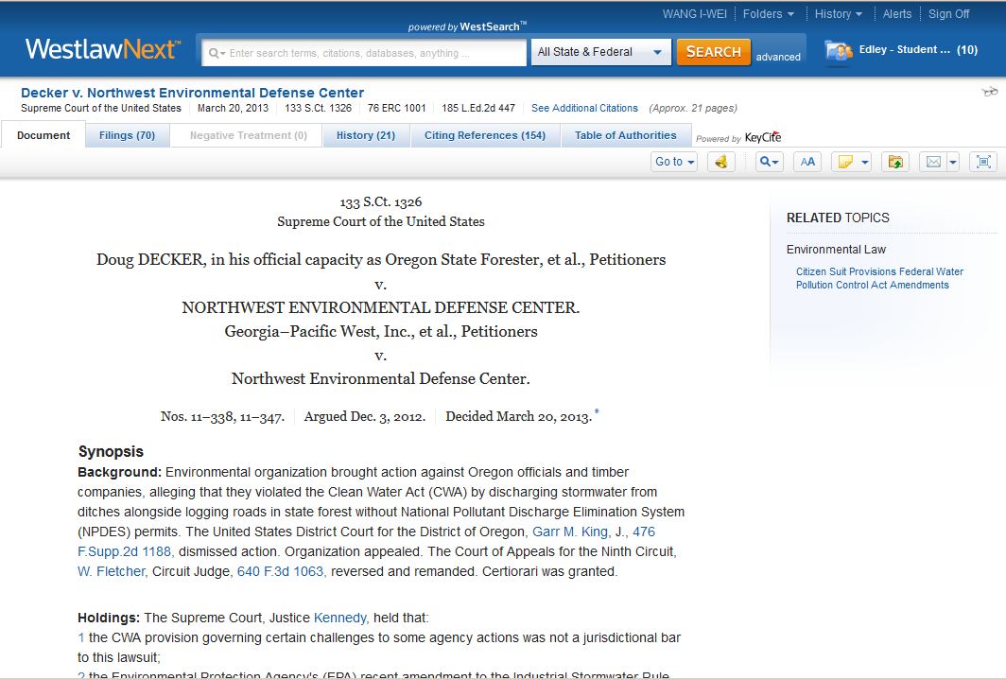
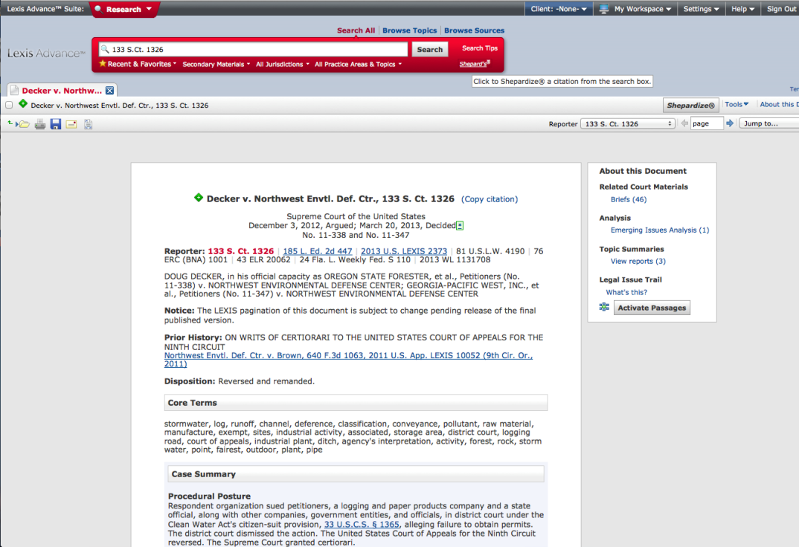
BACKGROUND – briefs & decisions below

Slide 15
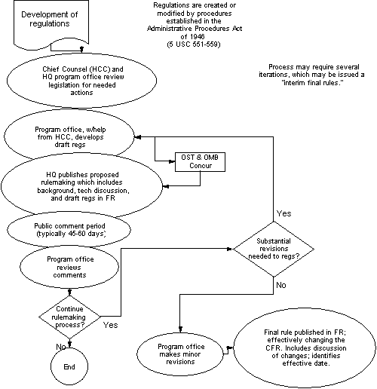
DEEP BACKGROUND – Regulatory Development

Slide 16
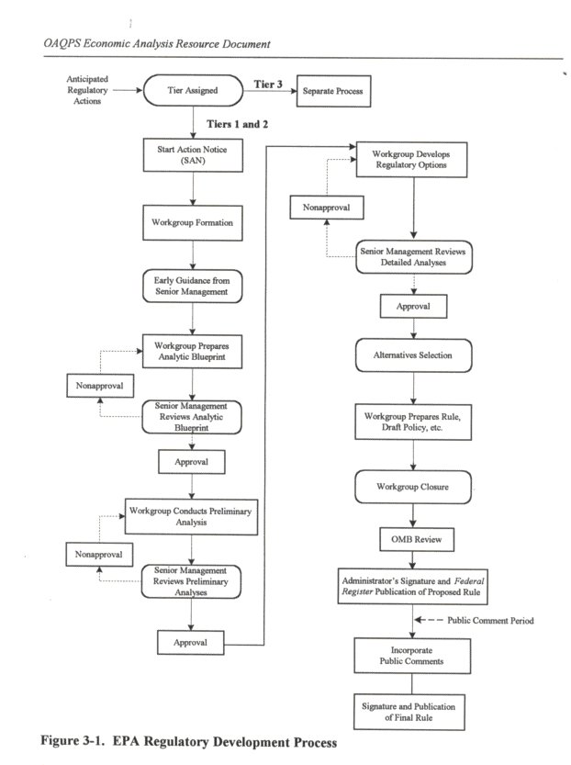
DEEP BACKGROUND – EPA’s Rulemaking Process
!

Slide 17
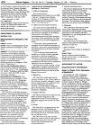
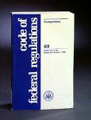
DEEP BACKGROUND – Rulemaking information & Rules
Federal Register on FDsys (1994- curr.)
Updated daily
PDF, HTML
Code of Fed. Regs. on FDsys (1996-curr.)
eCFR – daily(*), unofficial
PDF, HTML
Lexis/Westlaw, Hein Online
Environmental Law Reporter
www.regulations.gov

Slide 18
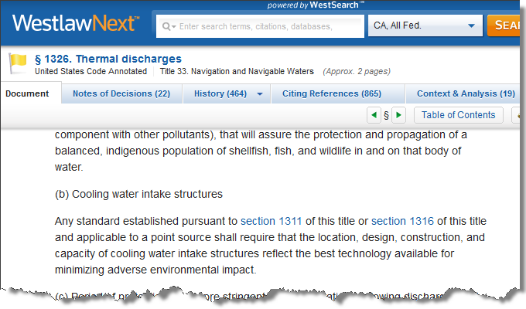
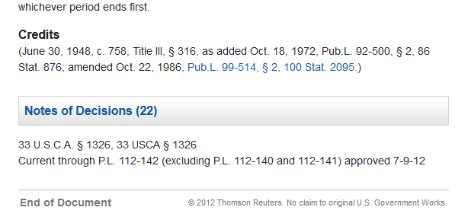
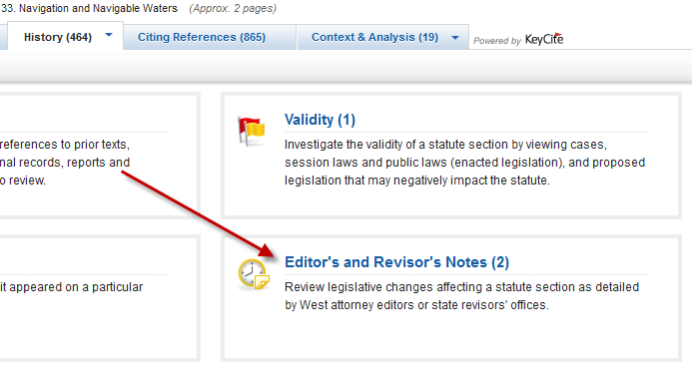
DEEP BACKGROUND – YOUR STATUTE’s sordid past
CREDITS
June 30, 1948, c. 758, Title III, § 316 – code section as written in original CWA (enacted 1948).
as added Oct. 18, 1972, Pub.L. 92-500, § 2, 86 Stat. 876 – code section as added by Clean Water Act of 1972 (major amendments – law we think of as “CWA”), next comes the Public Law number, and finally where the public law was published in the Statutes at Large.
and amended Oct. 22, 1986, Pub.L. 99-514, § 2, 100 Stat. 2095.) – last entry shows code section as amended was last changed by 1986 amendments – Public Law in the Statutes at Large.
HISTORICAL AND STATUTORY NOTES [under History – Editors’ and Revisors’ notes]
Senate Report No. 92-414 & S. Conf. Rpt. No. 92-1236 – discussing changes to the law
see 1972 U.S. Code Cong. and Adm. News, p. 3668. – note the reference to USCCAN (older volumes in storage)
Notes:
Under CREDITS, we see all of the legislative enactments that have affected this code section.
HISTORICAL AND STATUTORY NOTES direct us toward potential sources of legislative history that relate to this specific provision. Look in the history tab, in the quadrant called Editor’s and Revisor’s notes. These focus on the 2 pieces of legislative history that may relate tot his particular provision; note the 460 or so documents under the “Legislative history” quadrant of the history tab. The vast majority of these do not relate to this provision at all; they are here because section 1 of Pub.L. 99-514 was the Tax Reform Act of 1986, the last major overhaul of the entire Internal Revenue Code!! None of this relates at all to thiss provision from section 2 of Pub.L. 99-514. Laws and sausage.
These histories can be quite confusing because of the way legislation is often passed – as a rider on another bill, etc. Please come and ask a reference librarian if it looks confusing.

Slide 19
DEEP BACKGROUND – What is Legislative History?
How Our Laws Are Made (Thomas.gov)
Components –
Bill draft (s)
Committee Reports & Hearings
Amendments
Floor debate
Conference Committee Report
Signing Statement
Law

Slide 20
DEEP BACKGROUND - Naming & Citation Conventions
Laws
Slip Law (only has Public Law number, unbound) (PL__-__)
Session Law (published in Statutes at Large, has Stat. # and PL #) (__ Stat. __)
Codification: Subject arrangement in the United States Code (PL# & Stat# in ‘history’ section at end) (__ U.S.C.__)
West publishes the United States Code Annotated (__U.S.C.A.__)
Lexis publishes United States Code Service (__U.S.C .S.__)

Slide 21
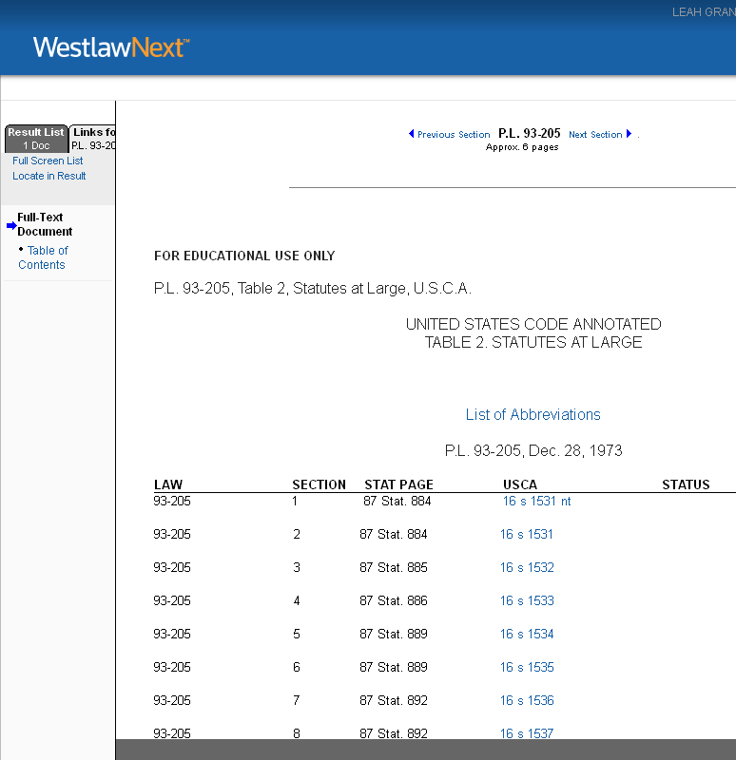
DEEP BACKGROUND - Naming & Citation Conventions
Endangered Species Act of 1973
Clean Air Act of 1955

Slide 22
DEEP BACKGROUND – Finding Legislative History
Has someone compiled it already?
Major acts (next 2 slides)
LawCat – “Clean Water Act” (subject “United States. Federal Water Pollution Control Act”)
HeinOnline
Melvyl catalog (UC + US academic libraries)
Is there a linked legislative history?
ProQuest Congressional
ProQuest Legislative Insight
No? DIY
Federal Legislative History Research Guide

Slide 23
DEEP BACKGROUND – Compiled Legislative Histories
Comprehensive Environmental Response, Compensation, and Liability Act (PL 96-510 (1980))
In Print
KF1299.H39 A3 1983 A legislative history of the Comprehensive Environmental Response, Compensation, and Liability Act of 1980 (Superfund), Public Law 96-510 : together with a section-by-section index (also on HeinOnline)
Via Westlaw Classic (compilation by Arnold & Porter)
CERCLA-LH
Via HeinOnline
Legislative History of the Comprehensive Environmental Response, Compensation, and Liability Act of 1980 (Superfund), Public Law 96-510: together with a section-by-section index
Endangered Species Act (PL 93-205 (1973))
In Print
KF5640.A32 A15 1982 A Legislative history of the Endangered Species Act of 1973, as amended in 1976, 1977, 1978, 1979, and 1980 (also on HeinOnline)
Via HeinOnline
Legislative History of the Endangered Species Act of 1973, as Amended in 1976, 1977, 1978, 1979, and 1980: Together with a Section-by-Section Index
Nat’l Envtl. Policy Act (PL 91-190 (1969))
In Print
KF3775 .L38 Legal compilation; statutes and legislative history, executive orders, regulations, guidelines and reports (1973) (also on HeinOnline) (40-volume legislative history compiling the legal authority under which EPA operates)
Via HeinOnline
Compilation of Selected Acts within the Jurisdiction of the Committee on Energy and Commerce
National Environmental Policy Act of 1969
RCRA (PL 94-580(1976))
Via ProQuest Legislative Insight
Resource Conservation and Recovery Act of 1976
Via HeinOnline
Superfund Amendments of 1986
Administrative Procedure Act (PL 79-324, 60 Stat. 237 (1946); 84 Stat.2086 (1970))
In Print
KF5416.A315 A15 1946 Administrative Procedure Act : Legislative history. 79th Congress. 1944-46
KF3775 .L38 Legal compilation; statutes and legislative history, executive orders, regulations, guidelines and reports (1973) (also on HeinOnline) (40-volume legislative history compiling the legal authority under which EPA operates)

Slide 24
Sources of Rulemaking information & Rules
Federal Register (FR)
GPO Access (1994-present)
Updated daily
PDF, HTML
Code of Federal Regulations (CFR)
GPO Access (1996-present)
e-CFR (updated daily, not official)
PDF, HTML
Lexis & Westlaw
Knowledge Mosaic
Environmental Law Reporter
www.regulations.gov
Promulgating agency!

Slide 25
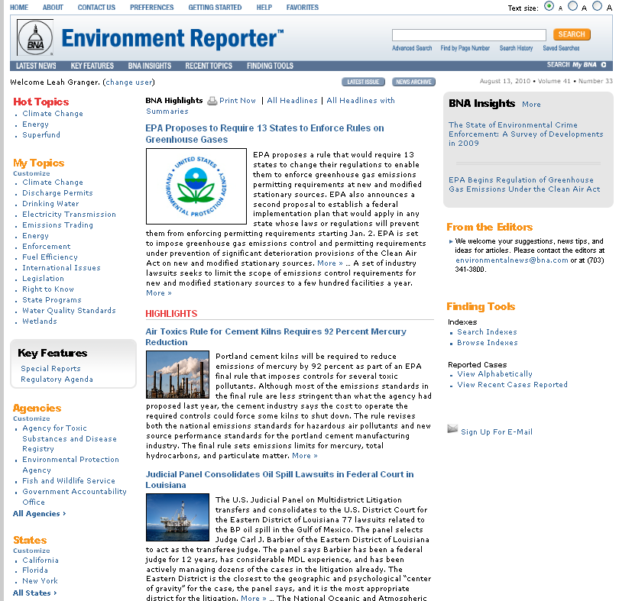
Bloomberg BNA
Save favorite searches and articles from session to session.
Search for specific news stories, cases, or legislation.
Customize what you see by court, agency, state, or country.
Sign up for weekly email of latest news.

Slide 26
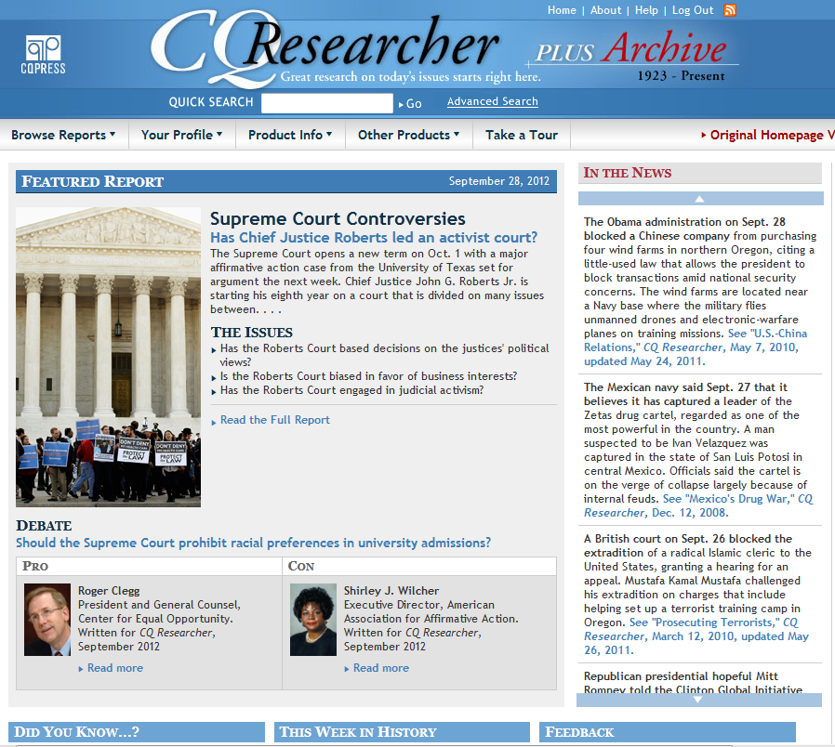

Slide 27
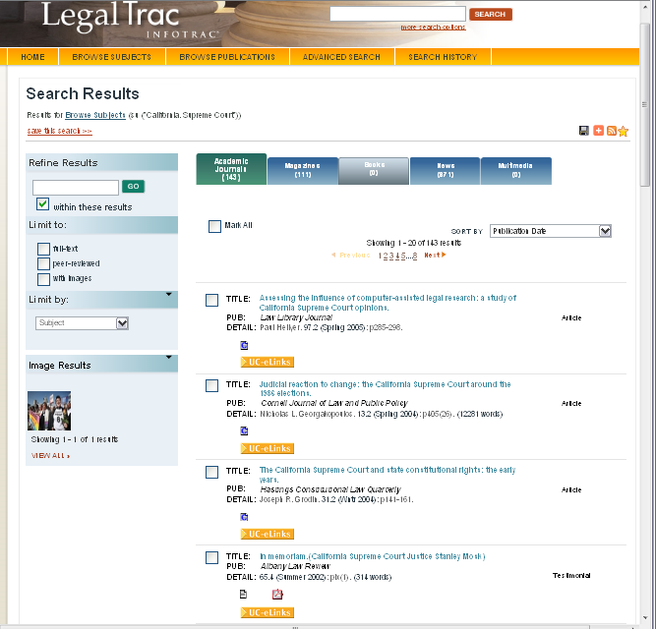
LegalTrac
Narrow results.
Export citations to reference management tool.
View articles, books, news, magazines.
Click on UC-eLinks to go to PDF of article.
See and retrieve PDF directly from LegalTrac.

Slide 28
Keeping track
Fee-based resources
EndNote
academic license ~$90(?) (UCB software partner … Cal Student Store: 845-1226 ext. 8470)
Supports Bluebook
Free at Berkeley
Refworks
Create account
Some BB support
Organize materials, links to full text
Guide
Open Source
Zotero
Supports BB
Organize as pathfinder
Save PDF, websites, etc.
Guide

Slide 29
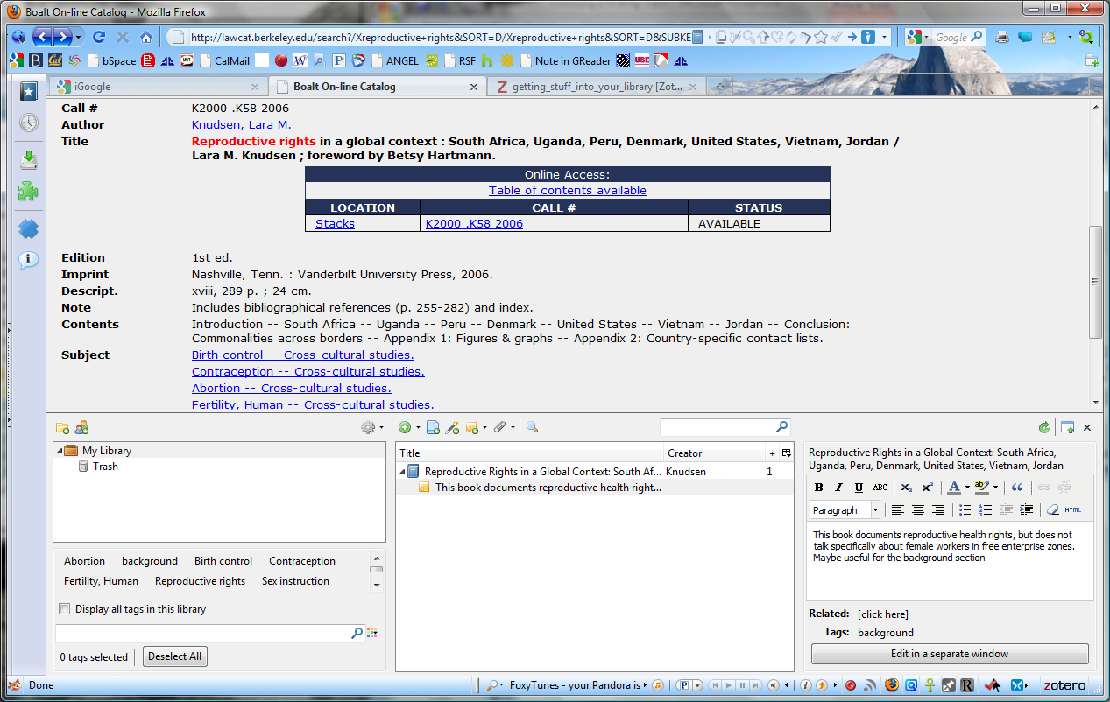
Zotero
Note the book icon.
LawCat
Add notes, attached to citation.
Add tags.
Zotero button in status bar makes it open in lower half of browser window.

Slide 30
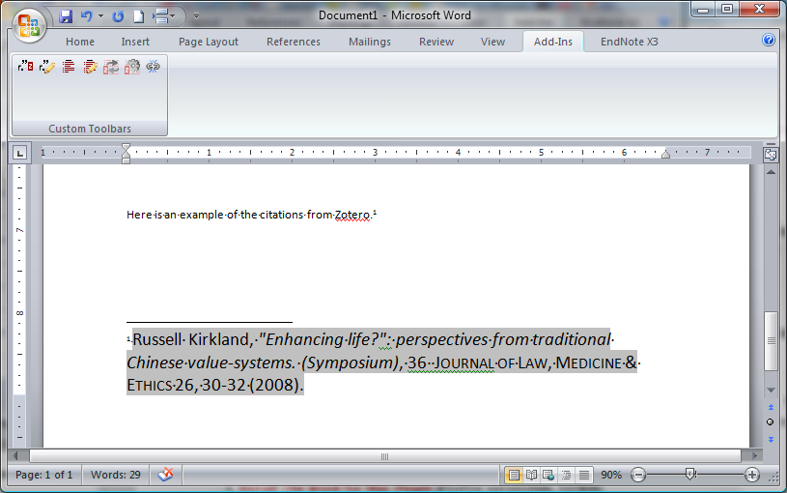
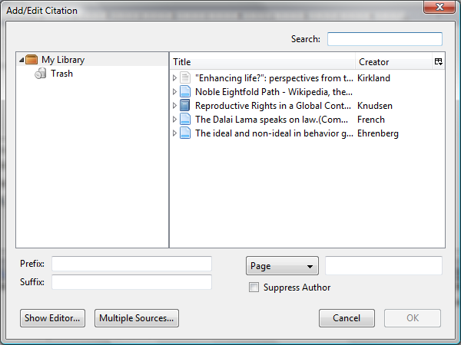
Zotero Word PLUG-in
Toolbar icons for inserting references.

Slide 31
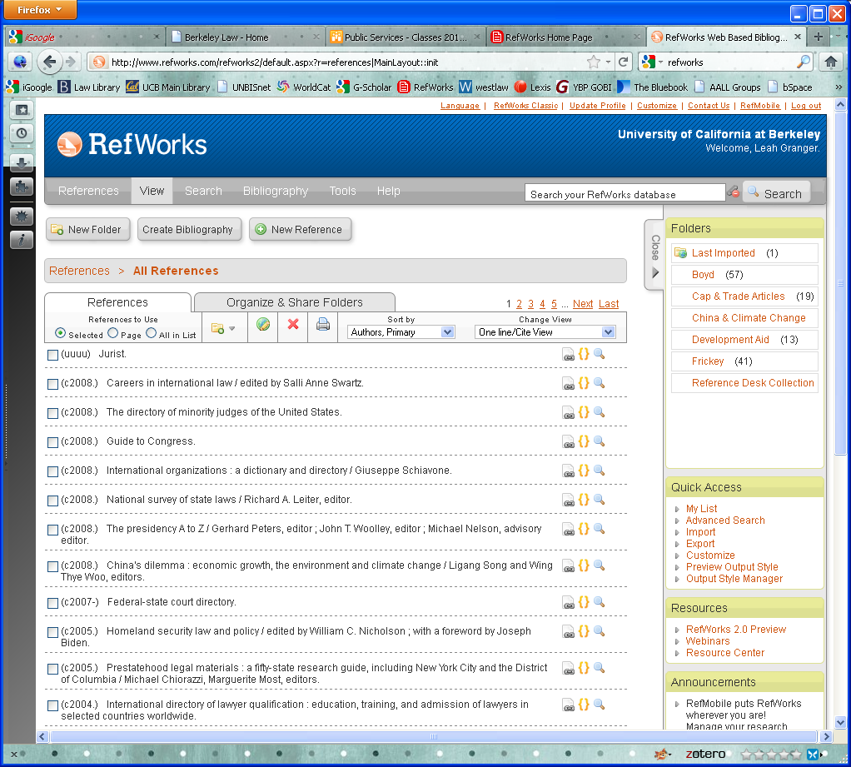
Refworks
Supports Bluebook citations.
Supported in all databases (except Westlaw/Lexis)
Web-based
Attach PDFs

Slide 32
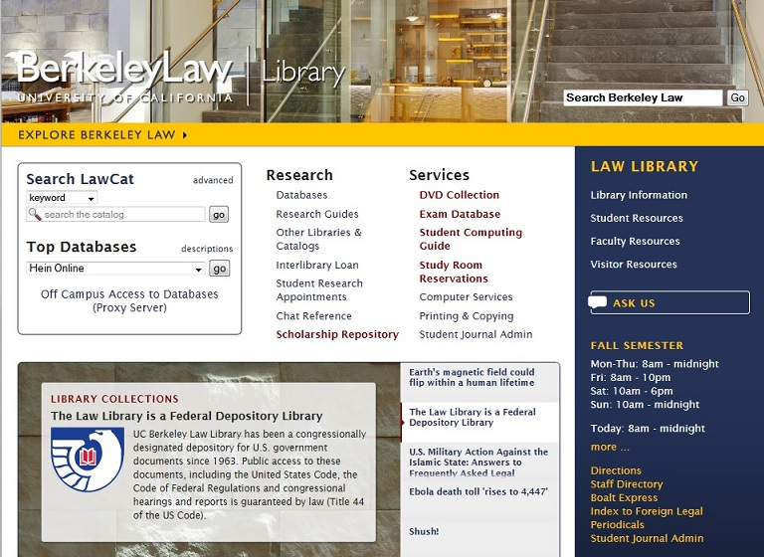
Questions?
Live chat.
Dean C. Rowan
drowan@law.berkeley.edu
Reference desk
(510) 642-0900
Request an appointment with a Reference Librarian.

