Slide 1
Trump’s Executive Orders on Immigration
Professor Leti Volpp
UC Berkeley School of Law
Prepared for Berkeley Law Teach-in
Feb. 9, 2017

Slide 2
Executive Order: Border Security and Immigration Enforcement Improvements
“Section 1. Purpose. Border security is critically important to the national security of the United States. Aliens who illegally enter the United States without inspection or admission present a significant threat to national security and public safety….The recent surge of illegal immigration at the southern border with Mexico has placed a significant strain on Federal resources and overwhelmed agencies charged with border security and immigration enforcement, as well as the local communities into which many of the aliens are placed.
Transnational criminal organizations operate sophisticated drug- and human-trafficking networks and smuggling operations on both sides of the southern border, contributing to a significant increase in violent crime and United States deaths from dangerous drugs. Among those who illegally enter are those who seek to harm Americans through acts of terror or criminal conduct. Continued illegal immigration presents a clear and present danger to the interests of the United States….”

Slide 3
Wall
The Secretary of Homeland Security shall take immediate steps to:
  “plan, design, and construct a physical wall along the southern border”
  “allocate all sources of federal funds” for this
  “develop long-term funding requirements for the wall”

Slide 4
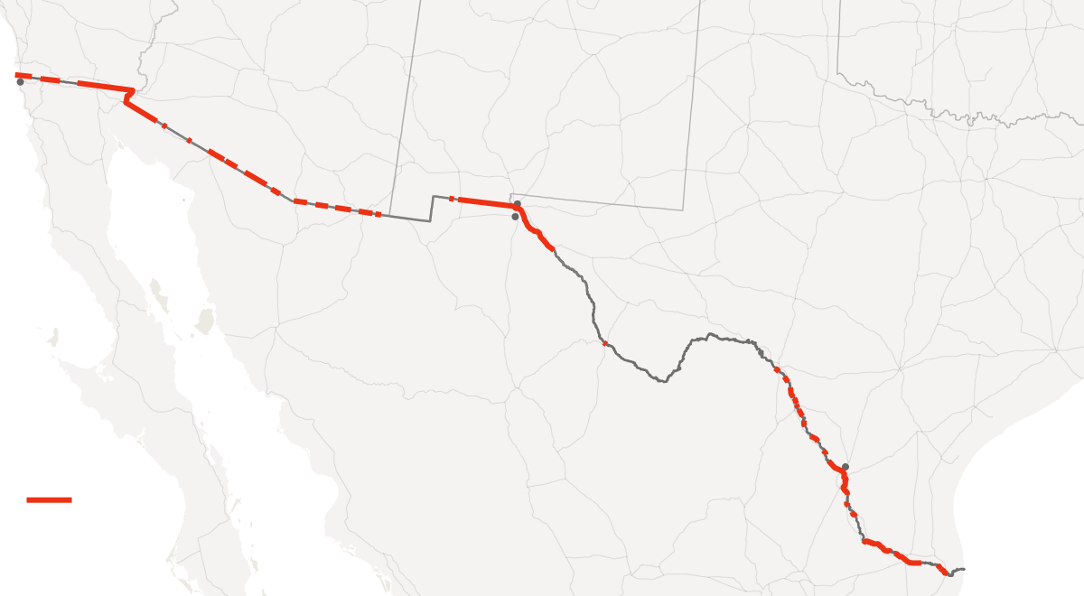
Red = areas where is already fencing

Slide 5
Estimated cost: $10 billion? $25 billion?
About 670 miles of fencing on the U.S.–Mexico border was completed in accordance with the Bush administration's Secure Fence Act of 2006. That cost about $2.4 billion, for roughly one-third of the entire border; these areas were easier and less costly to fence.
Who will pay for this?
Trump: a 20% tariff on imported goods from Mexico…..
paid for by American consumers.
Inhumane, and ineffective.

Slide 6
Detention
Noncitizens “are to be detained when apprehended by CBP pending the outcome of their removal proceedings or their removal from the country, to the extent permitted by law.”
Detention for illegal entry: “termination of ‘catch and release.’” This would mean no release on bond or use of electronic monitoring.

Slide 7
Almost ½ of persons apprehended crossing the US/Mexico border in 2016 were unaccompanied minors or families traveling together, fleeing violence in Central America.
Many families have been detained as a form of deterrence; this is described as the largest project of detaining families since Japanese American internment.
73% of immigration detainees are held in private prison facilities.
Under the EO, there would be a massive expansion of this system, with no exceptions made for asylum seekers.

Slide 8
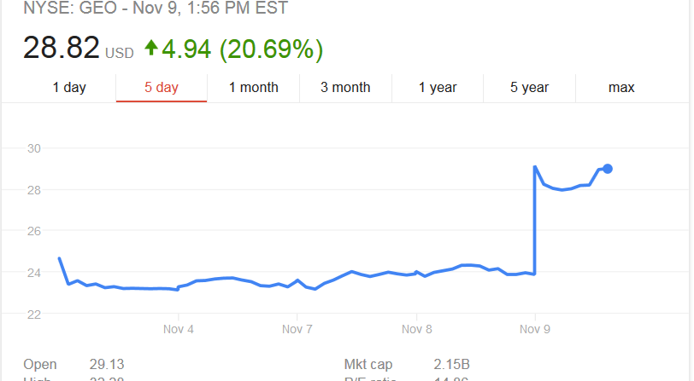
Geo Group stock price Nov 9 2016

Slide 9
Expanding expedited removal
“Pursuant to section 235(b)(1)(A)(iii)(I) of the INA, the Secretary shall take appropriate action to apply, in his sole and unreviewable discretion, the provisions of section 235(b)(1)(A)(i) and (ii) of the INA to the aliens designated under section 235(b)(1)(A)(iii)(II).”
Translation: this means expanding expedited removal.

Slide 10
What is expedited removal
Expedited removal provides for immediate removal upon an encounter with an immigration official without the opportunity to appear before an immigration judge in an administrative hearing. This hearing comes with the privilege of being represented, the right to present and examine evidence and the right to cross-examine witnesses. Expedited removal comes with no such rights.
Individuals who express fear are in principle referred to immigration officials for a “credible fear” interview. They are required to be detained under the credible fear interview and some remain detained after such a finding.

Slide 11
Who is subject to expedited removal: prior policy subjects noncitizens without proper documentation encountered at a port of entry or within 100 miles of the border who are within two weeks of having entered the United States.
The EO expands this:
Who may be subject now: noncitizens without prior documentation encountered throughout the interior who cannot prove they have been continuously present for the previous two years.
The Ninth Circuit ruled this week, 2-1, in Peralta-Sanchez, that there is no 5th A due process right to counsel in expedited removal.

Slide 12
Figure 2. Removals by Type
Office of Immigration Statistics Data: FY2004-FY2013
Congressional Research Service: Alien Removals and Returns: Overview and Trends
Alison Siskin, Specialist in Immigration Policy, February 3, 2015

Slide 13
Increased enforcement
5,000 additional BP agents to be hired.
287(g) agreements are to be revived, to “authorize state and local law enforcement to perform the functions of immigration officers in relation to the investigation, apprehension and detention of aliens in the U.S.”
  These are agreements which allow police department officers to act as immigration agents; these will likely roll out in locations with few immigration support organizations. 287(g) agreements began in 1996; under the Obama Administration they were first expanded, and then scaled back and replaced by Secure Communities.

Slide 14
Reduce relief
Parole and asylum provisions are not to be “illegally exploited to prevent the removal of otherwise removable aliens.”
  This presumably means tightening who is considered worthy of relief.

Slide 15
Executive Order: Enhancing Public Safety in the Interior of the United States
“Section 1. Purpose. Interior enforcement of our Nation's immigration laws is critically important to the national security and public safety of the United States. Many aliens who illegally enter the United States and those who overstay or otherwise violate the terms of their visas present a significant threat to national security and public safety. This is particularly so for aliens who engage in criminal conduct in the United States.”
“Sanctuary jurisdictions across the United States willfully violate Federal law in an attempt to shield aliens from removal from the United States. These jurisdictions have caused immeasurable harm to the American people and to the very fabric of our Republic.”

Slide 16
“Tens of thousands of removable aliens have been released into communities across the country, solely because their home countries refuse to accept their repatriation. Many of these aliens are criminals who have served time in our Federal, State, and local jails. The presence of such individuals in the United States, and the practices of foreign nations that refuse the repatriation of their nationals, are contrary to the national interest.”
“Although Federal immigration law provides a framework for Federal-State partnerships in enforcing our immigration laws to ensure the removal of aliens who have no right to be in the United States, the Federal Government has failed to discharge this basic sovereign responsibility. We cannot faithfully execute the immigration laws of the United States if we exempt classes or categories of removable aliens from potential enforcement. “
- (This last sentence is taken to be a slam on DACA and DAPA).

Slide 17
Expanding enforcement priorities:
Homeland Security shall prioritize for removal particular aliens, including “removable aliens who:
(a) Have been convicted of any criminal offense;
(b) Have been charged with any criminal offense, where such charge has not been resolved;
(c) Have committed acts that constitute a chargeable criminal offense;
(d) Have engaged in fraud or willful misrepresentation in connection with any official matter or application before a governmental agency ;
(e)Have abused any program related to receipt of public benefits;
(f) Are subject to a final order of removal, but who have not complied with their legal obligation to depart the United States; or
(g) In the judgment of an immigration officer, otherwise pose a risk to public safety or national security. “

Slide 18
This is a dramatic shift in enforcement priorities. Note, this does not change grounds of deportation.
Of persons who are removable, this would prioritize for removal noncitizens who are merely arrested, and not convicted, as well as noncitizens who an immigration officer believes has committed acts which would constitute a chargeable offense. There is speculation that this could include past illegal entry. There is speculation that the reference to “fraud” might include fraud in one’s immigration case, or fraud in working without authorization. “Abuse of a government program” is not defined.

Slide 19
Reporting today re case in Phoenix – believed to be first case bc of EO:
Guadalupe García de Rayos – she checked in yesterday with ICE, as she has done since she was arrested in a raid in 2008 at a water park where she worked. She had a deportation order issued in 2013, but was not a priority for enforcement.
Under the Obama administration, the priority for enforcement were those who were a threat to public or national safety, had ties to criminal gangs, or had committed serious felony offenses or a series of misdemeanor crimes.
Under those policies, she was not a priority for enforcement.
She is believed to be the first undocumented immigrant to be arrested during a scheduled meeting with immigration officials since Trump took office. The immigrant rights group Puente suggested she seek refuge at a church in Phoenix with two other undocumented immigrants; although frightened, she showed up for her appointment.
Protestors surrounded the van detaining her and tied themselves to it last night, they were arrested.
It was reported this morning that she has been deported to Mexico.

Slide 20
Increase enforcement
10,000 additional ICE officers to be trained.
Pressure on states and local authorities:

Slide 21
Threats to “sanctuary jurisdictions”
“Jurisdictions which willfully refuse to comply with federal law section 1373 (sanctuary jurisdictions) will not receive federal grants.”
Note, section 1373 does not actually force broad cooperation on unwilling states or localities. It merely says they may not forbid their employees from communicating immigration-related information to federal officials. The state or local law enforcement agency doesn’t have to collect or provide any requested information itself, and it can even remind its employees that they aren’t obligated to send such information.

Slide 22
“To better inform the public regarding the public safety threats associated with sanctuary jurisdictions, the Secretary shall utilize the Declined Detainer Outcome Report or its equivalent and, on a weekly basis, make public a comprehensive list of criminal actions committed by aliens and any jurisdiction that ignored or otherwise failed to honor any detainers with respect to such aliens.”
“The Director of the Office of Management and Budget is directed to obtain and provide relevant and responsive information on all Federal grant money that currently is received by any sanctuary jurisdiction.”

Slide 23
“Sanctuary jurisdictions” is not a settled phrase and has been applied to a wide range of actions which can range from state and local law enforcement agencies that refuse nearly all communication with DHS about persons thought to be unlawfully present, even when they are convicted of serious crimes, to others which won’t keep a person in detention beyond the end of their local sentence to allow for ICE to pick them up - unless ICE pays the full additional cost.

Slide 24
Note, there are constitutional limits on the extent to which the federal government could mandate that states or localities participate in federal enforcement, under the Supreme Court’s anti-commandeering doctrine. That doctrine holds that the federal government may not require states to enforce federal laws. It may, however, authorize or encourage such a role, including through federal grants to participating states or through the withholding of certain funding — as long as the withholding is not so big that the courts see it as unduly coercive. Any particular grant withheld also needs to be reasonably related to the purpose of the withholding.
And, note, the City of SF filed a lawsuit to challenge the provision threatening to withhold federal grants.
There is also proposed legislation in California (SB 54) to prevent local and state law enforcement from using resources to “investigate, interrogate, detain, detect, or arrest persons for immigration enforcement purposes.” Sate and local law enforcement could still respond to federal immigration enforcement requests for information and would still transfer or detain a person at the request of federal immigration if there was a judicial warrant.
Miami mayor “duped”: he has ordered local jails to detain inmates sought by immigration agents.

Slide 25
More state/local collaboration:
“The Secretary shall immediately take all appropriate action to terminate the Priority Enforcement Program (PEP) described in the memorandum issued by the Secretary on November 20, 2014, and to reinstitute the immigration program known as ‘Secure Communities.’”
  Under Secure Communities, participating jails submitted arrestees’ fingerprints not only to criminal databases, but to immigration databases as well, allowing ICE access to information on individuals held in jails.

Slide 26
Secure Communities became highly controversial when it led to the ICE arrest of long time resident undocumented immigrants based on mere traffic offenses. Many localities cut back on ICE cooperation. The Priority Enforcement Program was designed to restore cooperation. It called for ICE to narrow the circumstances in which custody requests or information requests would issue on the basis of those ICE fingerprint checks, so that jurisdictions would generally be asked to hold or turn over only persons with serious criminal offenses.

Slide 27
Governor Jerry Brown:
"So as we reflect on the state of our state, we should do so in the broader context of our country and its challenges. We must prepare for uncertain times and reaffirm the basic principles that have made California the Great Exception that it is.
First, in California, immigrants are an integral part of who we are and what we’ve become. They have helped create the wealth and dynamism of this state from the very beginning.
I recognize that under the Constitution, federal law is supreme and that Washington determines immigration policy. But as a state we can and have had a role to play. California has enacted several protective measures for the undocumented: the Trust Act, lawful driver’s licenses, basic employment rights and non-discriminatory access to higher education.
We may be called upon to defend those laws and defend them we will. And let me be clear: we will defend everybody – every man, woman and child – who has come here for a better life and has contributed to the well-being of our state."

Slide 28
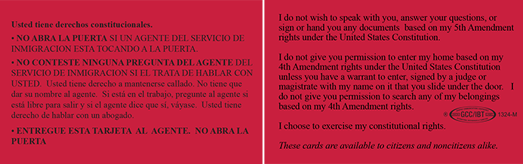
Immigrant Legal Resource Center Red Cards:

Slide 29
Protecting the Nation from Foreign Terrorist Entry into the United States
“Section 1. Purpose. The visa-issuance process plays a crucial role in detecting individuals with terrorist ties and stopping them from entering the United States. Perhaps in no instance was that more apparent than the terrorist attacks of September 11, 2001, when State Department policy prevented consular officers from properly scrutinizing the visa applications of several of the 19 foreign nationals who went on to murder nearly 3,000 Americans. And while the visa-issuance process was reviewed and amended after the September 11 attacks to better detect would-be terrorists from receiving visas, these measures did not stop attacks by foreign nationals who were admitted to the United States.
Numerous foreign-born individuals have been convicted or implicated in terrorism-related crimes since September 11, 2001, including foreign nationals who entered the United States after receiving visitor, student, or employment visas, or who entered through the United States refugee resettlement program. Deteriorating conditions in certain countries due to war, strife, disaster, and civil unrest increase the likelihood that terrorists will use any means possible to enter the United States. The United States must be vigilant during the visa-issuance process to ensure that those approved for admission do not intend to harm Americans and that they have no ties to terrorism.”

Slide 30
“In order to protect Americans, the United States must ensure that those admitted to this country do not bear hostile attitudes toward it and its founding principles. The United States cannot, and should not, admit those who do not support the Constitution, or those who would place violent ideologies over American law. In addition, the United States should not admit those who engage in acts of bigotry or hatred (including "honor" killings, other forms of violence against women, or the persecution of those who practice religions different from their own) or those who would oppress Americans of any race, gender, or sexual orientation.”

Slide 31
Entry into the U.S. of anyone who is a national of one of seven “designated countries: Iran, Iraq, Libya, Somalia, Sudan, Syria, and Yemen is suspended for at least 90 days. This includes nonimmigrant (temporary) visas and immigrant visas for those seeking to become U.S. permanent residents.
Note, nationals can include those born in another country but whose parents were, if such parentage entitles them to citizenship in that country. The EO appears to include those born in one of the designated countries even if they do not currently hold a passport from that country or no longer consider themselves a citizen of that country. On Feb. 3 DHS published a news alert that the ban does not apply to “dual citizens with passports from a country other than the seven listed.“
Note, the EO as written is unclear as to whether the ban includes legal permanent residents. On Feb. 1 the White House issued guidance stating that it does not apply to LPRs.

Slide 32
During the 90 day period DHS is to determine the criteria countries must provide regarding individuals seeking visas or admission to ensure the individual seeking the benefit is not a security or public safety threat.
After these determinations DHS is to submit a report within 30 days outlining countries that do not have adequate measures in place to ensure this.
Based on this and on any recommendation by the Secretary of Homeland Security the number of countries designated as detrimental to the interest of the United States may increase.

Slide 33
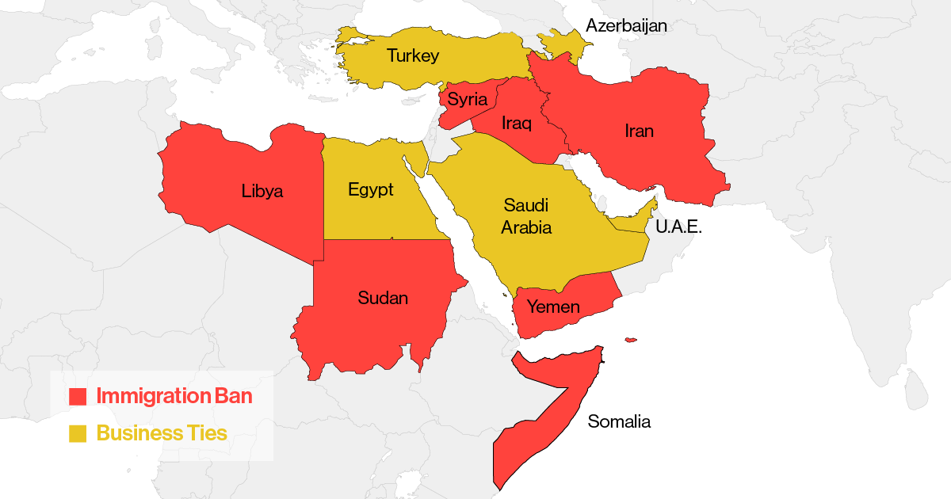

Slide 34
Refugees from any country are not to be accepted into the United States for 120 days. This is to ensure that refugees admitted “do not pose a threat to the security and welfare of the United States.” Individuals can be admitted on a case-by-case basis when in the national interest, including when they have a religious-based claim and the religion is a “minority religion in the individual’s country of nationality.”
Syrian refugees are indefinitely banned from admission.
The total refugee cap for 2017 is 50,000 (less than ½ of previous year).
After the 120 period, priority will be for those who are “a minority religion in the individual’s country of nationality.”

Slide 35
On February 3, 2017, the US District Court for the Western District of Washington issued a TRO blocking the following sections of the EO nation-wide:
- 90 day ban on 7 Muslim countries
- 120 day ban on refugees
- prioritization of certain refugee claims
- indefinite suspension of Syrian refugee admissions
- case by case refugee admissions
The Federal government attempted to stay this order. *This was denied by the Ninth Circuit Court of appeals on Feb. 9, 2017. This means the hold on the travel ban continues.
For a living document with more information on the Muslim/refugee ban see:
https://pennstatelaw.psu.edu/sites/default/files/QuestionsAnswersFinal.docx2-9.pdf

