Slide 1
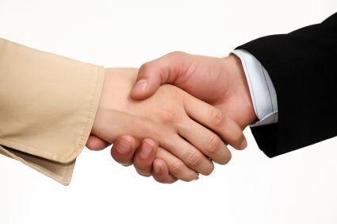
Halloum Negotiation
Competition
Competition Directors:
Natalie Flechsig
Joseph Santiesteban
Gabrielle Ahdoot
Website:http://www.law.berkeley.edu/6087.htm Email: HalloumCompetition@gmail.com

Slide 2
Info Session Agenda
What is the Halloum Negotiation Competition?
I’m a Law Student. What’s in it for me?
Mandatory Training Sessions
Competition Logistics and Dates
How to Sign Up
Questions & Answers

Slide 3




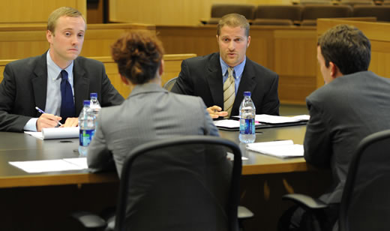
What is the Halloum Negotiation Competition?
20 teams of 2
Fact Pattern:
General &
Confidential Information
Structure of Competition Round:
  50 Minute-Negotiation
  10 Minute-Debrief
  Comments from the Judges

Slide 4
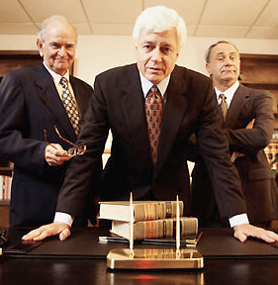
What is the Halloum Negotiation Competition?
How will the Judges be Assessing You?
NEGOTIATION PLANNING
FLEXIBILITY
OUTCOME
TEAM WORK
RELATIONSHIP BETWEEN TEAMS
SELF-ANALYSIS
NEGOTIATION ETHICS

Slide 5
What is the Halloum Negotiation Competition?

Slide 6
What is the Halloum Negotiation Competition?

Slide 7

What is the Halloum Negotiation Competition?
Time Commitment
No writing component.
No need for memorization.
You will always have your partner backing you up.
This is a problem-solving and collaborative environment.
Overall time commitment depends on you.
Notes:
Our preparation:
We spent a few hours on each fact pattern. We made a spreadsheet that listed for each term, the best case, the compromise, and the minimum acceptable.
We also noted for each term, a couple key facts that we could use to justify our reasoning to the other team and to the judges.

Slide 8

I’m a Law Student. What’s in it for me?
Learn negotiation skills from attending Professor Soper Training and by competing
Gain experience in transactional business negotiations
Network with practitioners, professors, and ADR members
Be scouted for the ADR team
Have your resume sent to the sponsoring firms
Food & wine reception for everyone after the final round
iPads and Cash prizes for top 2 teams

Slide 9
When will I negotiate in real life?
Settlement Agreements
Labor Disputes
Divorce and Child Support Arrangements
Plea Bargains
✓ Business Transactions and Disputes

Slide 10
Mandatory Training Sessions
Monday, March 11th
12:45pm
“Be a Competitor: Learn the Rules of the Game.”
Lunch will be provided.
Monday, March 18th
12:45pm
“Be a Lawyer: Learn Negotiation Skills from Professor Avila.”
Lunch will be provided.

Slide 11
Competition Logistics and Dates
Preliminary Rounds
Monday, April 1st
Each team competes once per night during one of these time slots:
6:00 – 7:30 pm or
7:45 – 9:15pm
Preliminary Rounds
Thursday, April 4th
Each team competes once per night during one of these time slots:
6:00 – 7:30 pm or
7:45 – 9:15pm
Semi-Final Rounds
Monday, April 8th
top 4 teams compete
Final Round
Thursday April 11th
final 2 teams compete
Everyone welcome to come watch final round and enjoy the food & wine reception!

Slide 12
How to Sign Up:
Entries will be accepted on a first-come, first-serve basis.
Pick up sign up sheet here or download form from the 1L or 2L Facebook groups this afternoon.
Beginning at noon on Tuesday, February 26, 2013, submit the form and your resumes to halloumcompetition@gmail.com

Slide 13
FAQ
What if I don’t have a partner?
Will I be at a disadvantage if I don’t have any experience?
Seriously, how much time does this take?
What if I change my mind after I’m selected for the competition?

Slide 14

Questions?

Slide 15



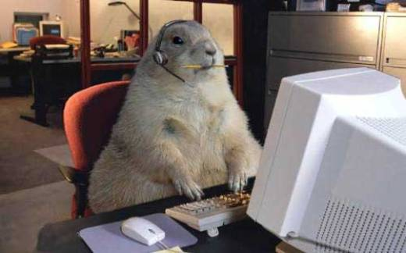
Sign up Tomorrow at 12pm!

