Slide 1
What is D-Lab?
Justin McCrary
CSLS Workshop

Slide 2
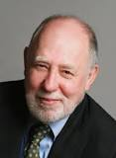
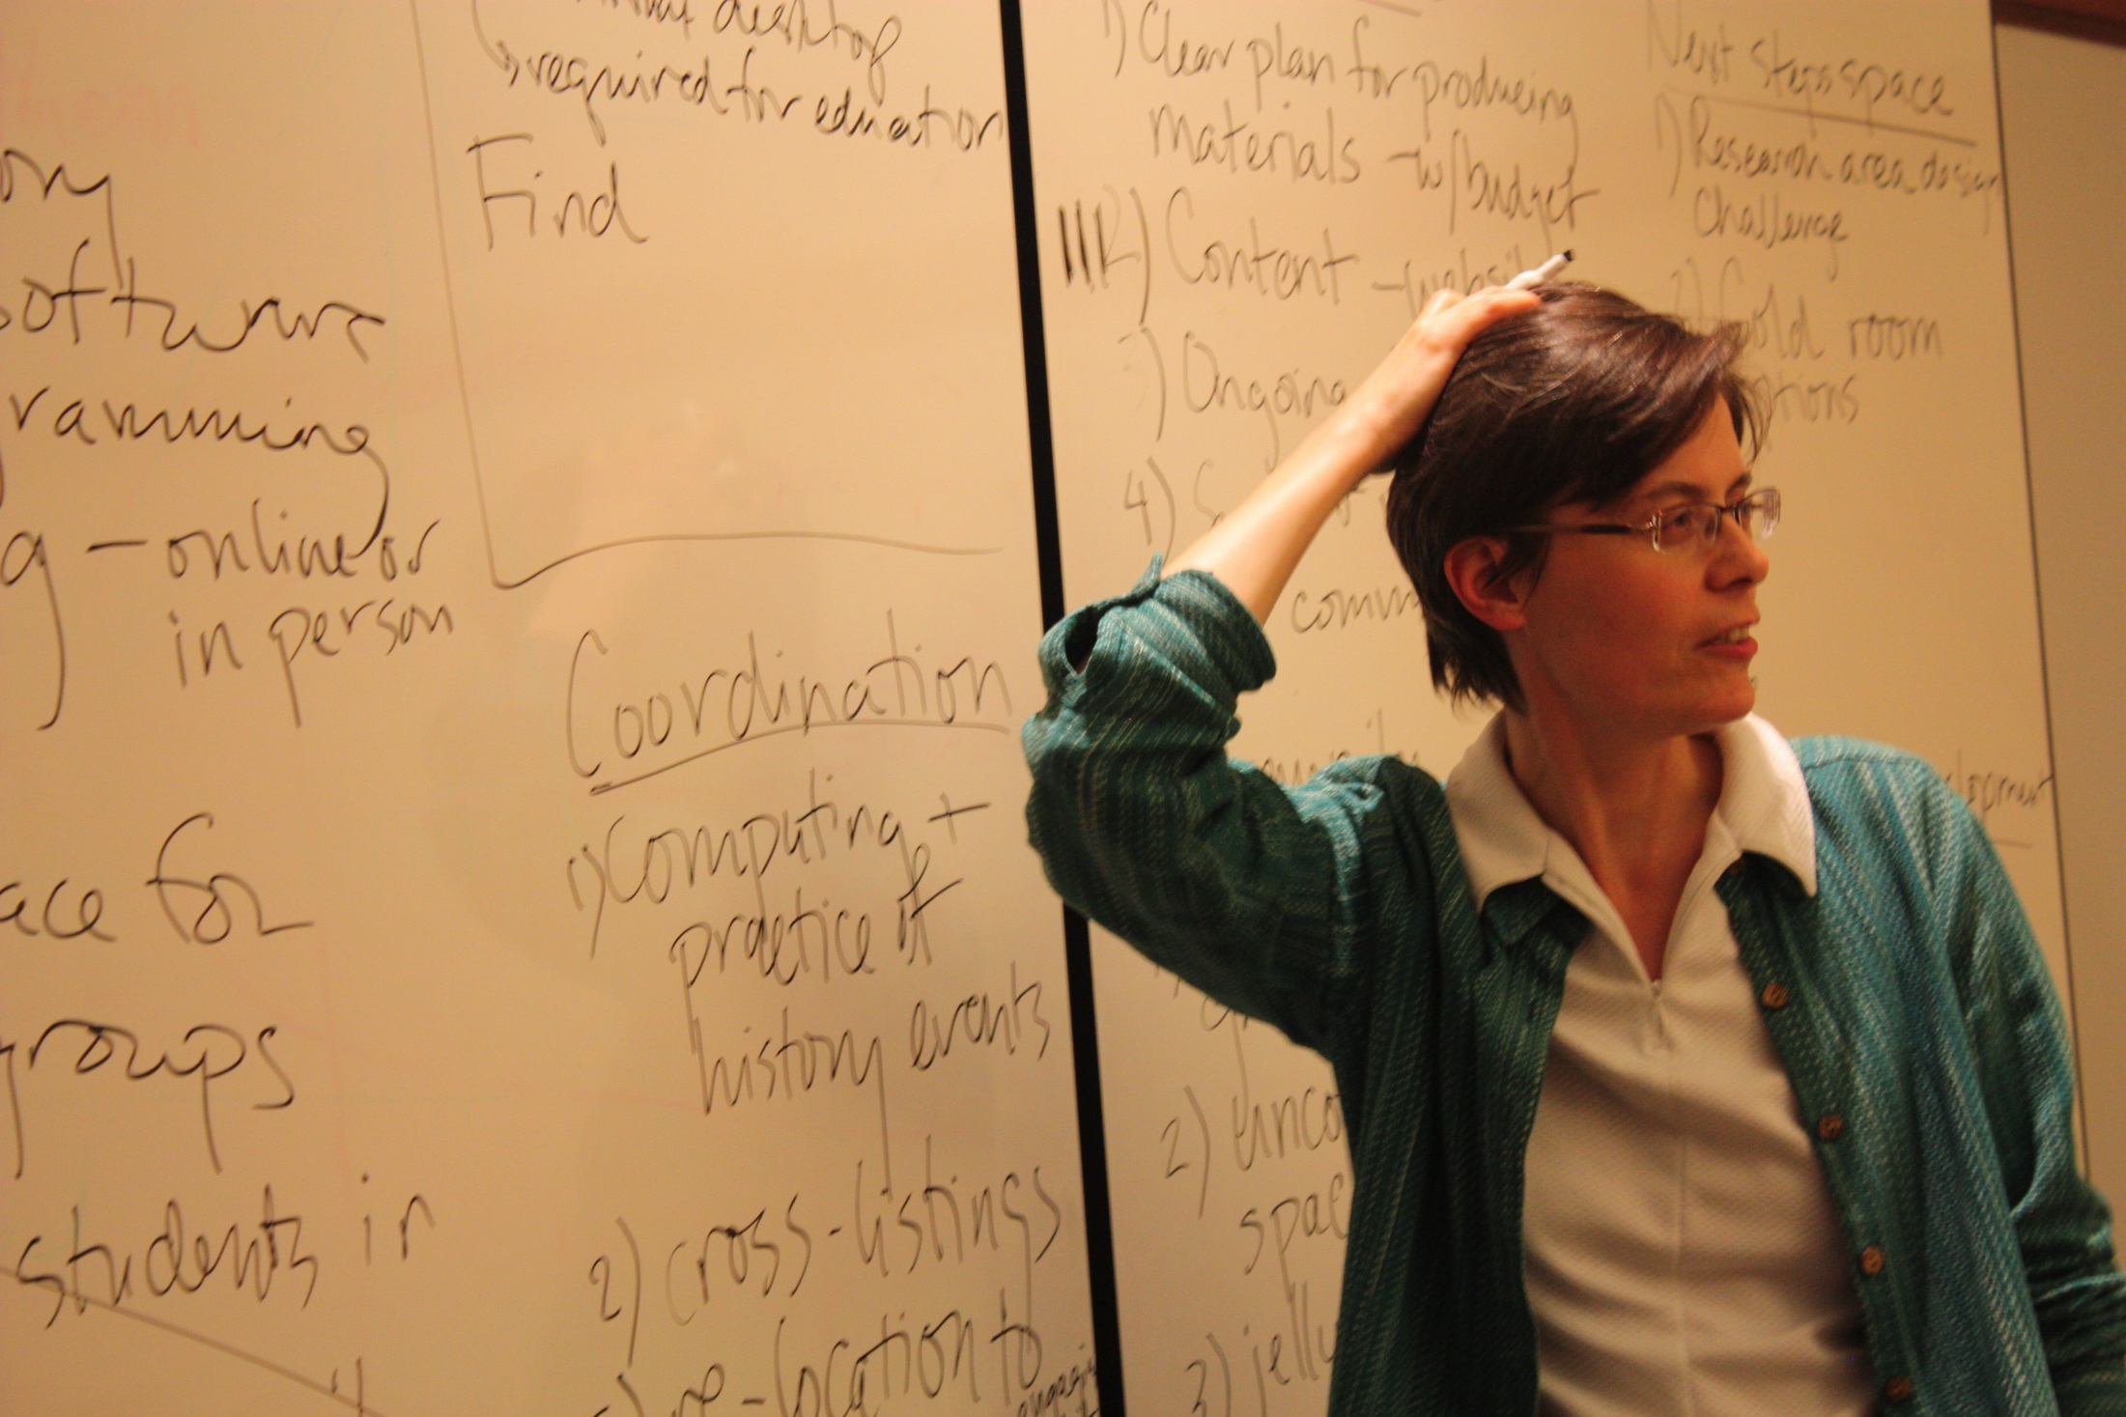
D-Lab: Social Sciences Data Laboratory
Organized Research Unit
Funded by the Vice Chancellor for Research
Strong connections to some other emerging ORUs you may have heard about (Matrix, BIDS, etc.)
Mission: Help faculty, graduate students and advanced undergraduates do better social science by taking advantage of new tools and new collections
Motivation: Breakdown of traditional model of graduate training

Slide 3
Core D-Lab Objectives
TRAINING
Basic, Intermediate, and Advanced (new as of this fall)
Trainings specific to languages (e.g., R, Stata, SAS, Atlas.TI)
Trainings specific to methodologies (e.g., causal inference)
Quantitative, Qualitative, Visualizations
ARCHIVING
California Census Research Data Center
Currently working on MOUs with government and private entities regarding repository facilities (stay tuned…)

Slide 4
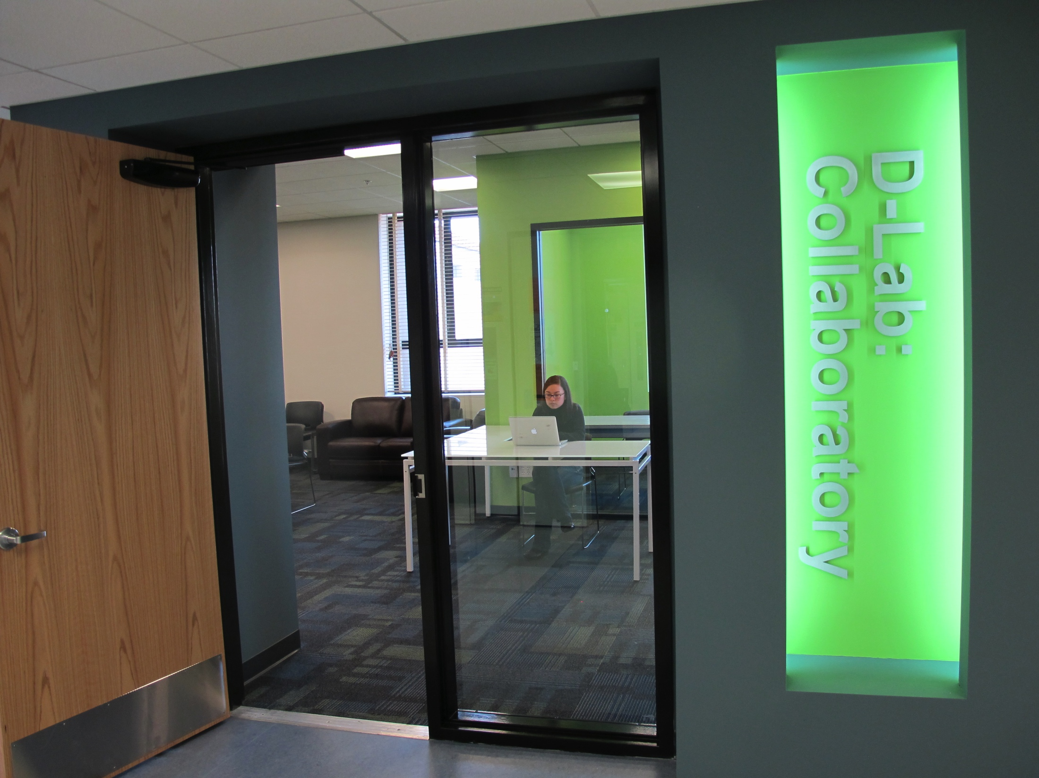
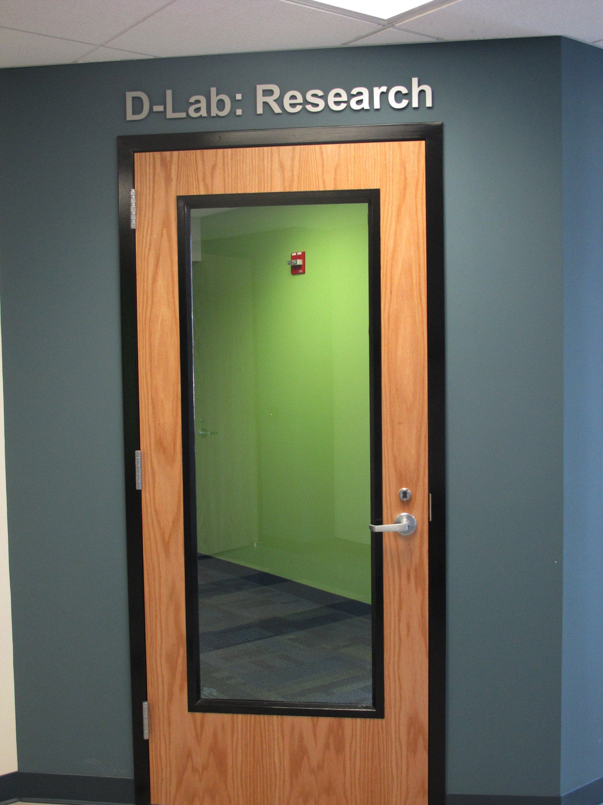
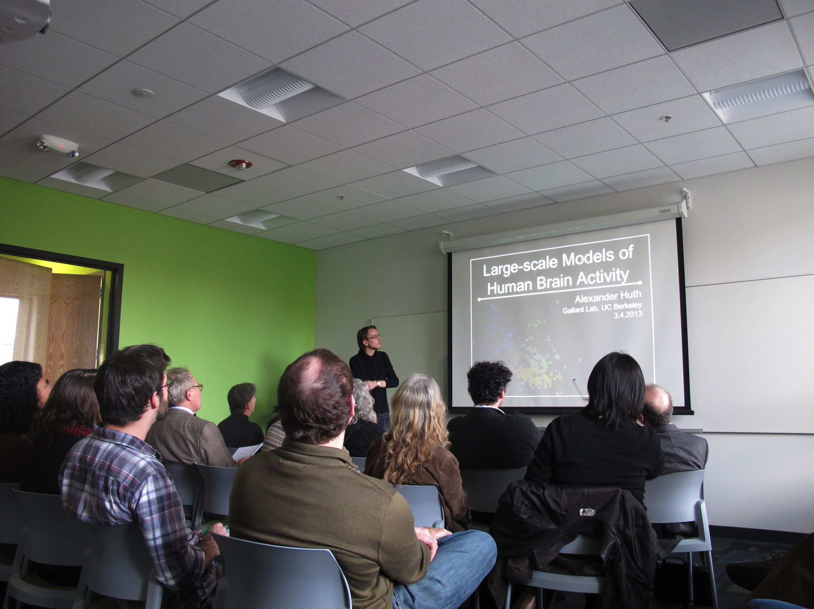
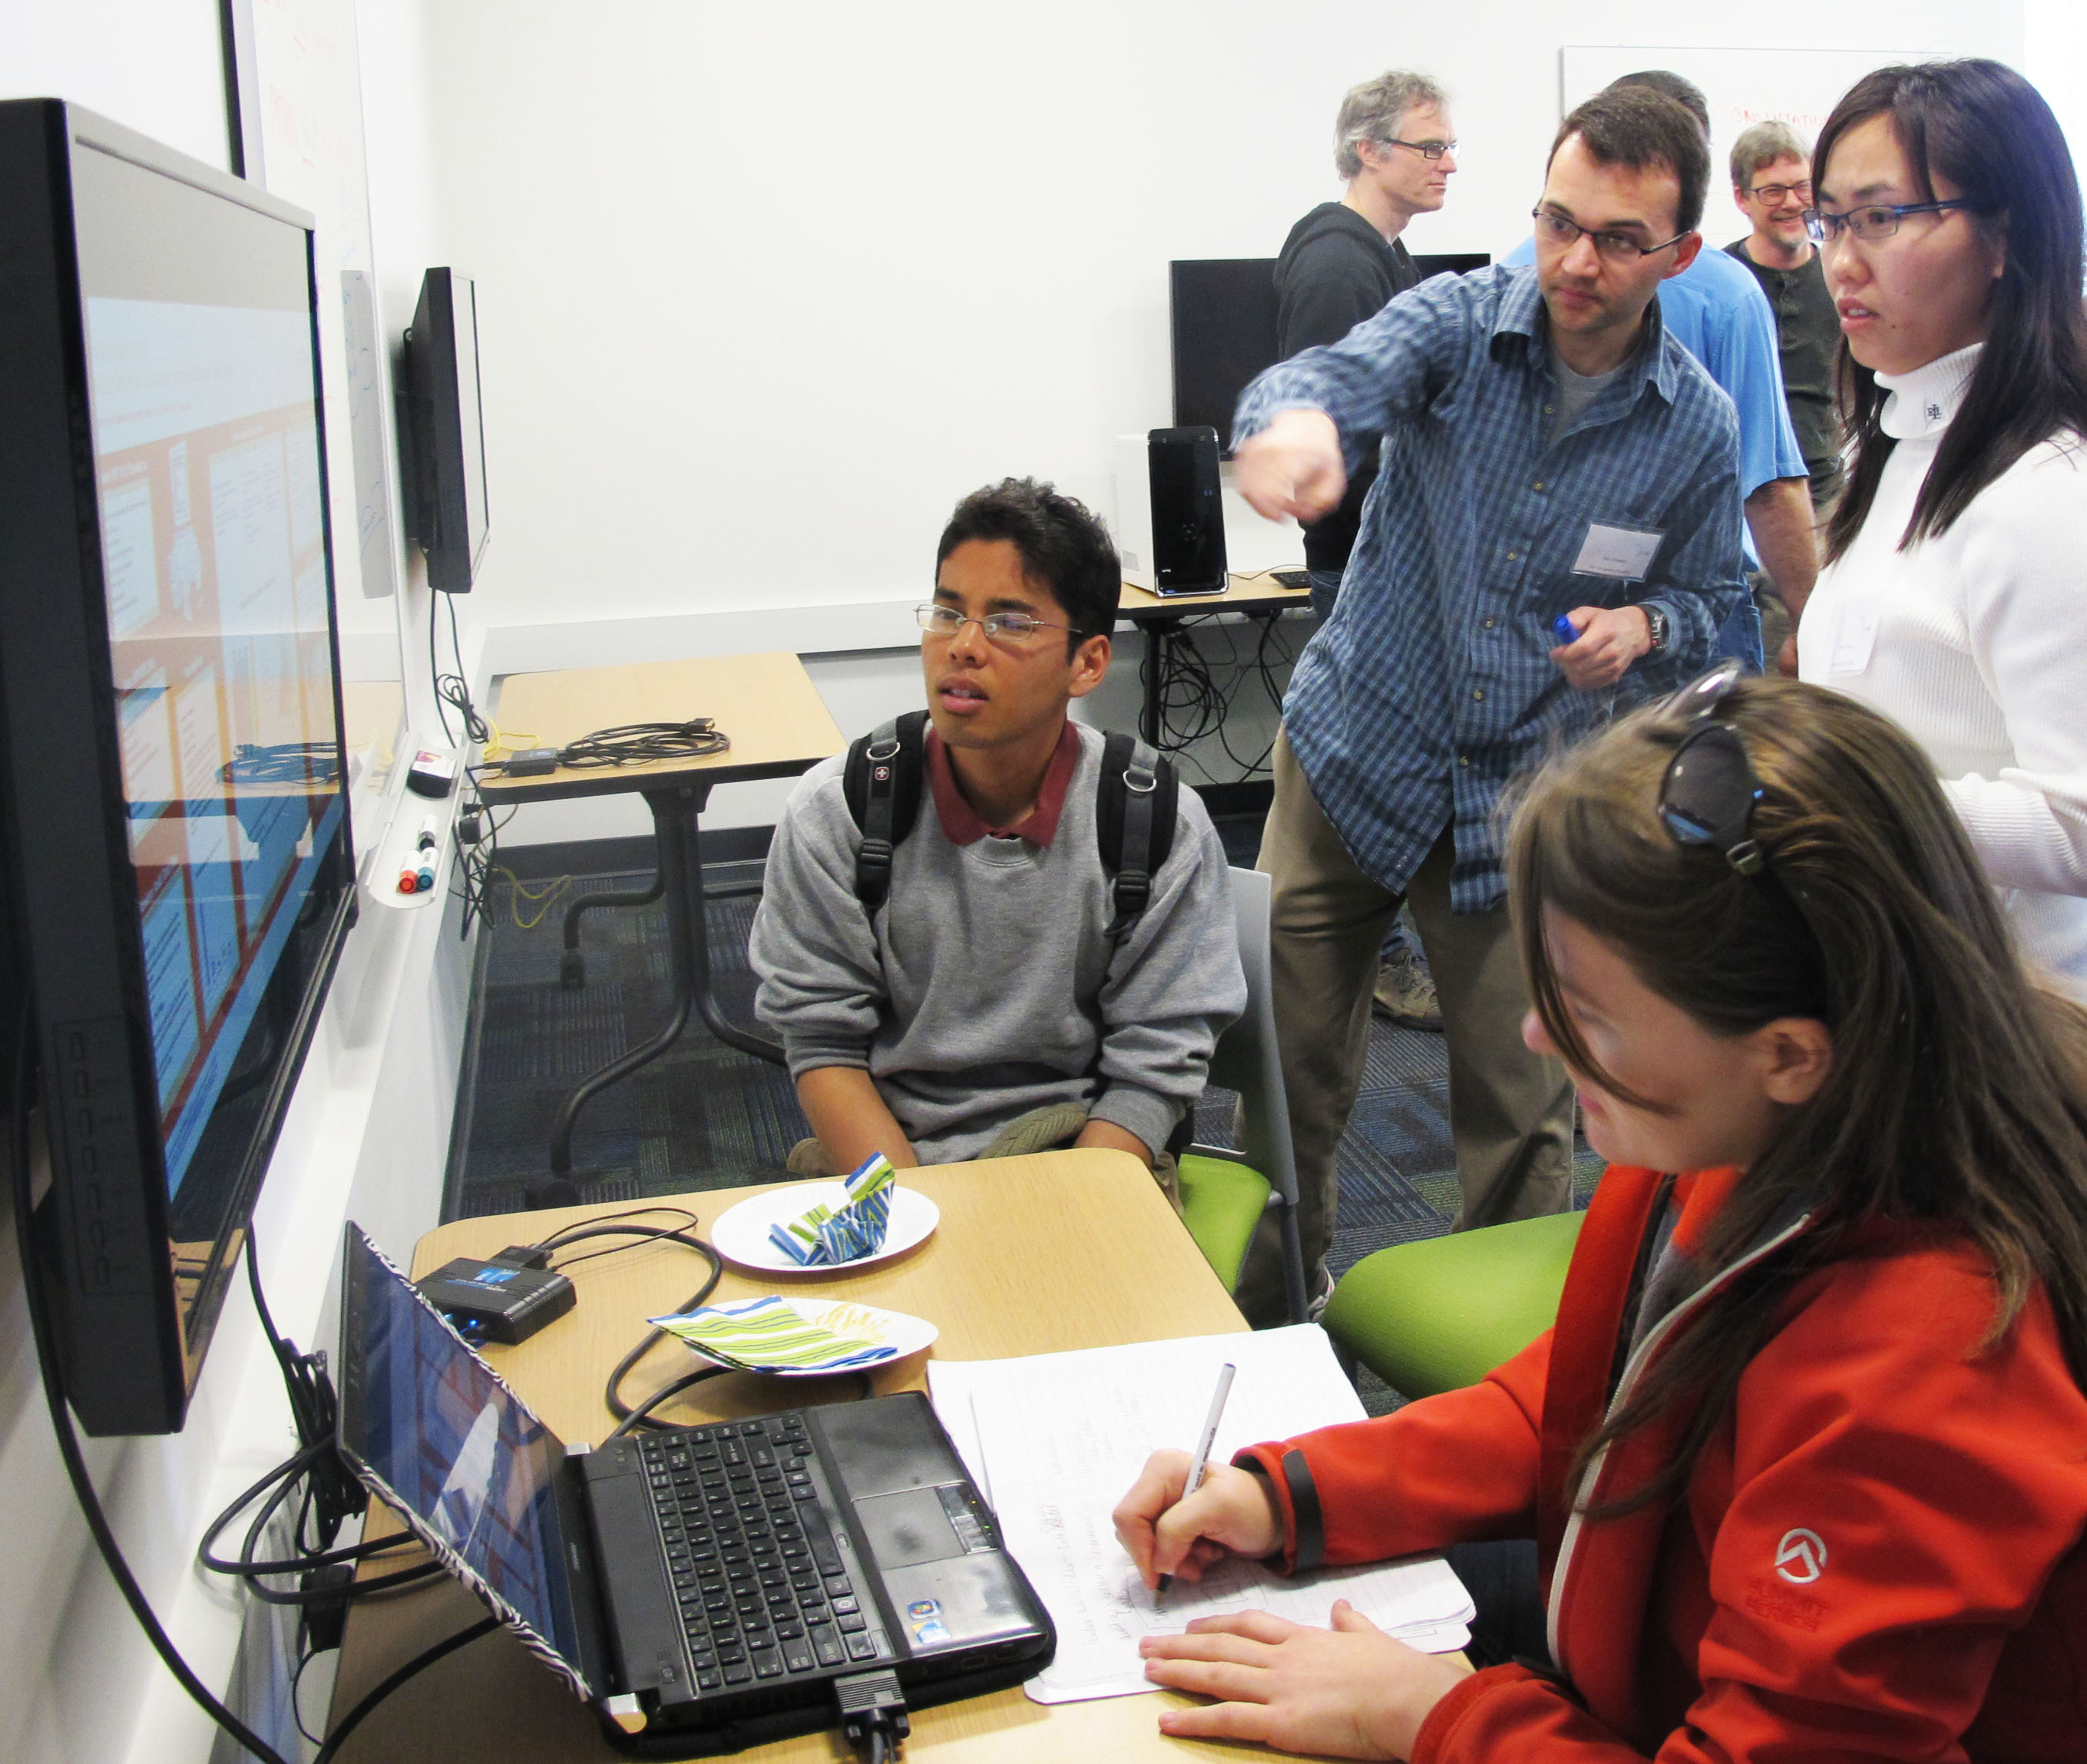
Where is D-Lab?
350 Barrows: Convening room, Collaboratory, Research Space

Slide 5
What is D-Lab Like?
Collaborative!
D-Lab and other organizations
Matrix
BIDS (Berkeley Institute for Data Science)
BRC (Berkeley Research Computing)
Library
Helpful!
Think anarcho-syndicalist, with hacking skills
Proselytizing!
We think that nearly all social science scholarship could benefit from some of the emerging tools, and we want to tell you why
Active!
We love helping people get their work done. D-Lab meetings end with action items that then get acted upon. We help campus negotiate site licenses for software (Qualtrics, currently working on Stata)

Slide 6
Special Projects
Contests for top programmers
Undergraduate contests in Stata
rolling out this Spring or next Fall
Graduate student contests in R
Cash prizes
Rolling out next Fall
Training on BRC’s new High Performance Computing cluster
Use case of financial data; collaboration between Haas, BRC, and D-Lab
Experimenting with new kinds of data collections
Oakland Police Department camera data, stop data
Docket sheet data on litigation process
Corporate charters and textual analysis
Boston Police Strike of 1919 and the language of annual reports

Slide 7
Working Groups: Self-organize!
We provide physical space and moral support to:
Computational Text Analysis Working Group
Python Workers Party
Digital Humanities Working Group
Qualitative Methods Group
Drupal Users Group
Bitcoin Working Group
Unicode Working Group
Social Computing
R Language Beginner Study Group
Current working groups are listed at http://dlab.berkeley.edu/working-groups and historical working groups are listed at http://dlab.berkeley.edu/past-working-groups

Slide 8
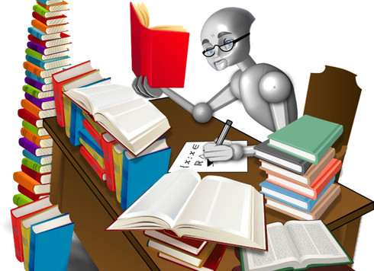
CTAWG Computational Text Analysis Working Group Tuesday 4-6pm, Twice a Month
Coordinators: Nick Adams nickbadams@berkeley.edu Brooks Ambrose brooks_dlab@berkeley.edu

Slide 9
A Many-to-Many Teaching and Learning Model
Large group presentations and events
Small groups focus on particular text methods and projects
Guest talks from experts in the field
Programming tutorials w/ sample code
Online support forum to troubleshoot projects
Collaboration opportunities

Slide 10
Law & Social Justice Applications
Don’t have an army of grad students? Text analysis methods can help:
Track changes in opinions, rulings, pretrial risk assessments, etc. across time/jurisdiction
Choose relevant cases from a huge corpus
Measure attention to topics in legal literature
Explore digitized archives and evidence
Study media, pop culture, public opinion

Slide 11
Join the CTAWG Legal Team!
Learn new techniques, support your project, and collaborate with other scholars studying law and social justice!
For more information, contact:
Talia Schwartz taliashwartz@berkeley.edu

Slide 12
Trainings: An Overview
This week
Introduction to Survey Research
Useful Stuff in R
Beginning Stata
Digital Methods + Your Research: The Possibilities and Challenges of (Your) Digital Humanities Projects
How Much Does "the Digital" Matter for Distant Reading?
Double Feature: Network Analysis & Visualization AND Managing Your Research Like a Boss
Rest of the Month
R Graphics
QMG Presents: Integrating Quantitative Data in Qualitative Research
Qualitative Data Analysis with Atlas.TI
Starting a Historical GIS Project
Reference Management with Zotero
Exploratory Plotting and Data Analysis in R
Life Cycle of a Text Analysis Project
First one for March:
Institutional Review Board (IRB) General Overview

Slide 13
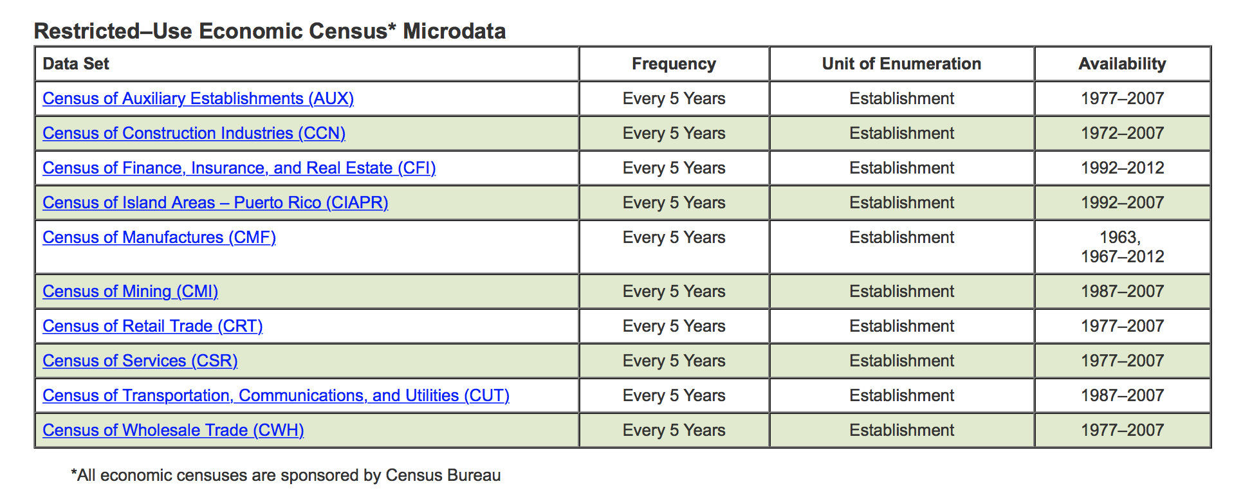
Archiving: California Census Research Data Center (CCRDC)

Slide 14
Archiving: CCRDC

Slide 15
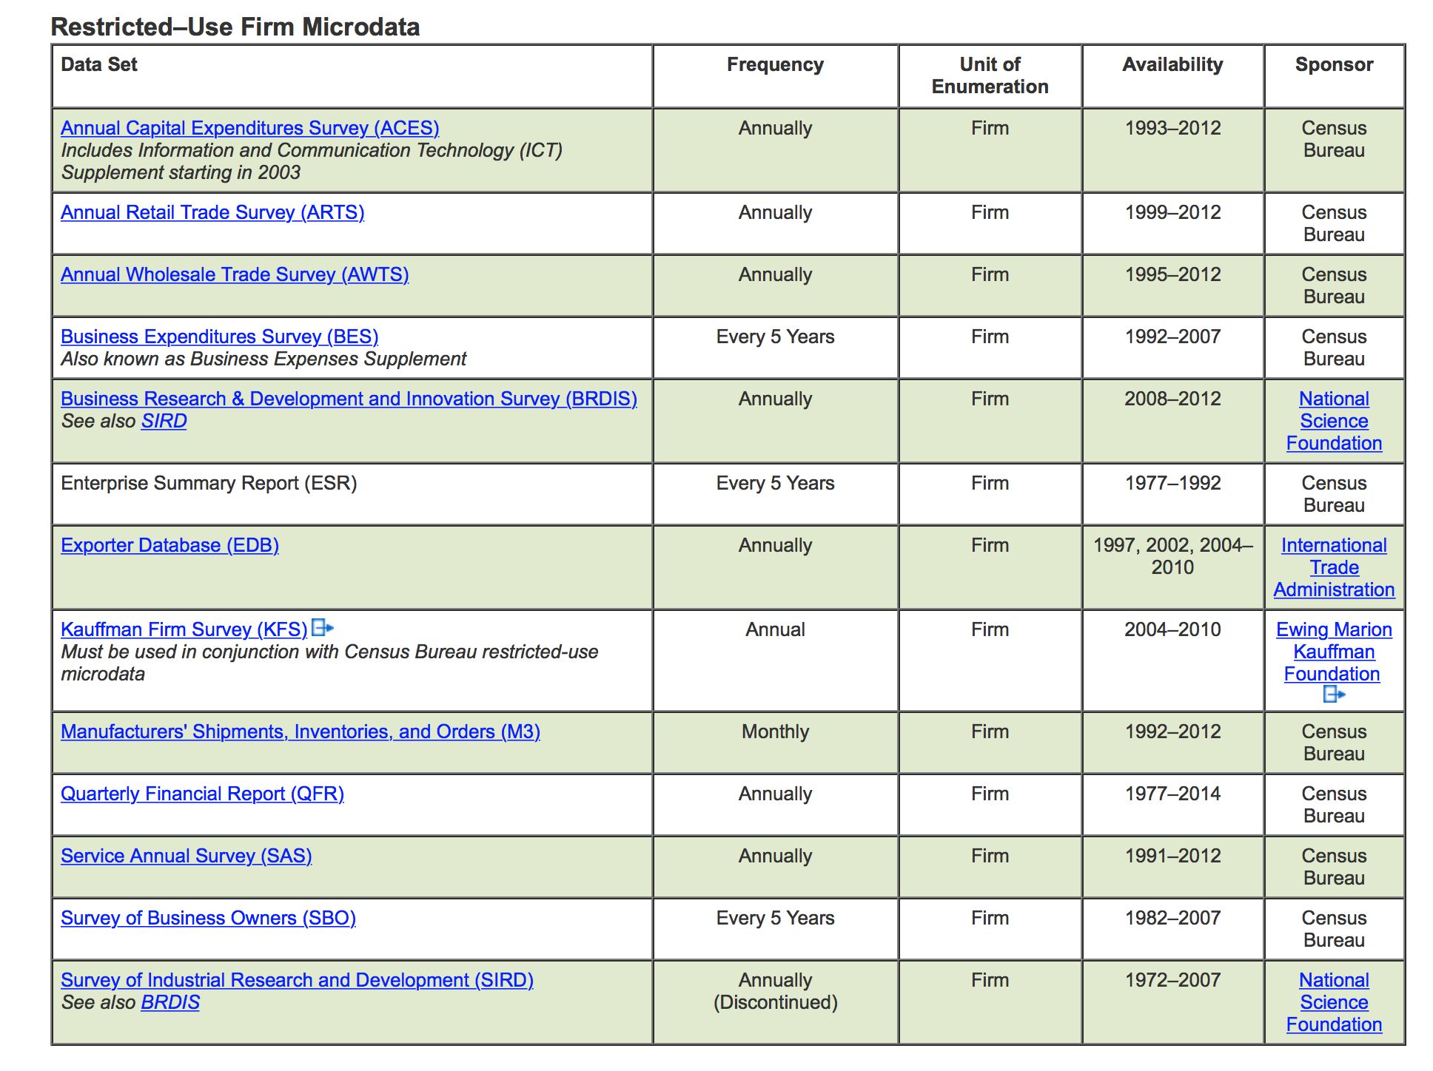
Archiving: CCRDC

Slide 16
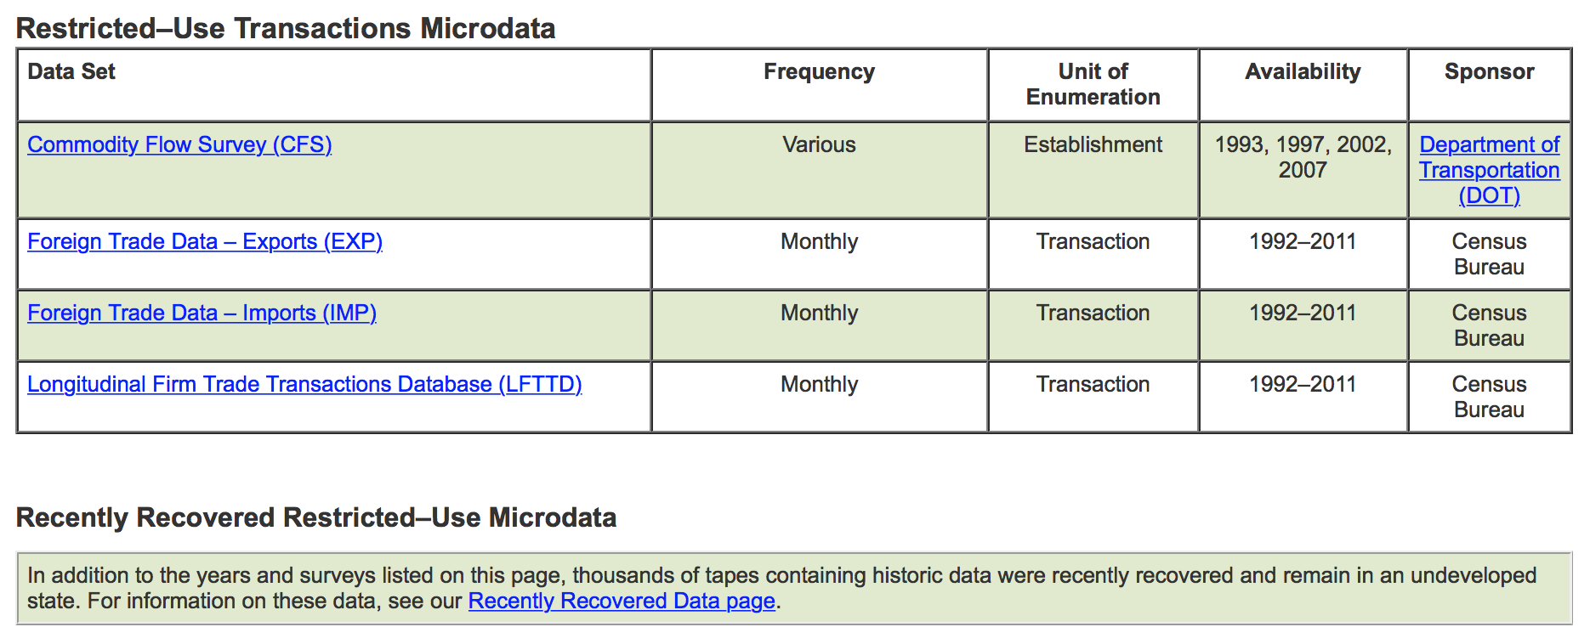
Archiving: CCRDC

Slide 17
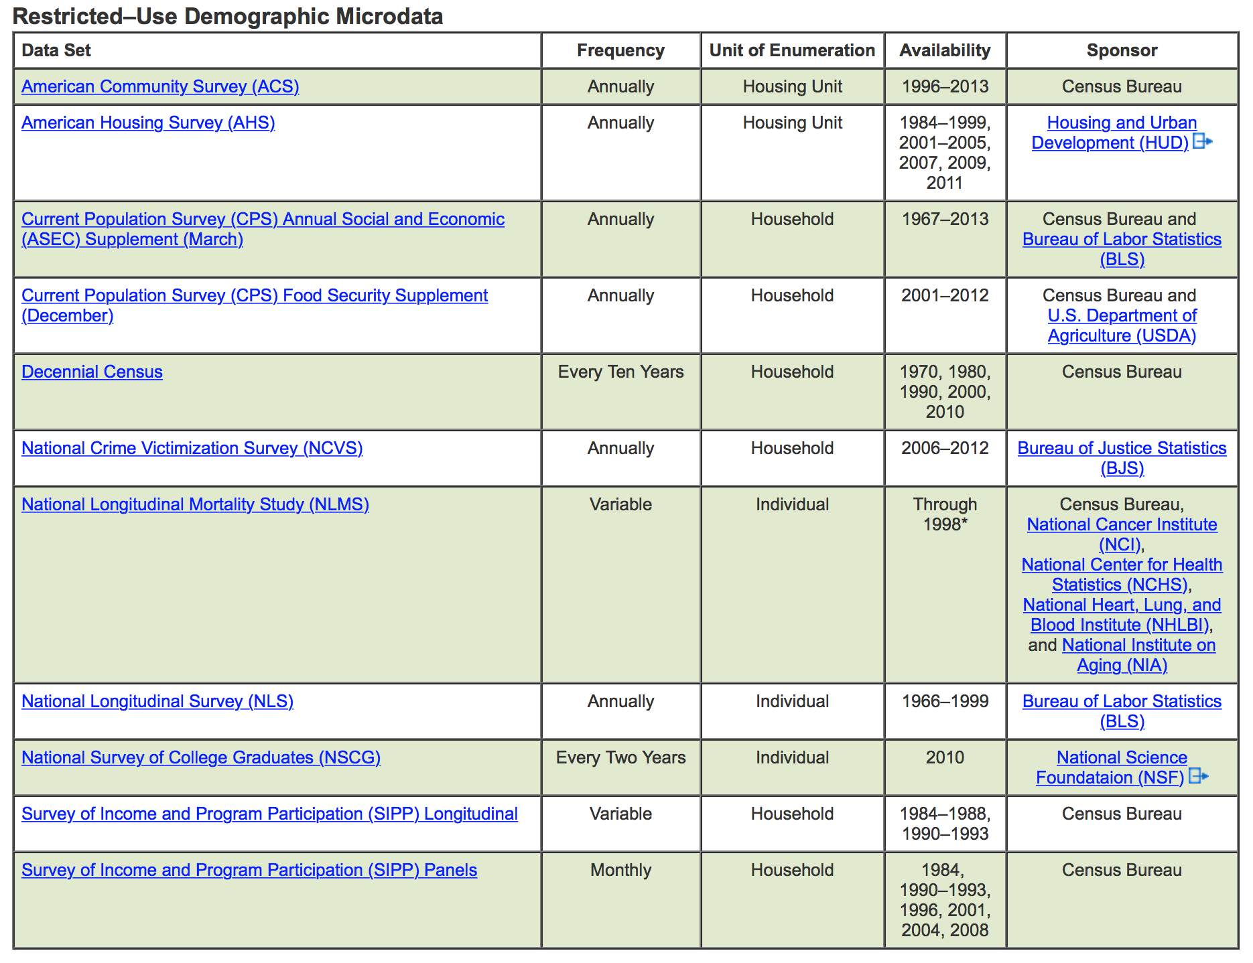
Archiving: CCRDC

Slide 18
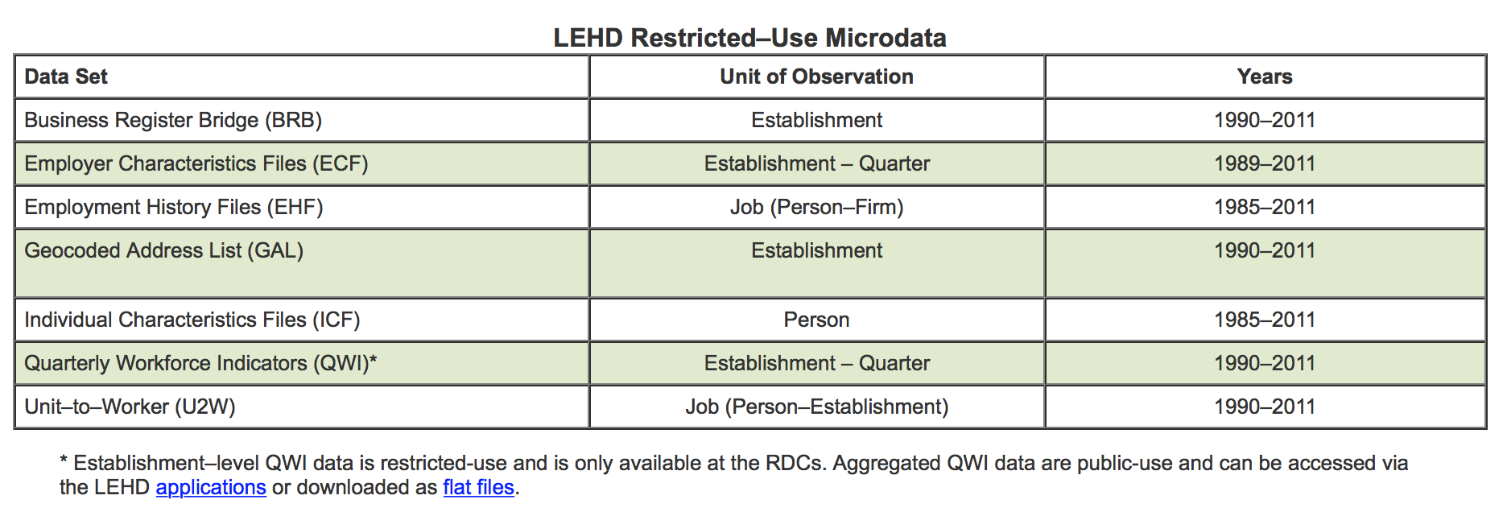
Archiving: CCRDC

Slide 19
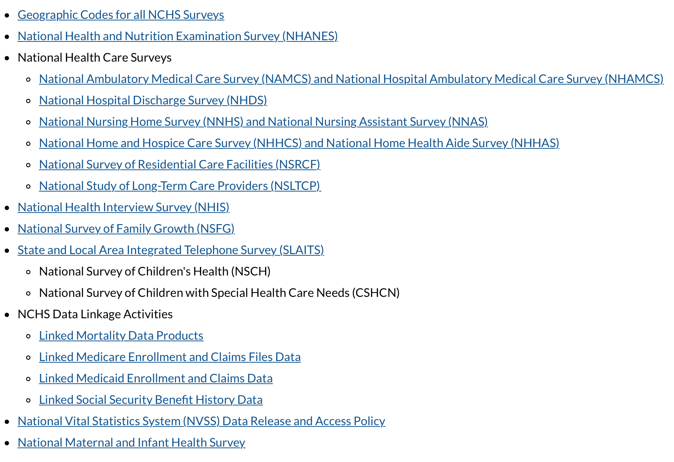
Archiving: Health Data @ CCRDC

Slide 20
D-Lab
Come hang out in the physical space
You’d be surprised what you can learn!

