Slide 1
Creating Public Interest or Public Sector Resumes
Alexander Lee, Associate Director for Public Interest & Public Sector Programs
Berkeley Law Career Development Office

Slide 2
Research the Employer
Understand their vision or mission
Understand how they accomplish their goals (programs & types of legal work), and
Understand what qualities & skills they are looking for in their interns & employees

Slide 3
Research the Employer
Read job description carefully & note desired skills & qualifications
Read organization’s website thoroughly
Consult other students
Student-to-Student Career Fair (Fall)
Student evaluations in b-Line
Attend employer receptions and externship fairs
Talk to CDO attorney-counselors

Slide 4
Revise Your Existing Resume
Use legal resume formatting
Samples on CDO website
1 page only
If you have extensive work history and are having trouble staying within 1 page, see a CDO counselor for help
Customize to the employer
Three general sections: Education, Experience, & Additional Info
Match your work with sought-after skills
Use employers’ language & framing (e.g. “oppressed communities” vs. “underserved,” “people of color” vs. “minorities”)

Slide 6
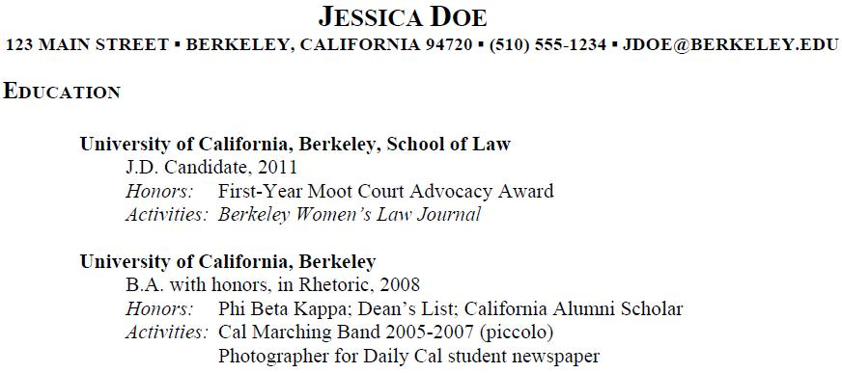
Education (1st Section)
Reverse chronological order of graduation
List honors & activities separately

Slide 7
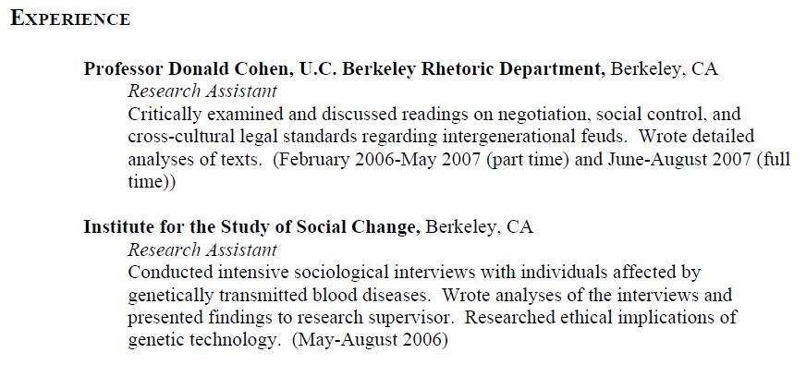
Experience
Reverse chronological order
Include substantial volunteer experience (at least 6 months)
Use paragraphs, not bullet points & focus on accomplishments & skills

Slide 8
Additional Information
Indicate language skills or other distinctions
Optional section

Slide 9
Other Considerations
Potentially controversial information on your resume
Avoid large gaps in work history
Don’t put anything in that you would not want to come up in an interview
If you indicate a high-level of ability in language(s) other than English, expect to be interviewed partially in that language(s)
Spell check, and then spell check again!

Slide 10
Resume Help From the CDO
Employer research
Resume editing & counseling
Alexander Lee
Associate Director for Public Interest & Public Sector Programs
283 Simon Hall
alee@law.berkeley.edu
(510) 643-4779
Linda Maranzana
Associate Director for Public Interest & Public Sector Programs
290 Simon Hall
lmaranzana@law.berkeley.edu
(510) 643-2675

