Slide 1

The Future of Intellectual Property Protection in China –
Copyrights and Patents
Mark Cohen
October 4, 2012
Berkeley, California

Slide 2
Contents
The problems are:
China Need to Foster Rights Consciousness
The System Only Protects Foreigners
China Must First Generate Its Own IP
Their Needs to Be a Political Culture for IP
China Needs Domestic Support for IP
The Problem is Really Too Much Bureaucracy?

Slide 3
Premise 1: “There remains a need to foster rights consciousness” (Alford, p. 117)
Most litigious society for IP in the world
Largest trademark (11 years), patent offices, others (e.g., Budapest Convention deposits)
High patent/TM rights per capita or high damages or innovative education does not necessarily mean high protection.
IP Litigation China v. US (2011/not adjusted for reporting years)
Apples to Apples?

Slide 4
High Proportion of Small Inventors Than the U.S.
U.S. Percent of Patents (2011)
U.S. CORPORATION 44.3%
U.S. GOVERNMENT 0.4
U.S. INDIVIDUAL 5
FOREIGN CORP. 48.3
FOREIGN GOVT 0.07
FOREIGN INDIVID. 1.9
(http://www.uspto.gov/go/taf/topo_06.htm#PartA1_2b)
China (2011)
INVENTION PATENTS -
  SERVICE INVENTIONS 82%
  NON-SERVICE INVENTIONS 18
DESIGN PATENTS
  SERVICE 50.6
  NON SERVICE 49.4
UTILITY MODELS
  SERVICE 66.8
  NON SERVICE 33.1
Average/Non Service: 33.4

Slide 5
Premise 2: “It is inconceivable that a system designed to protect [foreigners] and not [Chinese] could be sustained in China. “ (p. 119)
Foreign cases were 2.2% of the 2011 docket and declining
Foreign Cases

Slide 6
Premise 3: “Serious protection of IP must await..the development of Chinese generated IP” (p. 123)
Patent Applications - 2011
1 |  | Invention |  | Utility Model |  | Design |  | Total
 |  | Number | % | Number | % | Number | % | Number | %
Total | Sub-total | 526412 | 100.0% | 585527 | 100.0% | 521468 | 100.0% | 1633347 | 100.0%
 | Service | 432123 | 82.0% | 391408 | 66.8% | 263844 | 50.6% | 1087375 | 66.6%
 | Non-service | 94289 | 18.0% | 194124 | 33.1% | 257624 | 49.4% | 546037 | 33.4%
Domestic | Sub-total | 415829 | 100/78.9 | 581365 | 99.3% | 507538 | 97.3% | 1504732 | 92.1%
Foreign | Sub-total | 110533 | 100/20.9 | 4162 | 1% | 13930 | 2.7% | 128625 | 7.9%

Slide 7
SIPO Patent Filings Comparison 2006 & 2011 (%)

Slide 8
Premise 4:
“ [T]he most important factor in explaining the late appearance and relative insignificance of the idea of intellectual property in the Chinese world lies in what, for lack of a better term, we might describe as its political culture….”(p. 119)

Slide 9
Premise 5: Is Chinese Domestic Support Key?
“Until China perceives the value of intellectual property rights as intrinsic and important to its own economic well-being, enforcement of intellectual property will always be an uphill battle in China.” (Chow & Han, at 323)
….Or are there certain decisions already made?

Slide 10
Contra:
“The future competition in the world is in intellectual property.”
Wen Jiabao (Premier 2004)

Slide 11
Civil litigation – venue is key!

Slide 12
Venue –Average Duration of Case

Slide 13
Source: Chinese Institute of Publishing
Sciences, National Reading Survey (2008, 09).

Slide 16
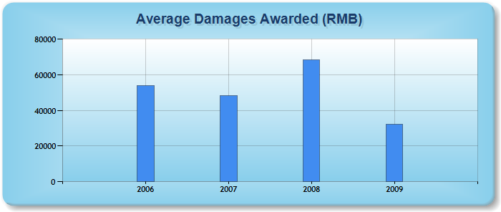
Litigation Outcomes: Designs
1,197 Infringement Cases, Injunction Ratio: 81.5%
(Source: www.ciela.cn, March 21, 2011)

Slide 17
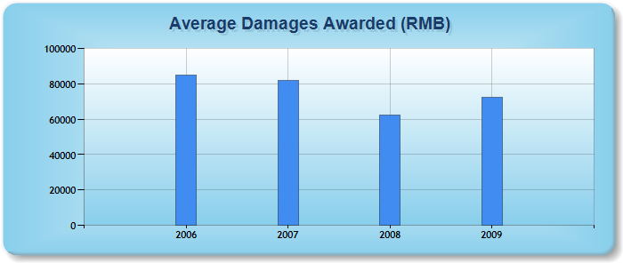
Litigation Outcomes: Utility Models
630 cases. Injunction Ratio: 73.75%
Source: www.ciela.cn (March 21, 2011)

Slide 18
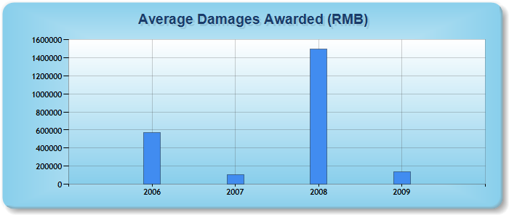
Litigation Outcomes: Invention Patents
383 cases, Injunction Ratio: 71.5%
Sources: www.ciela.cn (March 21, 2011)

Slide 19
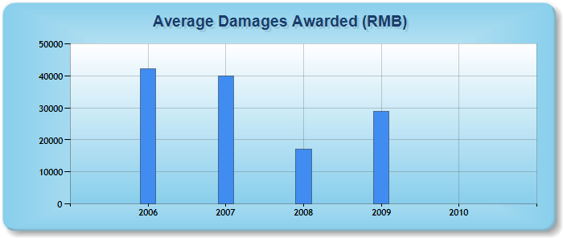
Copyright Comparison
Injunction Ratio: 79.5% (similar to designs)
Damages – Most Similar to Designs
5,203 cases. Source: www.ciela.cn

Slide 20
The Future: Huge Unrealized Potential Market
538 million Internet users: highest in the world – most on broadband
69.4% (356 million) using mobile phones to access the Web (March 2012, up from 60.8% in December 2009);
Phones now sold with apps to access infringing content on WAP sites
Music and other content have been principle “driver” of Internet growth – virtually all unauthorized.
Continuing market access restrictions
Continuing “relational” perspective to enforcement

Slide 21
6. Or is the Problem Excess Government Involvement?
“[T]hose shaping science policy and those working at the bench clearly recognize the problems with China's current research culture: It wastes resources, corrupts the spirit, and stymies innovation. The time for China to build a healthy research culture is now, riding the momentum of increasing funding and a growing strong will to break away from damaging conventions. A simple but important start would be to distribute all of the new funds based on merit, without regard to connections. Over time, this new culture could and should become the major pillar of a system that nurtures, rather than squanders, the innovative potential of China…”
Editorial, “China’s Research Culture”, Science (Sept. 3, 2010) (Yigong Shi and Yi Rao).

Slide 22

Does the Science Analogue Apply to Culture?
China’s localities shy away from novel-product innovation largely because of constraints stemming from central government control. First and foremost, since local officials know that economic growth is the key to political advancement, they pour their efforts and capital into short-term projects and proven technologies rather than long-term, uncertain primary research. China’s capricious policy environment, moreover, means that would-be entrepreneurs in high-technology industries also pursue low risks, short time horizons and quick returns – the exact opposite required for novel-product R&D.
Dan Breznitz and Michael Murphree, Run of the Red Queen.
“China’s art world does not exist” (Ai Weiwei) vs.

Slide 23

Too Much of a Political Culture in Some Instances?

Slide 24
China Invents by Season
Patent Cooperation Treaty Filings

Slide 25
Systemic Copyright Issues
Criminal Thresholds
Unclear Divisions Among Civil, Criminal, Admin Enforcement
“Inducement” liability – Does it Exist?
Under-resourced NCA
  Resources in content control/propaganda
End-User Piracy Infringement –
  Difficulties in pursuing SOE’s
Market Access limiting revenues for enforcement actions

Slide 26
Proposed Fourth Amendment to the Patent Law – What Does it Suggest for Copyright?
Proposed:
  Treble Damages
  Ex Officio Enforcement if Affects “Market Order”
  Administrative Private Compensation – IPR Enforcement as “Management”
  National Level Involvement in Enforcement
  Improvements in evidence production (civil and administrative)
  Weakening role of judiciary?

Slide 27
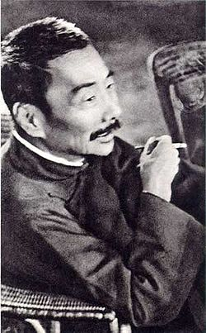
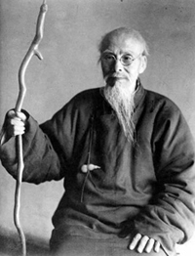
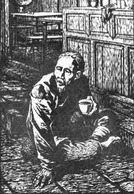
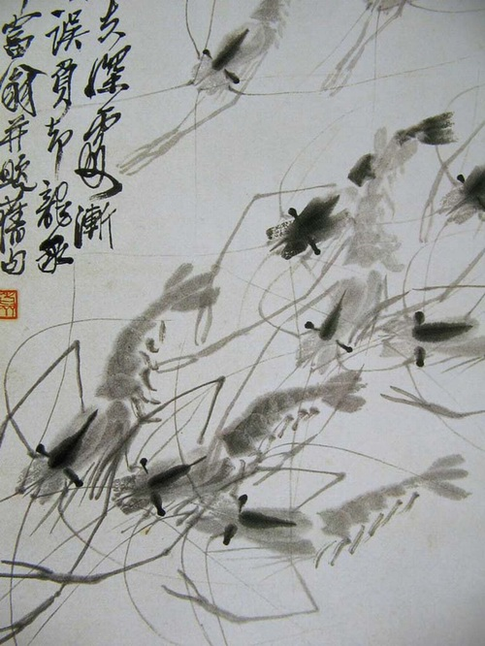
The correct historical approach?
“Study me and live,
imitate me and die”
“To take a book is not to steal a book” (or an elegant offense).
“Intellectual property is a modern concept for China and is inconsistent with many of its historical and social traditions” (Chow & Han, at 320)

Slide 28
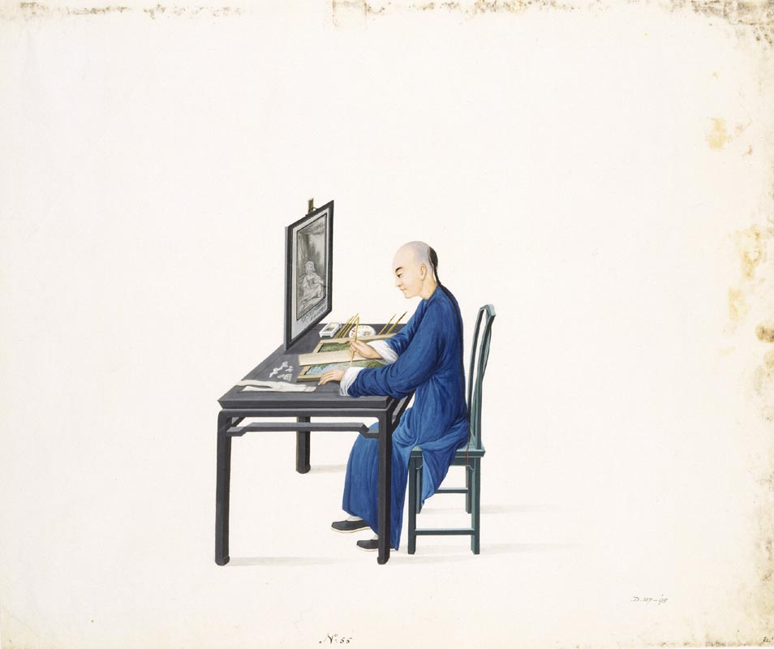

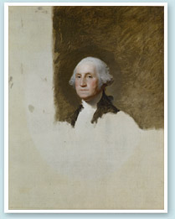
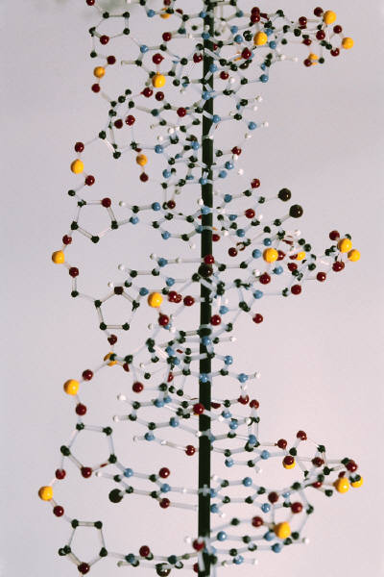
The Future?

